Slide 1
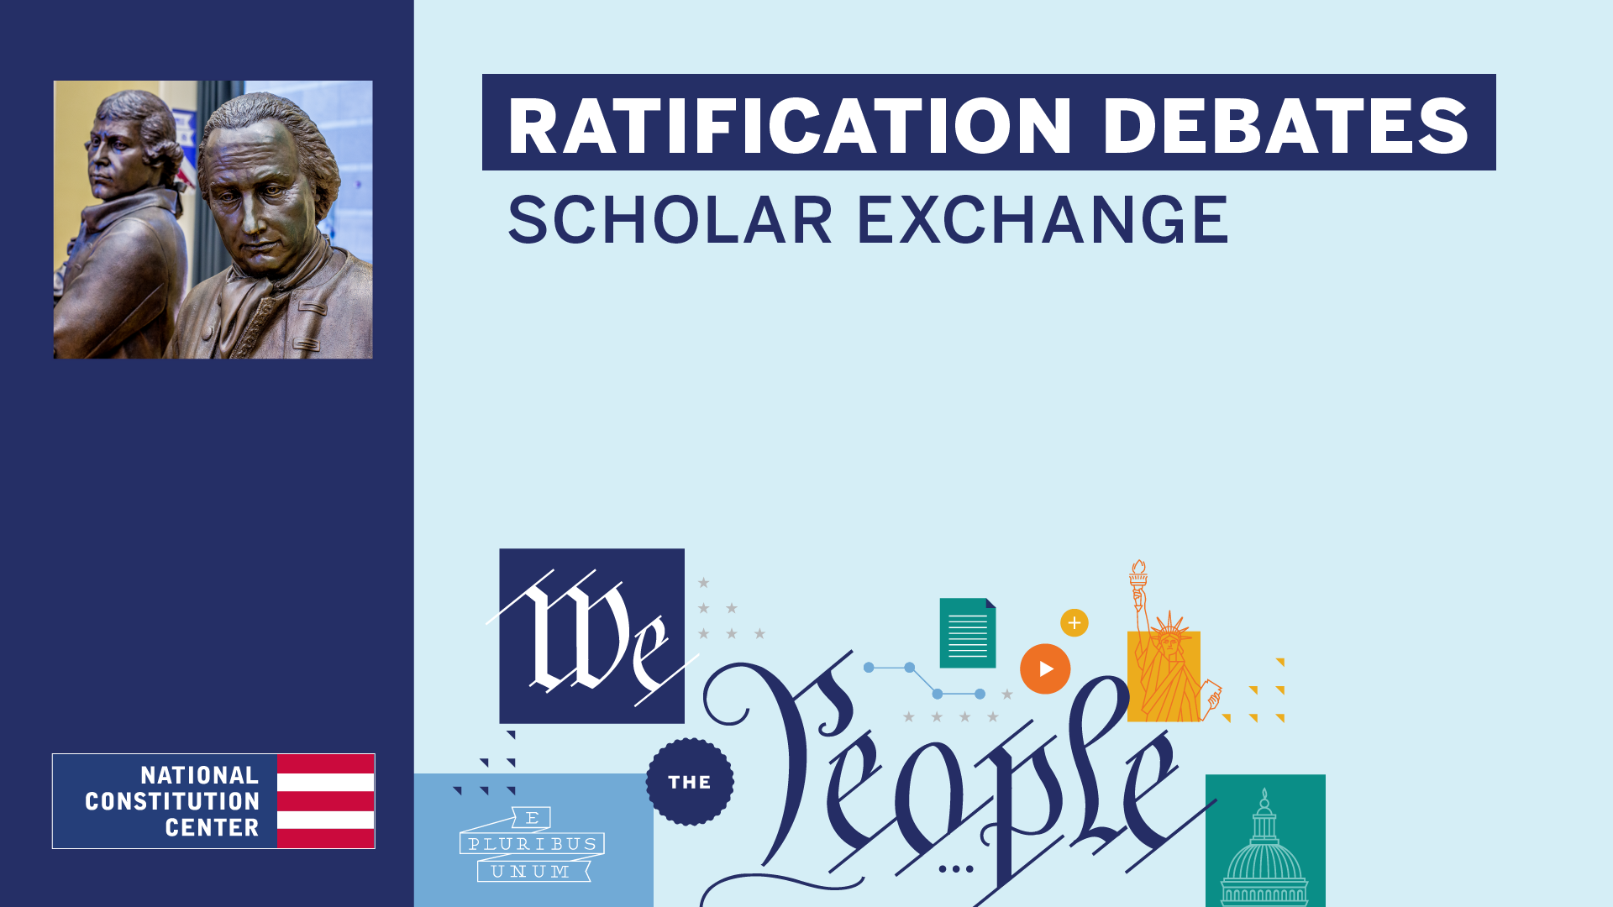
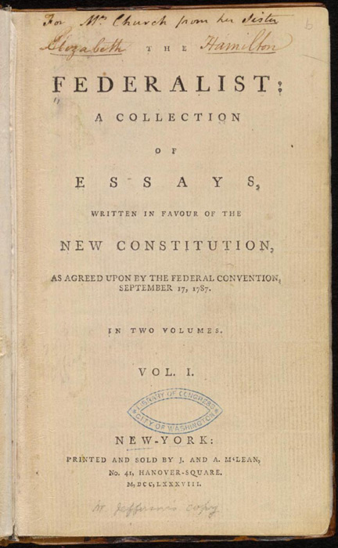
RATIFICATION AND
THE FEDERALIST PAPERS

Slide 2
FRAMING QUESTIONS
When was the Constitution completed and signed, and what was the process for deciding whether to adopt it?
What is ratification?
Who were the Federalists, and what were some of the key arguments in favor of the new Constitution?
Who were the Anti-Federalists, and what were some of the key arguments against the new Constitution?
What were The Federalist Papers, who wrote them, and what did they say?
How did the ratification process play out at the state level, and how did the supporters of the new Constitution win the battle?
What role did compromise play in the ratification of the U.S. Constitution?
What is the relationship between the ratification process and key constitutional principles like popular sovereignty and federalism?
RATIFICATION AND
THE FEDERALIST PAPERS

Slide 3
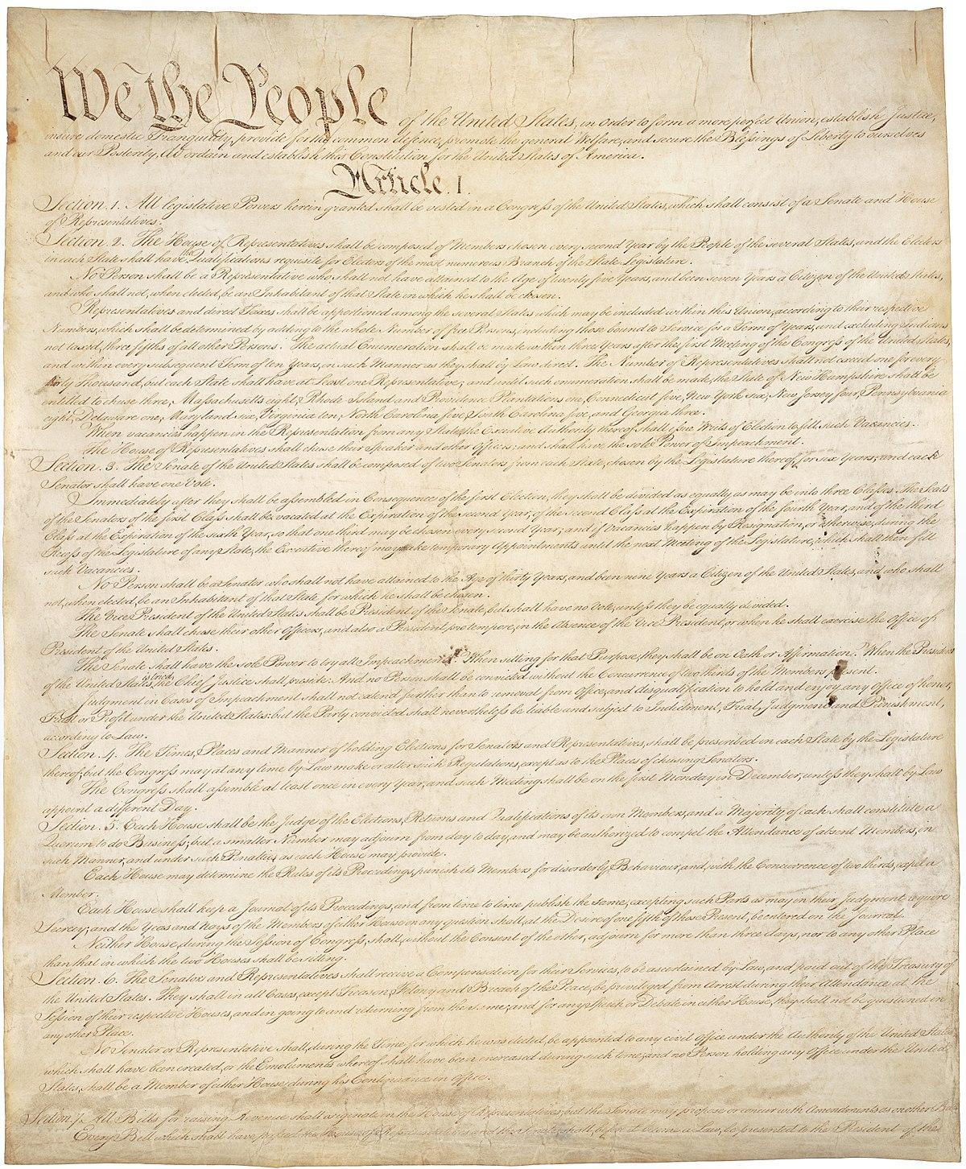
RATIFICATION AND
THE FEDERALIST PAPERS
THE CONSTITUTION
Signed September 17, 1787

Slide 4
RATIFICATION
The battle over whether to say “yes” or “no” to the new Constitution.
RATIFICATION AND
THE FEDERALIST PAPERS

Slide 5
BATTLE OVER RATIFICATION
Federalists: Supporters of the Constitution
Anti-Federalists: Opposed the Constitution
RATIFICATION AND
THE FEDERALIST PAPERS

Slide 6
WHO WERE THE
FEDERALISTS
Two of America’s most beloved figures: George Washington and Benjamin Franklin. And some of the nation’s most gifted political leaders (and thinkers), including James Madison, Alexander Hamilton, John Jay, John Dickinson, James Wilson, and Gouverneur Morris.
Overall, they tended to be better educated than the Anti-Federalists.
And they were more likely to be wealthy and to live in cities.
RATIFICATION AND
THE FEDERALIST PAPERS

Slide 7
THE FEDERALISTS’ PERSPECTIVE
Federalists generally wanted a stronger national government
In the Federalists’ view, America’s national government must have the sorts of powers that national governments—for instance, those in Europe—usually had: The power to raise an army, tax, regulate commerce and trade with other nations and between the American states, shape the nation’s foreign policy, and the power to declare war.
RATIFICATION AND
THE FEDERALIST PAPERS

Slide 8
THE FEDERALIST PAPERS
The Federalist Papers were a series of 85 essays printed in newspapers to persuade critics of the Constitution and those on the fence to support ratification.
RATIFICATION AND
THE FEDERALIST PAPERS

Slide 9
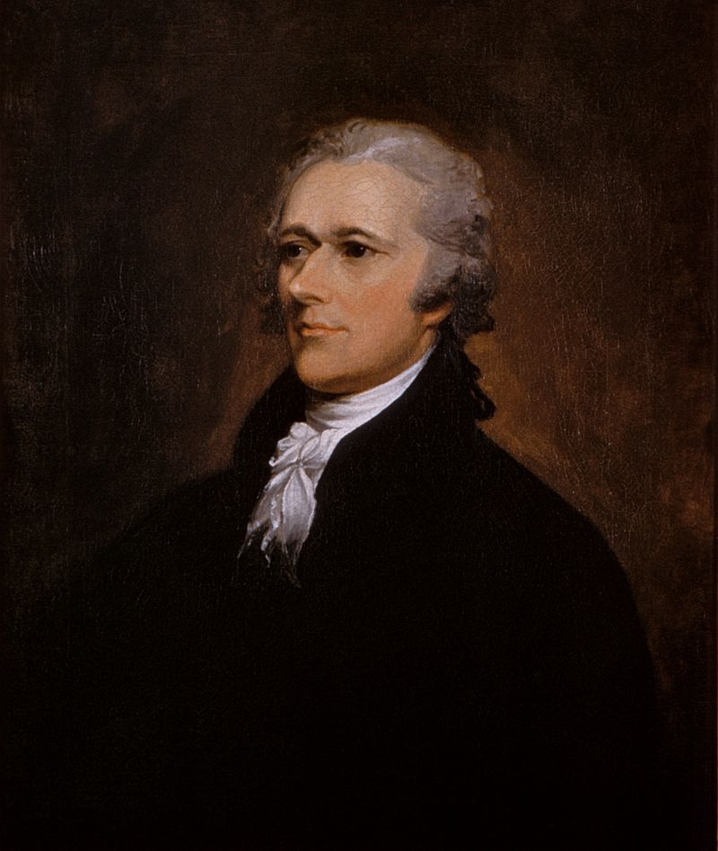
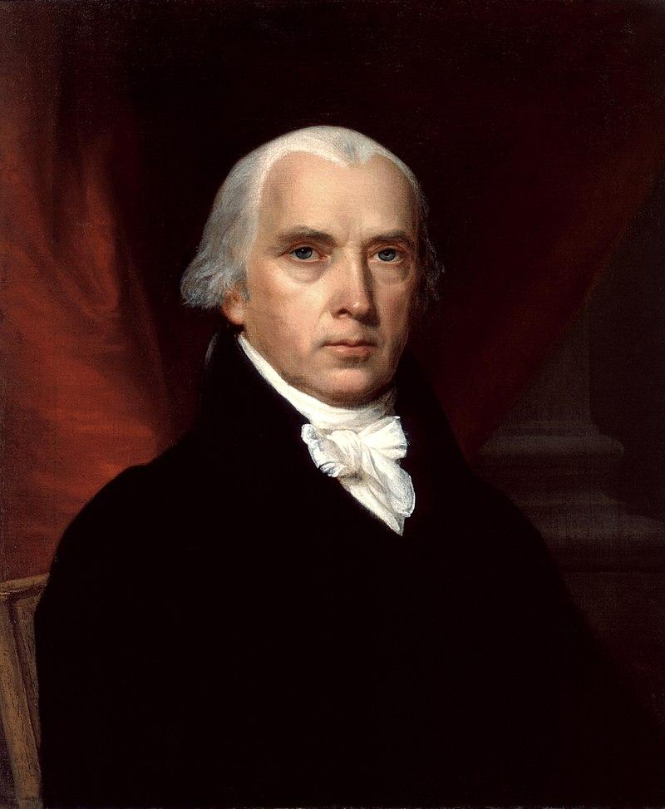
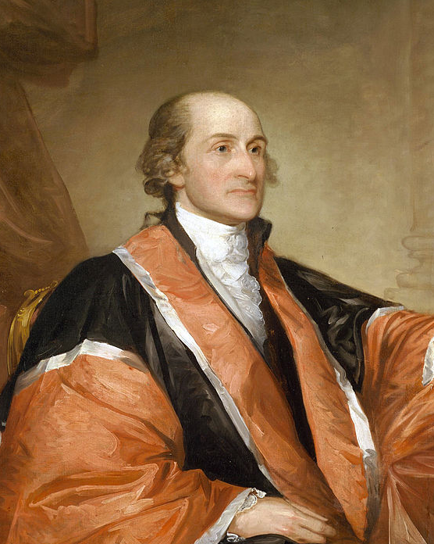
THE FEDERALIST PAPERS
RATIFICATION AND
THE FEDERALIST PAPERS
Alexander Hamilton
James Madison
John Jay
All three authors wrote under the same famous pen name—“Publius.”

Slide 10
WHO WERE THE
ANTI-FEDERALISTS
The Anti-Federalist camp included its own list of Founding-era heavyweights—including: Virginia’s George Mason, Patrick Henry, and Richard Henry Lee; Massachusetts’s Samuel Adams, Elbridge Gerry, and Mercy Otis Warren; and New York’s powerful Governor George Clinton.
Generally speaking, Anti-Federalists were more likely to be small farmers than lawyers or merchants.
In addition, Anti-Federalist support was stronger: out West rather than in the East, in rural areas rather than in the cities, and in large states rather than in small states
RATIFICATION AND
THE FEDERALIST PAPERS

Slide 11
THE ANTI-FEDERALISTS’ PERSPECTIVE
While the Federalists argued for a stronger national government, the Anti-Federalists defended a vision of America rooted in powerful states. The Anti-Federalists feared that the new Constitution gave the new national government too much power.
And that this new government—led by a new group of distant, out-of-touch political elites—would: seize all political power, swallow up the states—the governments that were closest to the people themselves, and abuse the rights of the American people.
RATIFICATION AND
THE FEDERALIST PAPERS

Slide 12
BIG IDEA
When the Constitution was signed by the Framers at the Constitutional Convention on September 17, 1787, it was a mere proposal. The Framers understood that the people themselves still had to accept this new Constitution. Acting through their state ratifying conventions, the American people had to decide whether to give the Constitution life—whether to say “yes” or “no.”
RATIFICATION AND
THE FEDERALIST PAPERS

Slide 13
RATIFICATION AND
THE FEDERALIST PAPERS
THE CONSTITUTION
Signed September 17, 1787

Slide 14
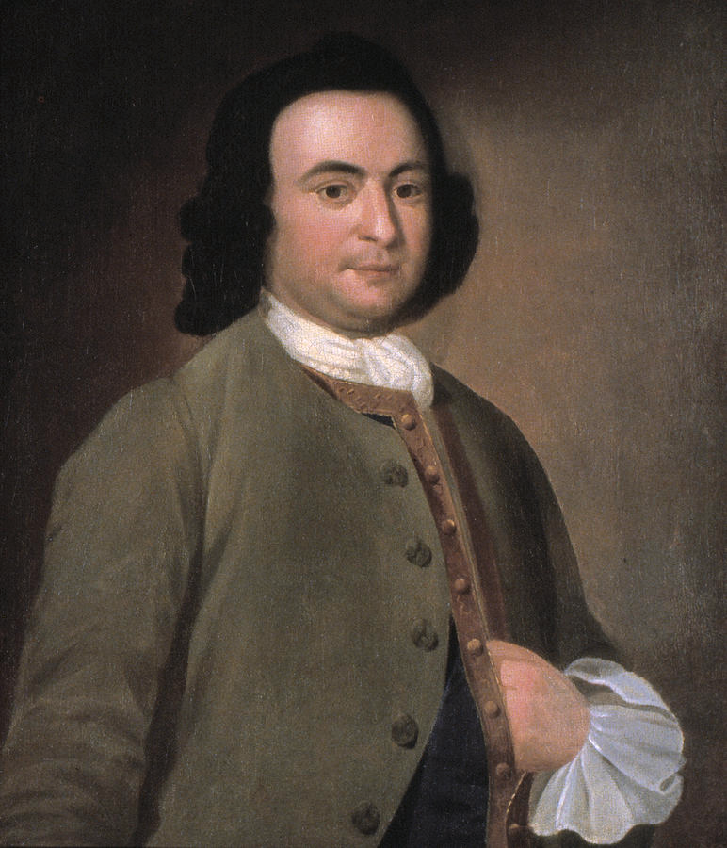
RATIFICATION AND
THE FEDERALIST PAPERS
George Mason

Slide 15
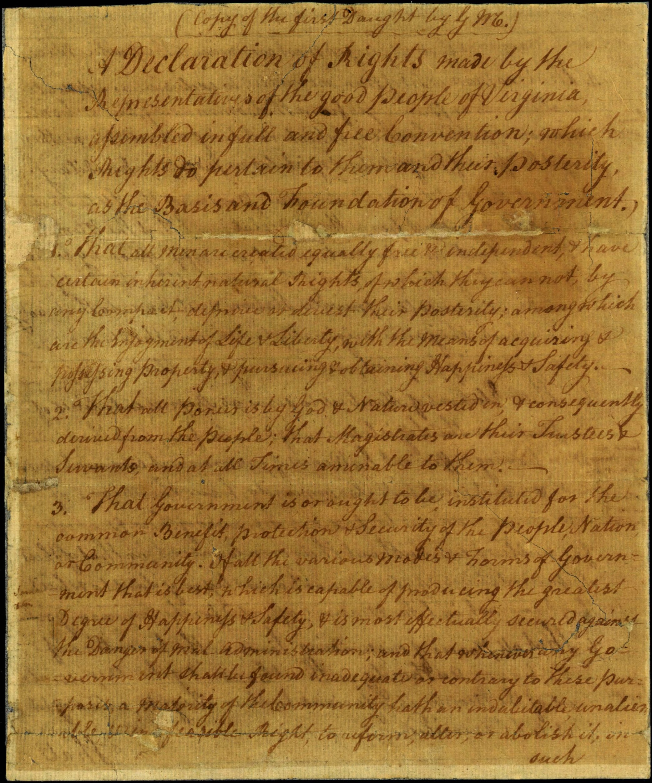
THE VIRGINIA DECLARATION OF RIGHTS
RATIFICATION AND
THE FEDERALIST PAPERS

Slide 16
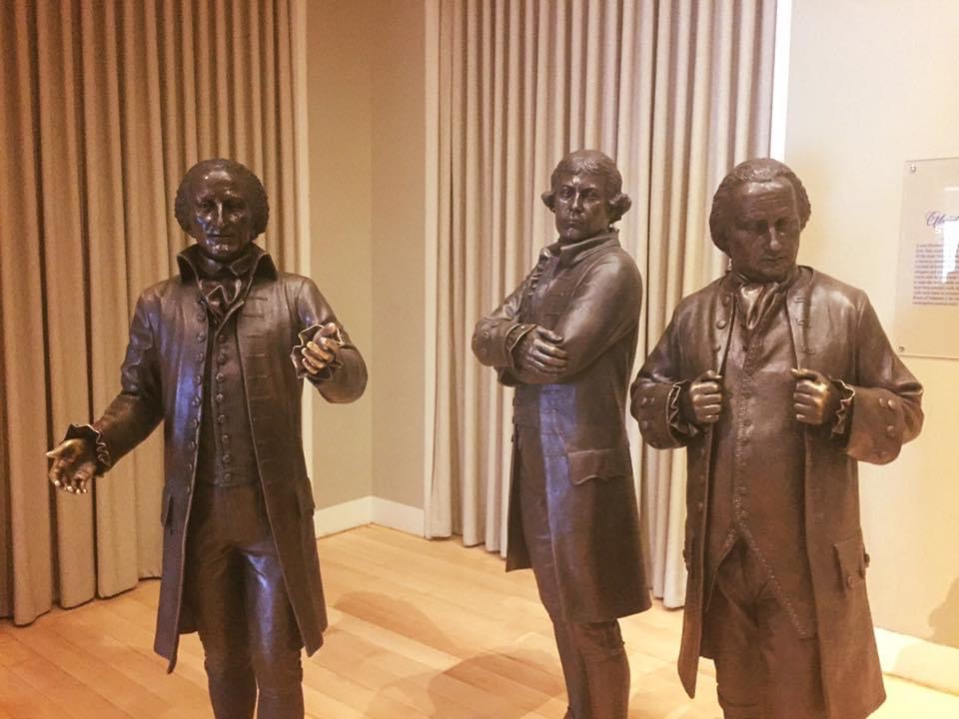
THE DISSENTERS
RATIFICATION AND
THE FEDERALIST PAPERS
Edmund Randolph
Elbridge Gerry
George Mason

Slide 17
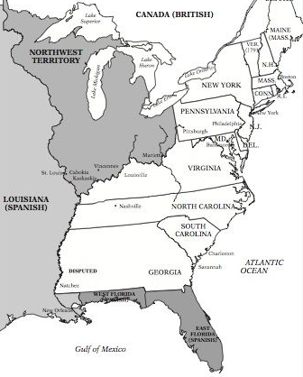
STATE CONVENTIONS
RATIFICATION AND
THE FEDERALIST PAPERS

Slide 18
EARLY RATIFICATIONS
The first state to ratify the Constitution was Delaware on December 7, 1787 (unanimous).
Pennsylvania: December 12, 1787 (46-23—which was a bitter fight)
New Jersey: December 18, 1787 (unanimous)
Georgia: January 2, 1788 (unanimous)
Connecticut: January 9, 1788 (128-40)
RATIFICATION AND
THE FEDERALIST PAPERS

Slide 19
MASSACHUSETTS COMPROMISE
Under this “Massachusetts Compromise,” a majority of delegates agreed to ratify the new Constitution, but only if the Convention agreed to recommend a set of amendments to the new Congress following ratification.
The Massachusetts Convention finally voted in favor of ratification on February 6, 1788.
This Massachusetts Compromise paved the way for the Constitution’s ratification—every remaining state convention—except for Maryland’s—recommended amendments as part of their decision to ratify.
RATIFICATION AND
THE FEDERALIST PAPERS

Slide 20
MORE RATIFICATIONS
Maryland: April 28, 1788 (63-11).
South Carolina: May 23, 1788 (149-73).
New Hampshire: June 21, 1788 (57-47).
Virginia: June 25, 1788 (89-79—in a close fight)
New York: July 26, 1788 (30-27—in another bitterly close fight).
The final two states—North Carolina and Rhode Island—wouldn’t ratify the Constitution until after the new government was already established.
RATIFICATION AND
THE FEDERALIST PAPERS

Slide 21
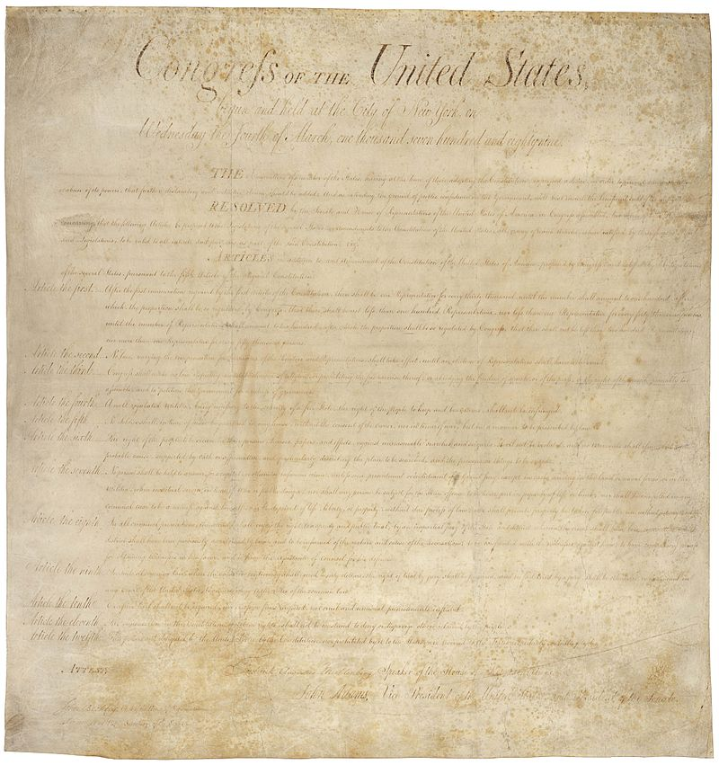
The Bill of Rights was approved by the First Congress and ratified December 15, 1791
RATIFICATION AND
THE FEDERALIST PAPERS
THE BILL OF RIGHTS

Slide 22
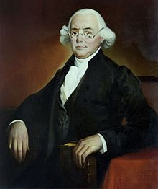
“You have heard of Sparta, of Athens, of Rome; you have heard of their admired constitutions. . . . But did they ever furnish . . . an exhibition similar to that which we now contemplate? Were their constitutions framed by those, who were appointed for that purpose by the people. After they were framed, were they submitted to the consideration of the people?”
RATIFICATION AND
THE FEDERALIST PAPERS
JAMES WILSON

Slide 23
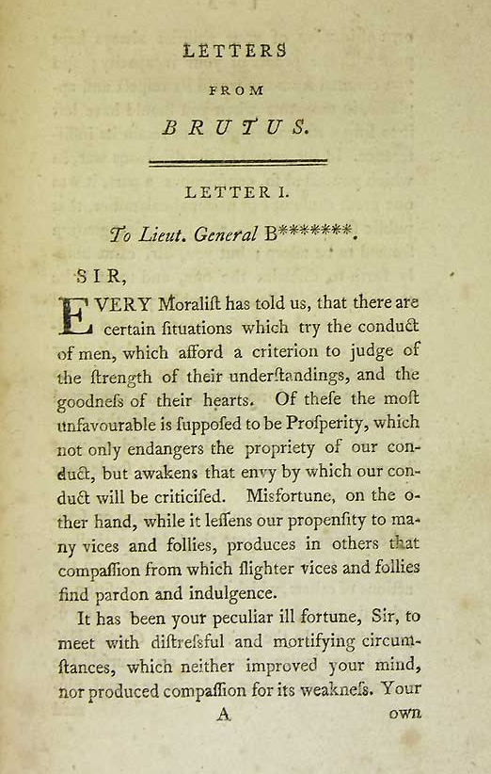
BRUTUS
For Brutus, the ratification debate came down to one key question: Do we want a system driven by powerful states or one organized around a single grand republic governed by a national legislature, a national executive, and a national court system?
Brutus—and his Anti-Federalist allies—sided with state and local governments over a powerful national government.
Brutus warned that the new Constitution would end with an all-powerful national government.
Finally, Brutus feared that a republican form of government—one rooted in elections and popular self-governance—couldn’t succeed in a large nation like America.
RATIFICATION AND
THE FEDERALIST PAPERS
Most scholars believe that these essays were written by New York Anti-Federalist Robert Yates.

Slide 24
THE FEDERALIST PAPERS
The Federalist Papers were a series of 85 essays printed in newspapers to persuade critics of the Constitution and those on the fence to support ratification.
RATIFICATION AND
THE FEDERALIST PAPERS

Slide 25
THE FEDERALIST PAPERS
RATIFICATION AND
THE FEDERALIST PAPERS
Alexander Hamilton
James Madison
John Jay
All three authors wrote under the same famous pen name—“Publius.”

Slide 26
THE FEDERALIST PAPERS
Federalist No. 10
“The Utility of the Union as a Safeguard Against Domestic Faction and Insurrection”
Written by James Madison
Published on November 22, 1787
RATIFICATION AND
THE FEDERALIST PAPERS
James Madison

Slide 27
THE FEDERALIST PAPERS
Federalist No. 10
“Among the numerous advantages promised by a well-constructed Union, none deserves to be more accurately developed than its tendency to break and control the violence of faction.”
RATIFICATION AND
THE FEDERALIST PAPERS
James Madison

Slide 28
THE FEDERALIST PAPERS
Federalist No. 10
“By a faction, I understand a number of citizens, whether amounting to a majority or a minority of the whole, who are united and actuated by some common impulse or passion, or of interest, adverse to the rights of other citizens, or to the permanent and aggregate interests of the community.”
RATIFICATION AND
THE FEDERALIST PAPERS
James Madison

Slide 29
THE FEDERALIST PAPERS
Federalist No. 10
“Extend the sphere, and you take in a greater variety of parties and interests; you make it less probable that a majority of the whole will have a common motive to invade the rights of other citizens; or if such a common motive exists, it will be more difficult for all who feel it to discover their own strength, and to act in unison with each other.”
RATIFICATION AND
THE FEDERALIST PAPERS
James Madison

Slide 30
THE FEDERALIST PAPERS
Federalist No. 51
“The Structure of the Government Must Furnish the Proper Checks and Balances Between the Different Departments”
Written by James Madison
Published on February 8, 1788
RATIFICATION AND
THE FEDERALIST PAPERS
James Madison

Slide 31
THE FEDERALIST PAPERS
Federalist No. 51
Madison explained how the Constitution’s structure checked the powers of the elected branches and protected against possible abuses by political elites.
For Madison, the solution was a combination of both separation of powers and checks and balance.
RATIFICATION AND
THE FEDERALIST PAPERS
James Madison

Slide 32
THE FEDERALIST PAPERS
Federalist No. 51
“Ambition must be made to counteract ambition. The interest of the man must be connected with the constitutional rights of the place. It may be a reflection on human nature, that such devices should be necessary to control the abuses of government. But what is government itself, but the greatest of all reflections on human nature?”
RATIFICATION AND
THE FEDERALIST PAPERS
James Madison

Slide 33
THE FEDERALIST PAPERS
Federalist No. 51
“If men were angels, no government would be necessary. If angels were to govern men, neither external nor internal controls on government would be necessary.”
RATIFICATION AND
THE FEDERALIST PAPERS
James Madison

Slide 34
THE FEDERALIST PAPERS
In The Federalist Papers, Madison, Hamilton, and Jay envisioned a constitutional system driven by reasoned debate and principled compromise.
RATIFICATION AND
THE FEDERALIST PAPERS

