Slide 1
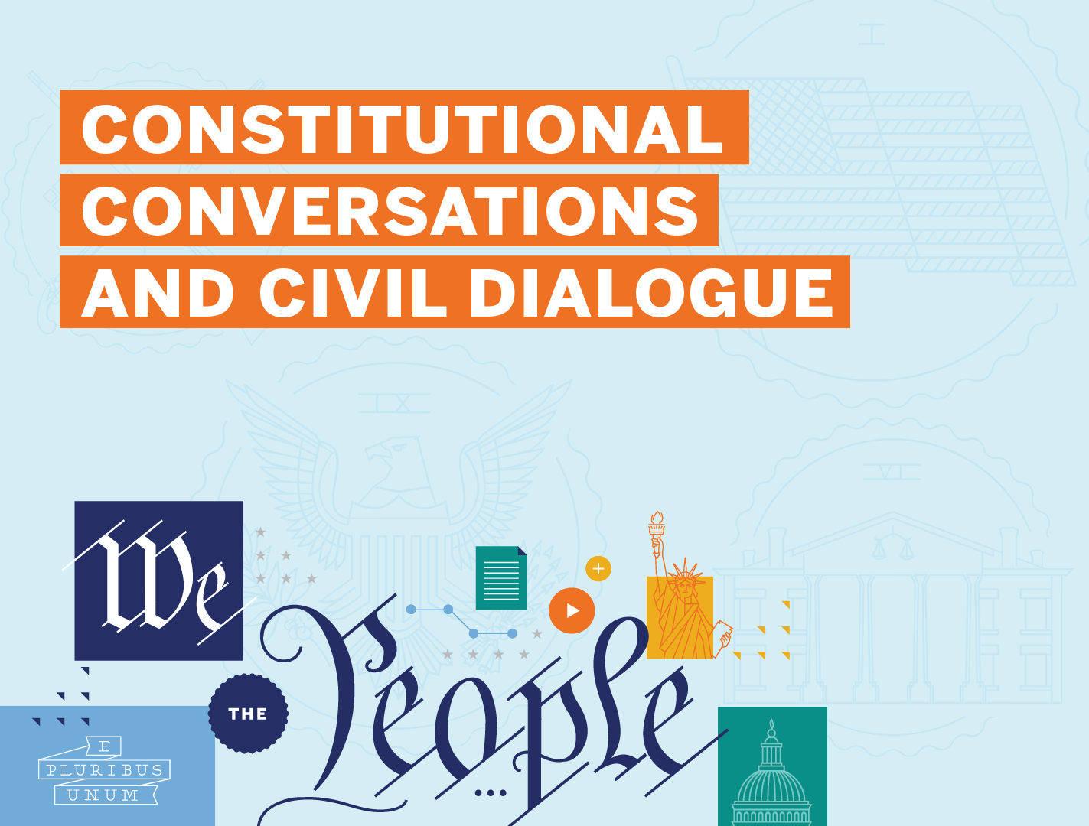
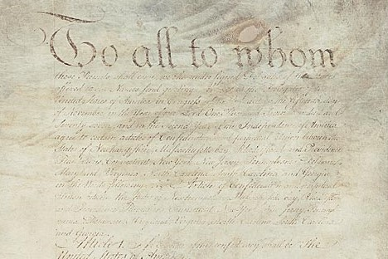

Principles of the American Constitution:
1776-1787
Scholar Exchange:
Principles of the American Constitution: 1776-1787

Slide 2
FRAMING QUESTIONS
Principles of the American Constitution:
1776-1787
Why did the Founding generation decide to write a new Constitution?
What was the Articles of Confederation, and what sort of national government did it establish?
What did the Founding generation learn from the state constitutions that the American people wrote before the U.S. Constitution?
What was Shays’ Rebellion, and how did it influence the Founding generation?
What key principles underlie the U.S. Constitution, and what sort of system of government did the Founding generation establish?

Slide 3
BIG IDEA
Principles of the American Constitution:
1776-1787
The Founders were children of the Enlightenment. When crafting a new Constitution, they learned from history and from their own experiences. Between the Declaration of Independence and the U.S. Constitution, the American people were governed at the national level by the Articles of Confederation and at the state level by state constitutions. With the U.S. Constitution, the Founding generation established a new national government. This new government was more powerful than the national government established by the Articles of Confederation, but also one of limited powers.

Slide 4
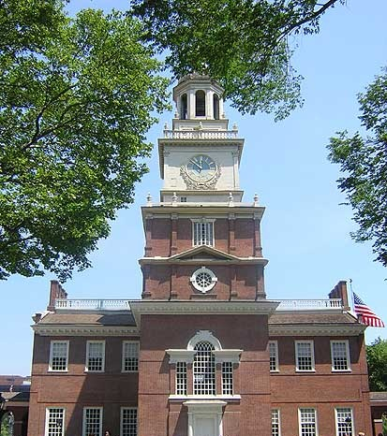
Principles of the American Constitution:
1776-1787
ROAD TO THE CONSTITUTIONAL CONVENTION
How did we get from the Declaration of Independence (and the American Revolution) to the U.S. Constitution?
What changed? What remained the same?
And how did this experience—and the debates of the period—shape the push to create a new national government in just a little over a decade?
Pennsylvania State House

Slide 5
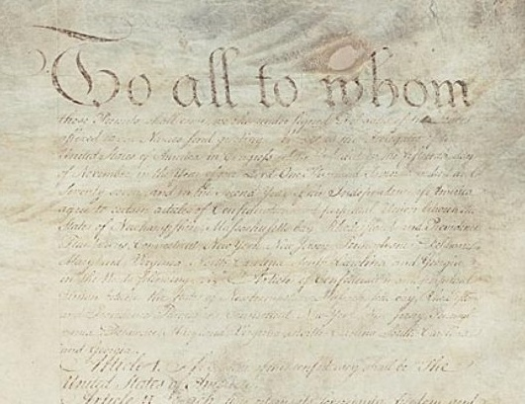
Principles of the American Constitution:
1776-1787
THE ARTICLES OF CONFEDERATION
“… league of friendship …”

Slide 6
Principles of the American Constitution:
1776-1787
THE ARTICLES OF CONFEDERATION
About the Articles:
The Articles created a national government centered on the legislative branch, which was comprised of a single house.
There was no separate House and Senate.
There was no separate executive branch or judicial branch.
And the delegates voted by state—with each state receiving one vote, regardless of its size.

Slide 7
Principles of the American Constitution:
1776-1787
THE ARTICLES OF CONFEDERATION
The powers of the national government were limited:
The national government didn’t have the power to tax or to regulate commerce between the states. It couldn’t force states to provide troops or send the government money.
Any proposed amendment to the Articles required unanimous approval from all thirteen states.
Congress couldn’t exercise the powers that it did have without support from nine of the thirteen states.

Slide 8
Principles of the American Constitution:
1776-1787
THE ARTICLES OF CONFEDERATION
These limits created several problems:
Without the power to tax, Congress struggled to fund that government and to pay its soldiers. It depended on voluntary contributions from state governments and many states refused to pay their share.
The national government struggled to defend the frontier.
Many states raised trade barriers against one another—imposing taxes on one another’s goods, spurring unhealthy competition between the states, and harming the new nation’s economy.

Slide 9
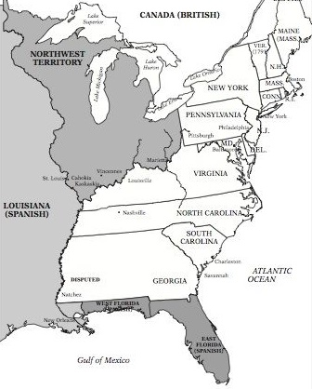
Principles of the American Constitution:
1776-1787
13 STATE GOVERNMENTS
In 1776 the American colonies set up state constitutions. This was a constitutional revolution in itself—a decisive turn towards written constitutions.
In the years between the Declaration of Independence in 1776 and the new Constitution in 1789, the United States was governed primarily by thirteen separate governments.

Slide 10
Principles of the American Constitution:
1776-1787
THEORY OF MIXED GOVERNMENT
This is the traditional idea that constitutions should model themselves after the British Constitution and include traces of three key sources of political power:
The One (Monarchy)
The Few (Aristocracy)
The Many (Democracy)

Slide 11
Principles of the American Constitution:
1776-1787
MIXED GOVERNMENT IN
STATE CONSTITUTIONS
The one was traditionally embodied by an executive:
Usually called a “Governor.”
And the few and the many were usually represented in the two houses of the state legislature:
The few in the upper house—often called a senate.
The many in a lower house—often called an assembly

Slide 12
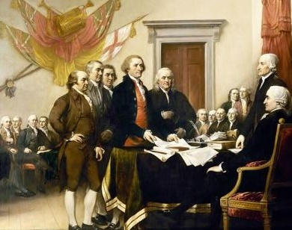
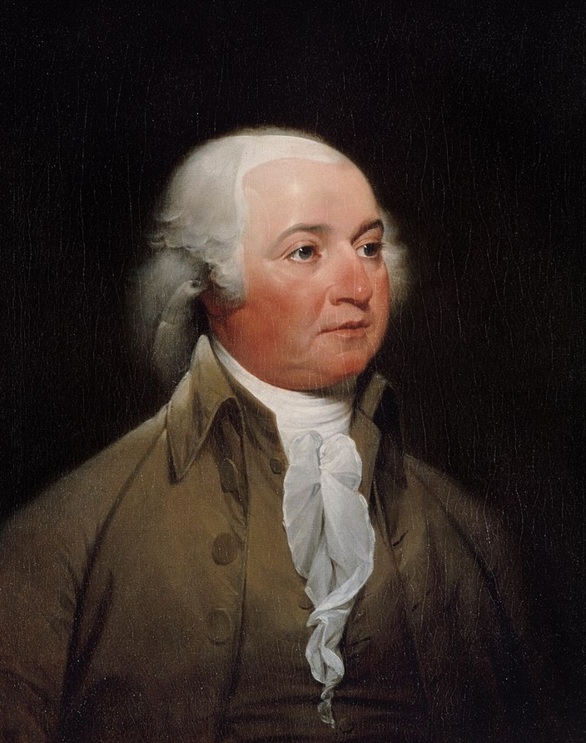
PRINCIPLES OF THE AMERICAN REVOLUTION
THOUGHTS ON GOVERNMENT
How might constitution-makers write a constitution that strikes the right balance between the one, the few, and the many?
John Adams
Notes:
https://www.britannica.com/biography/James-Otis

Slide 13
PRINCIPLES OF THE AMERICAN REVOLUTION
THOUGHTS ON GOVERNMENT
Adams argued that a constitution must create a mediating institution—one that might negotiate conflicts between the two most extreme branches: the lower house and the executive.
The key mediating institution should be the upper house—embodying the aristocratic element.
This “Senatorial part” would bring with it wisdom, civic republican virtue, and devotion to the common good.
Notes:
https://www.britannica.com/biography/James-Otis

Slide 14
PRINCIPLES OF THE AMERICAN REVOLUTION
THOUGHTS ON GOVERNMENT
Body of people “no doubt possessed common sense, honesty, and virtue,” few of them “much read in the history, laws or politics . . . from whose rises, revolutions and declensions the great landmarks of legislation and government are taken.”
John Adams
Notes:
https://www.britannica.com/biography/James-Otis

Slide 15
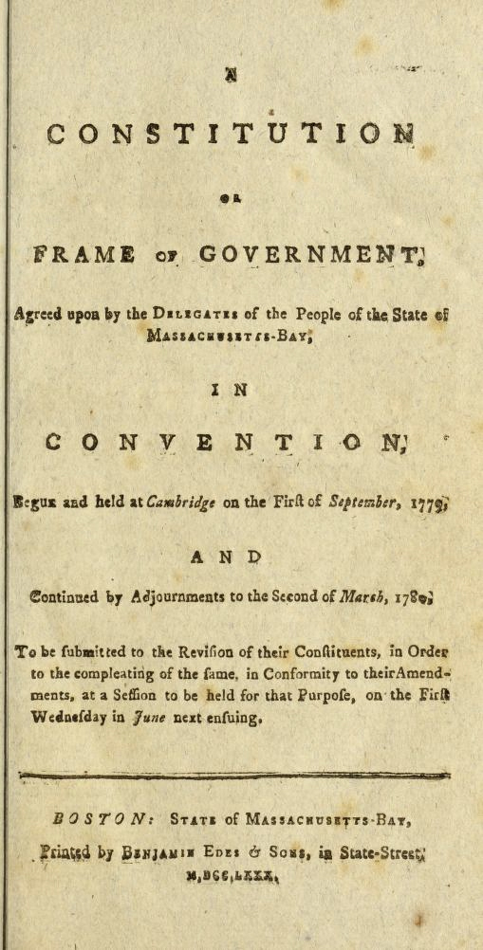
PRINCIPLES OF THE AMERICAN REVOLUTION
MASSACHUSETTS CONSTITUTION
In the Massachusetts Constitution, we see important constitutional principles like separation of powers (dividing the powers of government between three co-equal branches of government) and checks and balance (providing each branch of government with the powers to check the other branches).
Notes:
https://www.britannica.com/biography/James-Otis

Slide 16
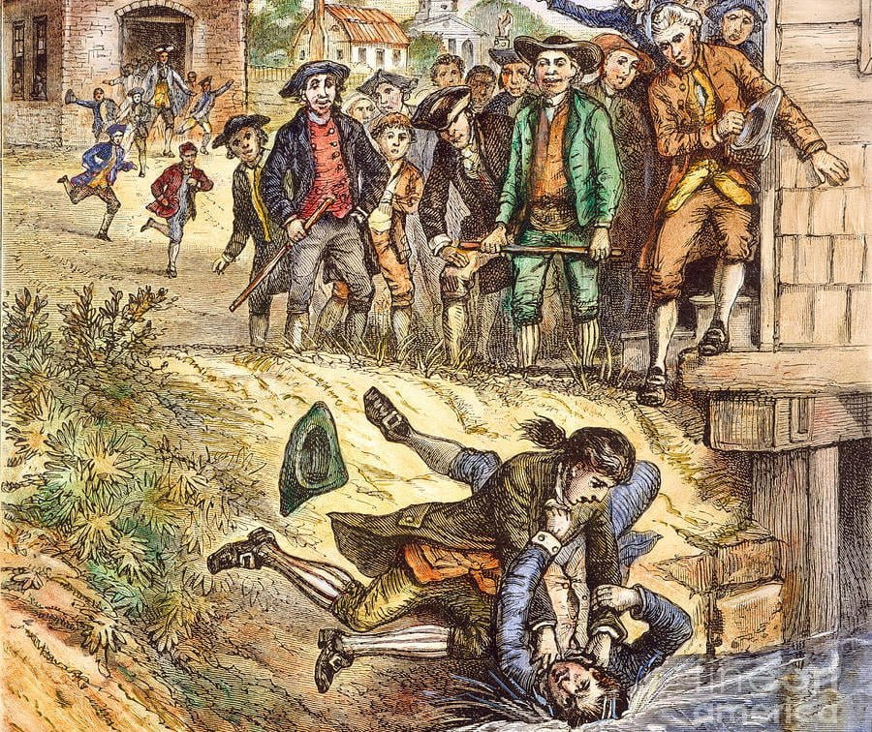
SHAYS’ REBELLION
Principles of the American Constitution:
1776-1787

Slide 17
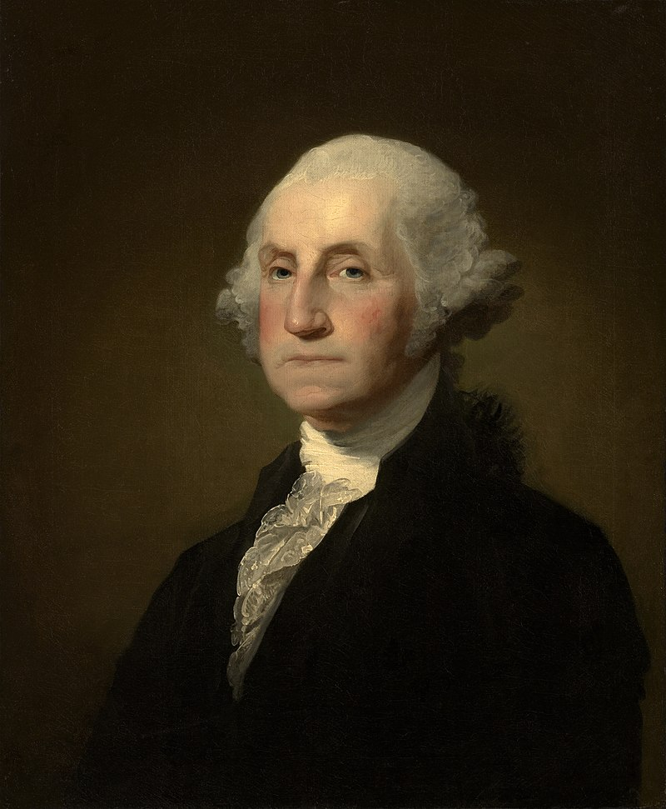
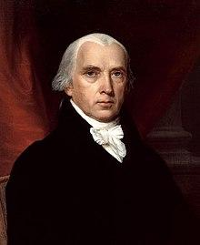
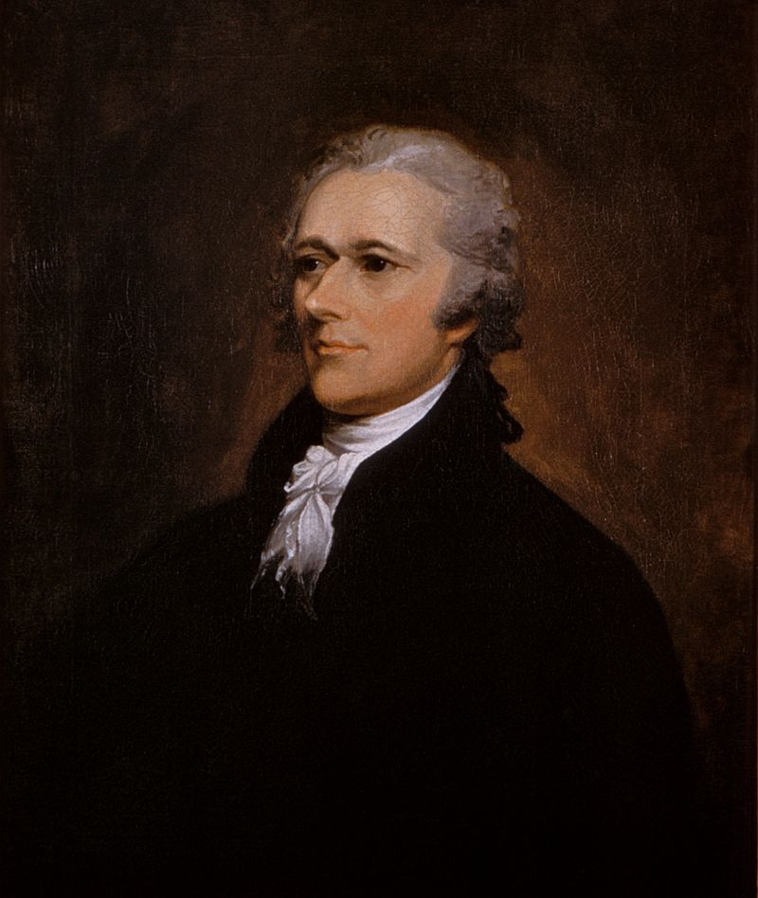
Principles of the American Constitution:
1776-1787
LEADERS CALL FOR A CONVENTION
George Washington
James Madison
Alexander Hamilton

Slide 18
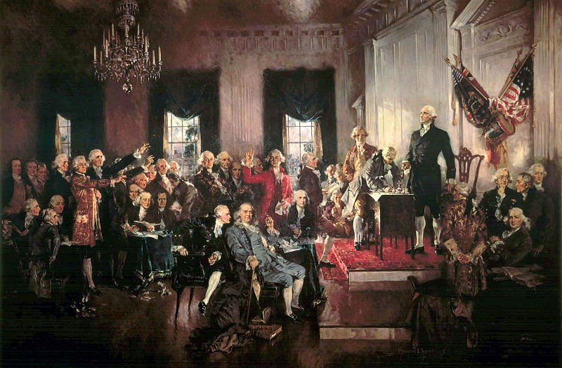
THE CONSTITUTIONAL CONVENTION
Principles of the American Constitution:
1776-1787
“.. sole and express purpose of revising the Articles …”

Slide 19
KEY PRINCIPLES UNDERLYING THE
U.S. CONSTITUTION
Principles of the American Constitution:
1776-1787
Popular Sovereignty
Federalism
Separation of Powers
Checks and Balances
Republicanism

Slide 20
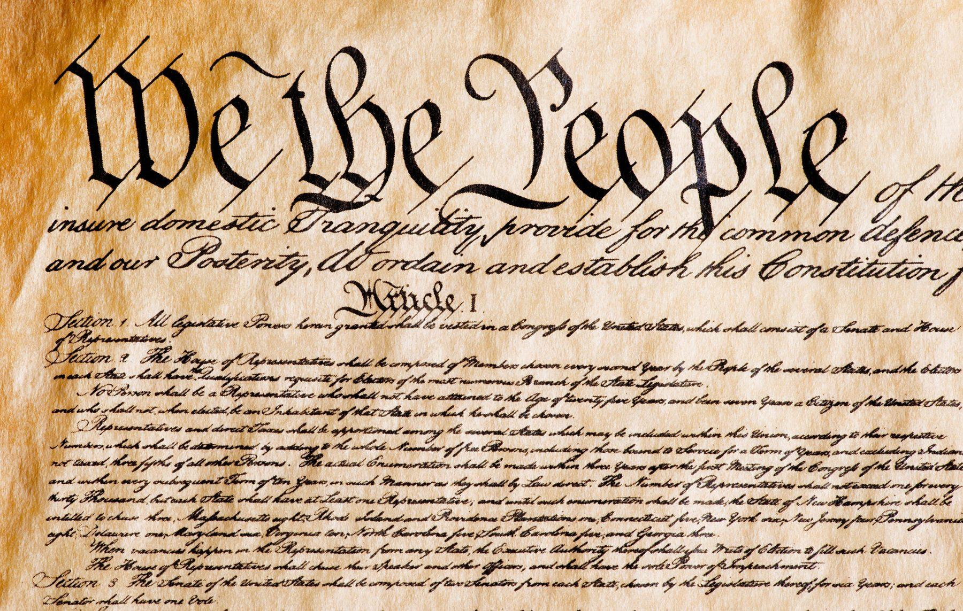
POPULAR SOVEREIGNTY
Principles of the American Constitution:
1776-1787

Slide 21
POPULAR SOVEREIGNTY
Principles of the American Constitution:
1776-1787
This is a just a fancy way of saying that the U.S. Constitution establishes a government that’s driven by us—not a monarch, not the elites, not an aristocracy—but by us, the American people.

Slide 22
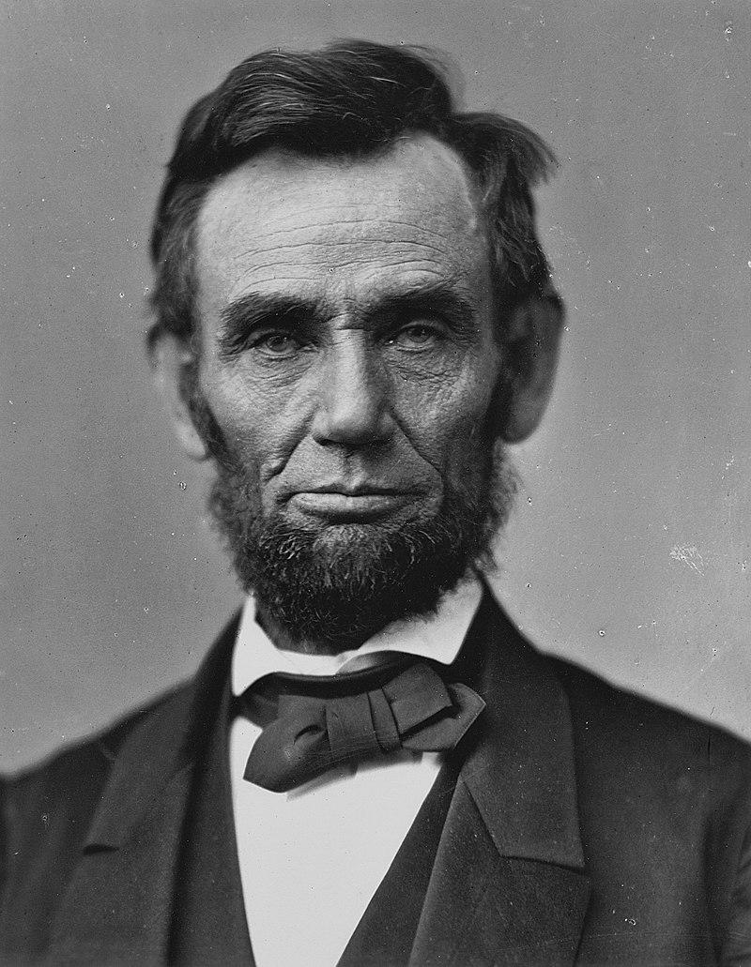
Principles of the American Constitution:
1776-1787
“government of the people, by the people, for the people.”
Abraham Lincoln

Slide 23
SOCIAL CONTRACT THEORY
Principles of the American Constitution:
1776-1787
All legitimate governments are based upon the consent of the people. Governments had the responsibility to protect individual natural rights in return for the obligations of responsible citizenship.

Slide 24
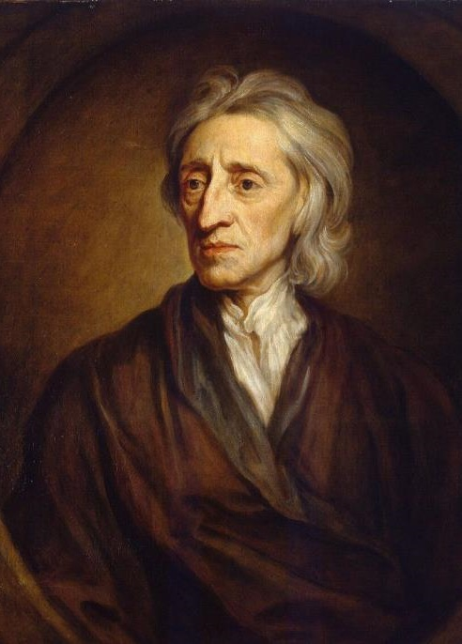
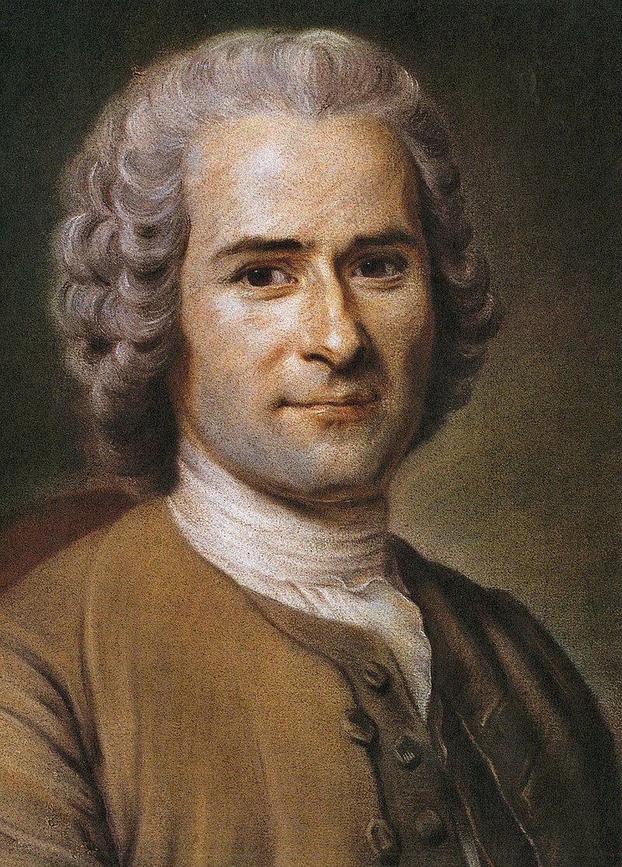
Principles of the American Constitution:
1776-1787
THE ENLIGHTENMENT
John Locke
Jean-Jacques Rousseau

Slide 25
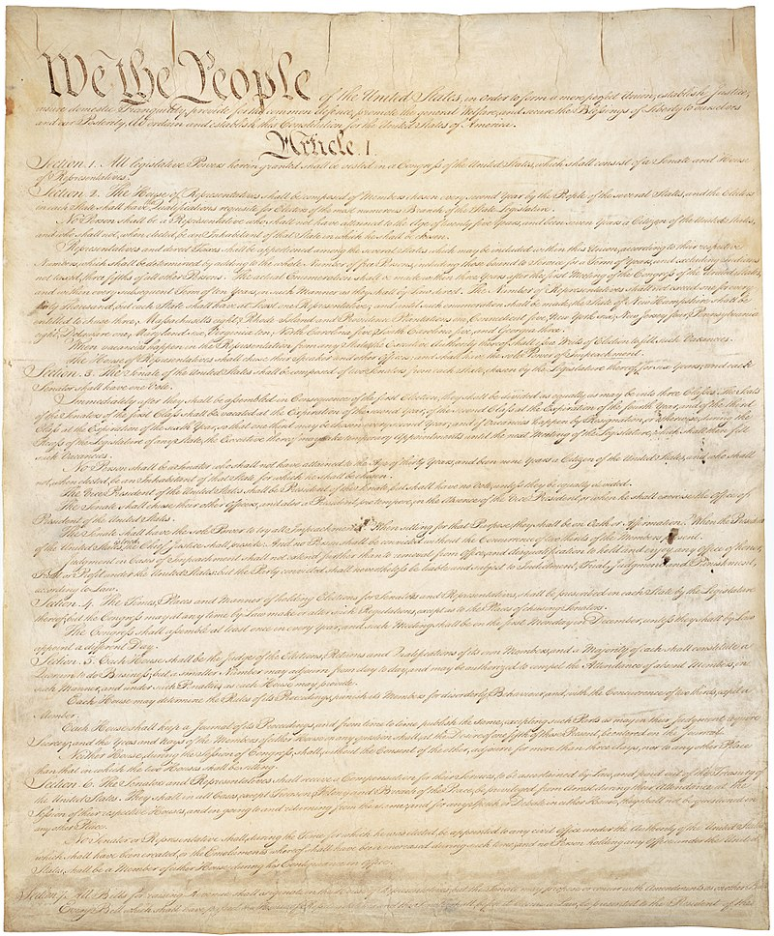

Principles of the American Constitution:
1776-1787
WHERE IS POPULAR SOVEREIGNTY IN THE CONSTITUTION
Preamble—“We the People”
Article VII—Constitution’s ratification (or approval)process
Article V—amendment process
Elections

Slide 26

Principles of the American Constitution:
1776-1787
Constitution was “of no more consequence than the paper on which it was written” unless ratified by the American people.
James Madison

Slide 27
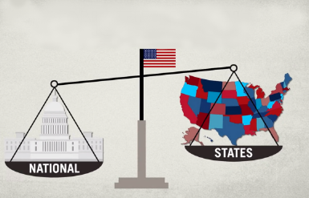
Principles of the American Constitution:
1776-1787
FEDERALISM

Slide 28
FEDERALISM
Principles of the American Constitution:
1776-1787
“Federalism” is the word used to describe the Constitution’s system of dividing political power between the national government and the states.

Slide 29
Principles of the American Constitution:
1776-1787
WHERE IS FEDERALISM IN THE CONSTITUTION
Article I, Section 3: The original Senate
Article I, Section 8: The powers of Congress—especially the Commerce Clause and the Necessary and Proper Clause
Article I, Section 10: Limitations on the powers of the states
Article IV: Privilege and Immunities Clause and Fugitive Slave/Rendition Clause
Article VI: Supremacy Clause
10th Amendment
The Enforcement Clauses of the Reconstruction Amendments

Slide 30
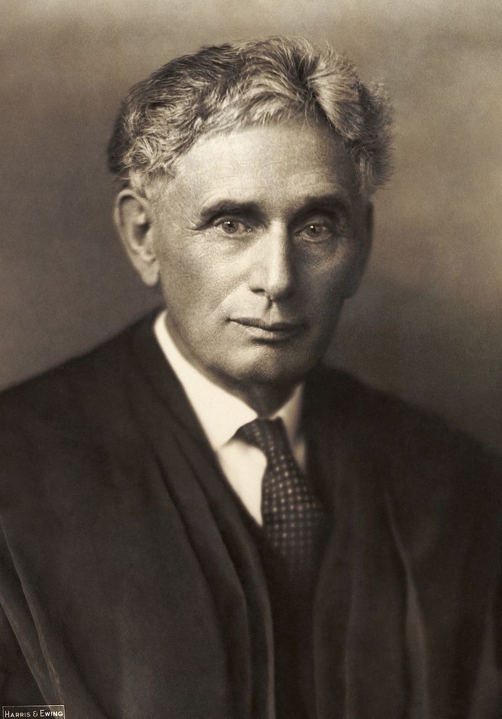
Principles of the American Constitution:
1776-1787
“Laboratories of Democracy”
Louis Brandeis

Slide 31
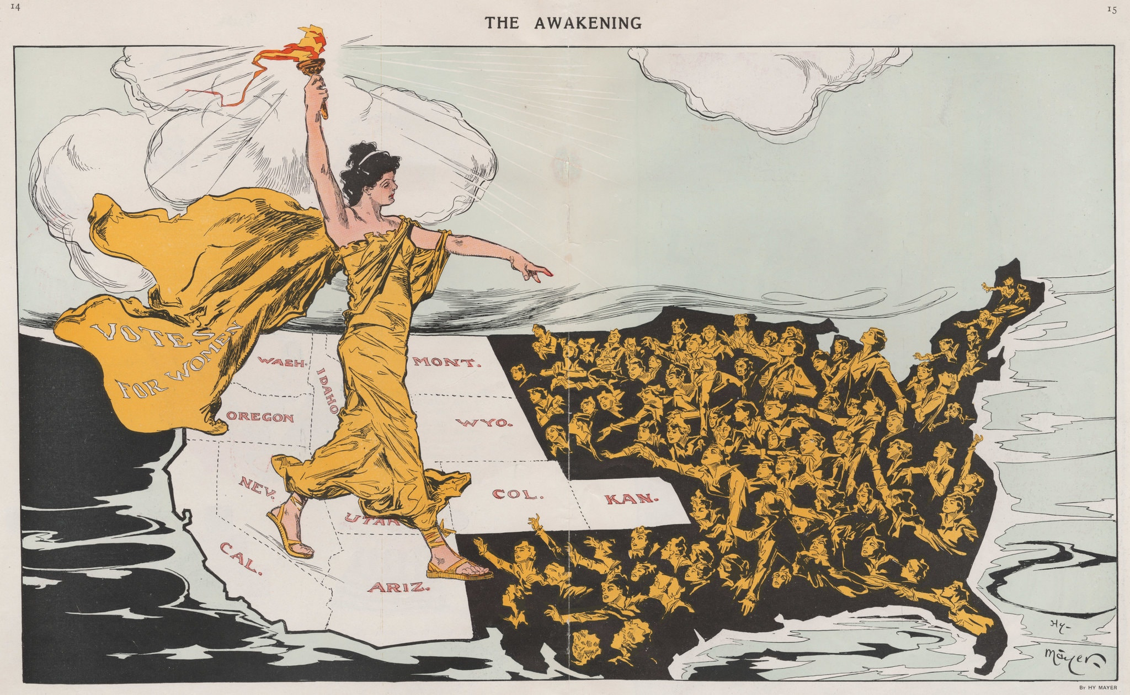
Principles of the American Constitution:
1776-1787
WOMEN’S SUFFRAGE MOVEMENT

Slide 32
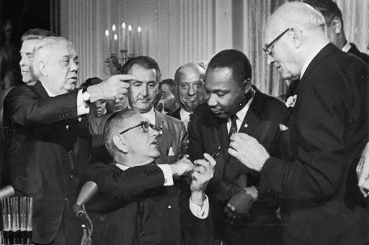
Principles of the American Constitution:
1776-1787
CIVIL RIGHTS ERA LEGISLATION

Slide 33



Principles of the American Constitution:
1776-1787
SEPARATION OF POWERS AND CHECKS AND BALANCES

Slide 34
Principles of the American Constitution:
1776-1787
SEPARATION OF POWERS AND CHECKS AND BALANCES
Through the separation of powers, the Constitution distributes political power between three branches of government.
The legislative branch—Congress—makes the laws.
The executive branch—led by the President—enforces the laws.
And the judicial branch—headed by the Supreme Court—interprets the laws.
At the same time, through its system of checks and balances, the Constitution grants each branch of government the power to check abuses by the other branches.

Slide 35
Principles of the American Constitution:
1776-1787
“Ambition must be made to counteract ambition. The interest of the man must be connected with the constitutional rights of the place. It may be a reflection on human nature, that such devices should be necessary to control the abuses of government. But what is government itself, but the greatest of all reflections on human nature?”
James Madison

Slide 36
Principles of the American Constitution:
1776-1787
“If men were angels, no government would be necessary. If angels were to govern men, neither external nor internal controls on government would be necessary.”
James Madison

Slide 37
Principles of the American Constitution:
1776-1787
CHECKS AND BALANCES IN ACTION
Congress has the power to make our nation’s laws, BUT…
The President was given the power to veto any law passed by Congress.
Federal judges were given the power to declare any law unconstitutional.

Slide 38

Principles of the American Constitution:
1776-1787
REPUBLICANISM

Slide 39
FEDERALISM
Principles of the American Constitution:
1776-1787
For the Founding generation, the American Revolution created a new republican world. This shift wasn’t just about getting rid of a King and holding elections.
There was a moral dimension to the American Revolution—one that got at the character of American society. The new government had to commit to (what the Founders referred to as) civic republican virtue.
Americans had to choose virtue over vice, reason over passion, and the public good over private self-interest.

Slide 40
Principles of the American Constitution:
1776-1787
Key traits of the good, republican citizen in America:
Restraint
Temperance
Fortitude
Dignity
Independence
Think:
George Washington!

Slide 41
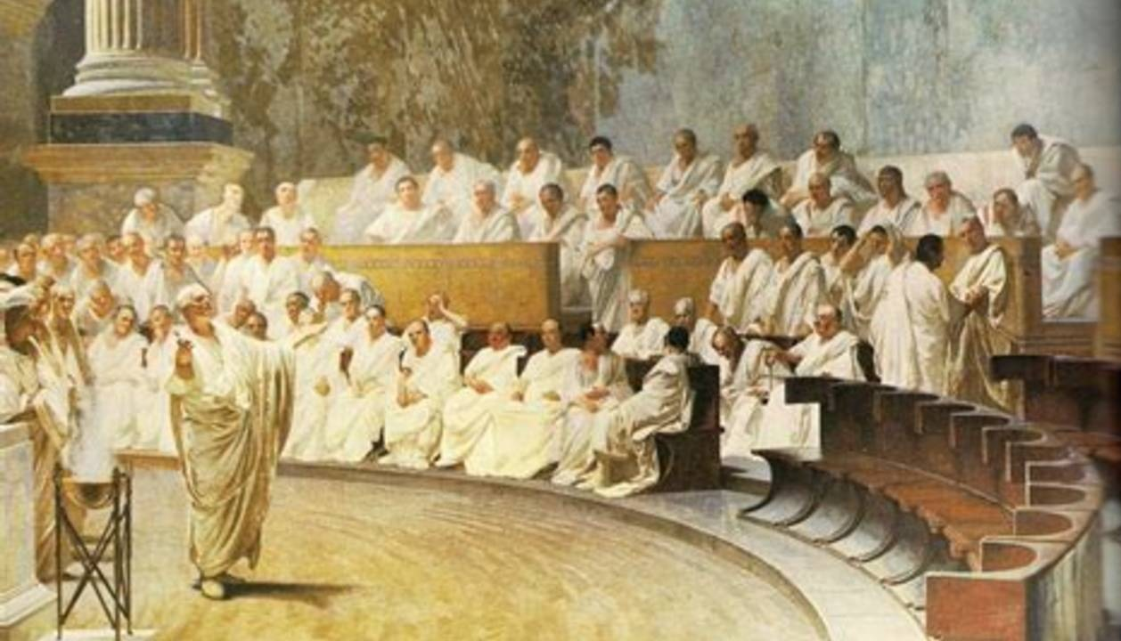
Principles of the American Constitution:
1776-1787
ROMAN REPUBLIC
History taught republics were fragile—and they all seemed destined to fall. They rise or fall based on the character and spirit of their people.
For republics to survive, citizens must sacrifice individual self-interest and commit to the public good.

Slide 42
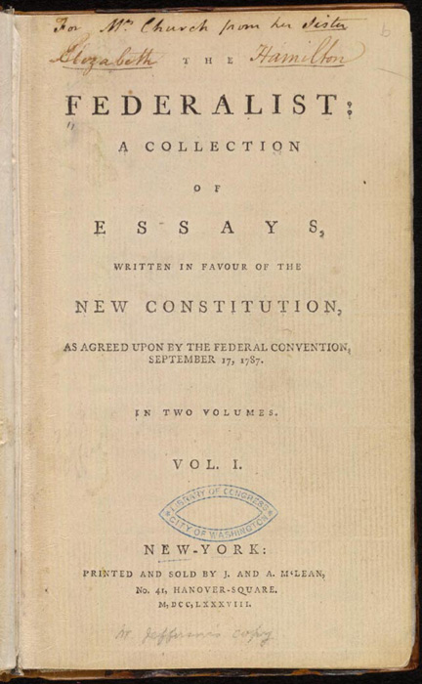
Principles of the American Constitution:
1776-1787
THE FEDERALIST PAPERS
By drafting and ratifying our Constitution, the Founding generation sought to create a national government more powerful than one created by the Articles of Confederation, but also one of limited powers.
In The Federalist Papers, James Madison, Alexander Hamilton, and John Jay envisioned a constitutional system driven by reasoned debate and principled compromise.

Slide 43
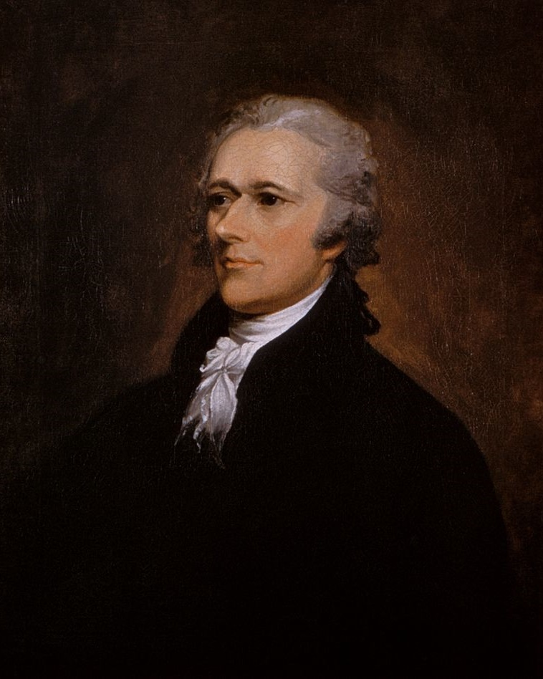

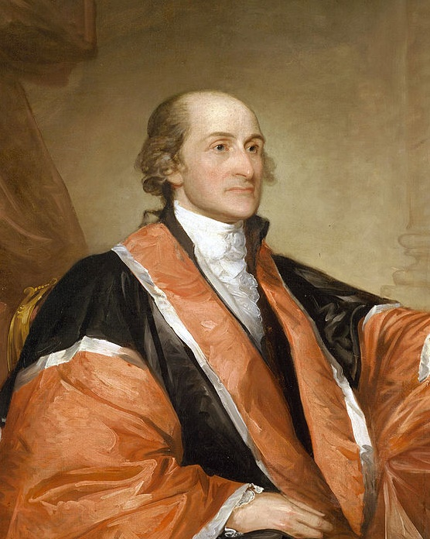
Principles of the American Constitution:
1776-1787
THE FEDERALIST PAPERS
Alexander Hamilton
James Madison
John Jay
All three authors wrote under the same famous pen name—“Publius.”

Slide 44
Principles of the American Constitution:
1776-1787
THE FEDERALIST PAPERS
In part, they feared majority and minority factions as enemies of public reason, and, in part, they sought to build a system that guarded against majoritarian tyranny, making it hard for (as James Madison put it) “stronger factions [to] readily unite to oppress the weaker.”

Slide 45
Principles of the American Constitution:
1776-1787
THE FEDERALIST PAPERS
For Madison, “the aim of every political constitution was . . . , first, to obtain for rulers men who possess most wisdom to discern, and most virtue to pursue, the common good of society.”
(Fed. 57)

Slide 46
Principles of the American Constitution:
1776-1787
THE FEDERALIST PAPERS
While states often had a limited pool of quality candidates for their legislatures, the national government would have, in John Jay’s words, “the widest field of choice.”
(Fed. 3)

Slide 47
Principles of the American Constitution:
1776-1787
THE FEDERALIST PAPERS
Since the Framers “extended . . . the spheres of elections,” a larger universe of potential candidates would be available for each position in the national government, and only those with well-established reputations would win.
(Fed. 27, Hamilton)

Slide 48
Principles of the American Constitution:
1776-1787
THE FEDERALIST PAPERS
This would result in elected officials who were “temperate and cool,”
congressional deliberations filled with “moderation and candor,”
(Fed 27, Ham)
And decisions that were “more wise, systematical, and judicious, than those of the individual states.”
(Fed. 3, Jay)

Slide 49
Principles of the American Constitution:
1776-1787
THE FEDERALIST PAPERS
This form of representative government would “refine and enlarge the public’s views, by passing them through the medium of a chosen body of citizens, whose wisdom may best discern the interest of their country, and whose patriotism and love of justice, would be least likely to sacrifice it to temporary or partial considerations.”
(Fed. 10, Madison)

