Slide 1
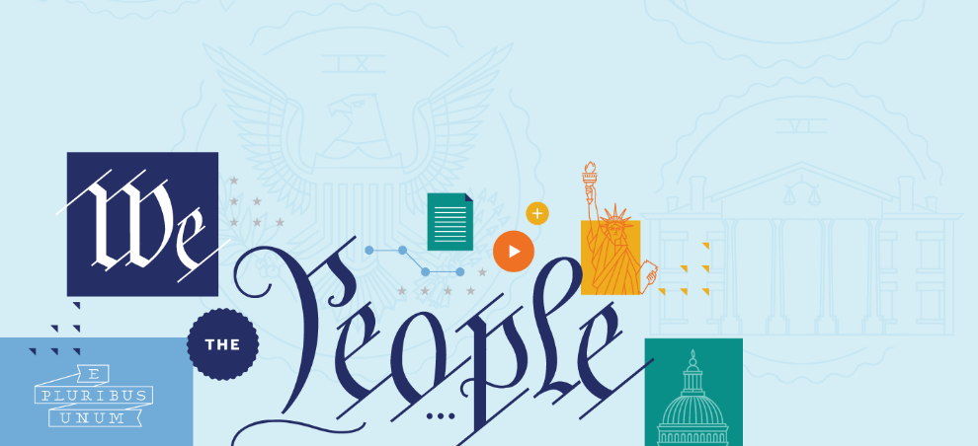
First Amendment: Speech and Press
First Amendment: Speech and Press

Slide 2
Big Questions
What was the Founding generation’s vision for the First Amendment’s protection of free speech and a free press?
What are some of the key periods in history that have tested the nation’s commitment to free speech?
How has the Supreme Court interpreted the First Amendment’s commitment to free speech and a free press over time?
How does the Supreme Court analyze free speech and free press cases today?
First Amendment: Speech and Press

Slide 3
Big Idea
Today, the Supreme Court protects free speech rights more strongly than at any time in our nation’s history—and American free speech protections are among the strongest in the world. Generally speaking, the government may not jail, fine, or punish people or organizations based on what they say or write, and the Court protects speech unless it is likely to cause immediate lawless action. (A standard rarely met in practice.) At the same time, there are certain contexts when the government has more leeway to regulate speech—for instance, with low-value speech like defamation or when speakers (like public school students) have a special relationship with the government.
First Amendment: Speech and Press

Slide 4
The First Amendment
Religion
Speech and Press
Assembly and Petition
First Amendment: Speech and Press
Establishment Clause
Free Exercise Clause

Slide 5
The First Amendment
Congress shall make no law respecting an establishment of religion, or prohibiting the free exercise thereof; or abridging the freedom of speech, or of the press; or the right of the people peaceably to assemble, and to petition the Government for a redress of grievances.
First Amendment: Speech and Press

Slide 6
The First Amendment
Congress shall make no law…
abridging the freedom of speech, or of the press…
First Amendment: Speech and Press

Slide 7
The First Amendment
First Amendment: Speech and Press

Slide 8
What is covered?
The Supreme Court has interpreted “speech” and “press” broadly as covering not only talking, writing, and printing, but also broadcasting, using the Internet, and other forms of expression.
First Amendment: Speech and Press

Slide 9
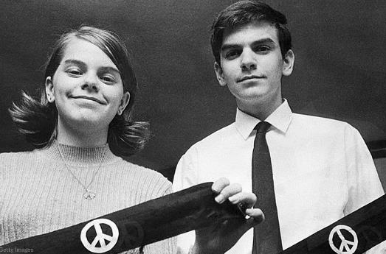
What is covered?
The freedom of speech also applies to symbolic expression, such as displaying flags, burning flags…wearing armbands, and the like.
First Amendment: Speech and Press

Slide 10
What is Not covered?
The First Amendment does not protect speakers against private individuals or organizations, such as private employers, private colleges, or private landowners. The First Amendment restrains only the government.
First Amendment: Speech and Press

Slide 11
The First Amendment
The Supreme Court has frequently declared that the very core of the First Amendment is that the government cannot regulate speech based on its content. Thus, the Supreme Court has held that restrictions on speech because of its content—that is, when the government targets the speaker’s message—generally violate the First Amendment.
First Amendment: Speech and Press

Slide 12
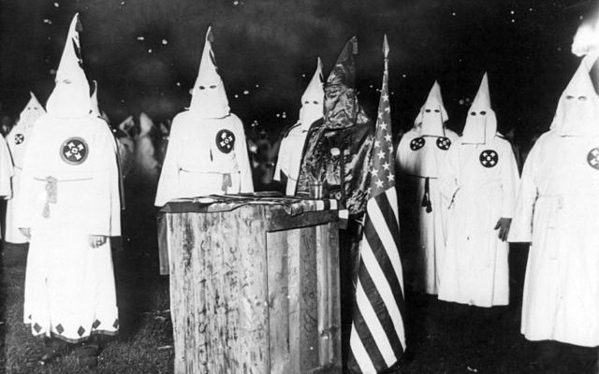
Brandenburg v. Ohio (1969)
First Amendment: Speech and Press

Slide 13
The Brandenburg Test
Generally speaking, the government may not punish speech unless it is directed to incite and likely to incite imminent lawless action.
First Amendment: Speech and Press

Slide 14
incorporation
When first ratified, the First Amendment only applied to the national government. This meant if your home state punished you for criticizing the Governor, the First Amendment didn’t protect you.
We needed 14th Amendment to reach state laws. Now, free speech protections apply as much to the President and Congress as they do to the Governor or state legislature—this is know as Incorporation.
First Amendment: Speech and Press

Slide 15
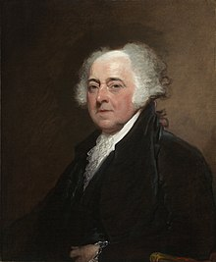
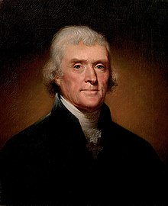
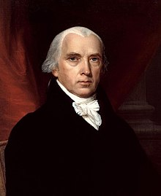
The Alien and Sedition Acts (1798)
First Amendment: Speech and Press
John Adams
Thomas Jefferson
James Madison
Notes:
https://www.archives.gov/historical-docs/todays-doc/index.html?dod-date=706

Slide 16
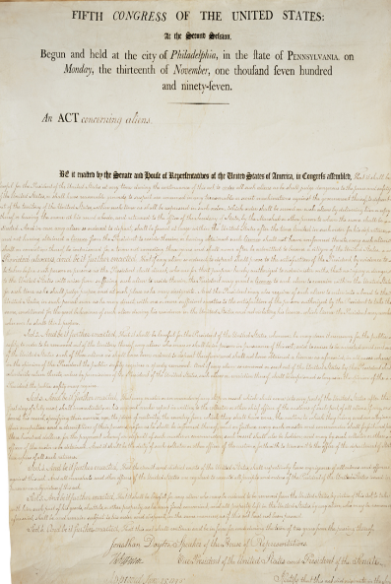
The Alien and Sedition Acts (1798)
The Acts were passed by the Adams Administration (and the Federalist Congress). They attacked the core of free speech and a free press—the right to criticize the government. Adams and the Federalists believed that limitations were necessary to preserve the nation.
First Amendment: Speech and Press
Notes:
https://www.archives.gov/historical-docs/todays-doc/index.html?dod-date=706

Slide 17
The Alien and Sedition Acts (1798)
First Amendment: Speech and Press
DO NOT CRITICIZE PRESIDENT
OKAY TO CRITICIZE VICE PRESIDENT
Notes:
https://www.archives.gov/historical-docs/todays-doc/index.html?dod-date=706

Slide 18
The Virginia and Kentucky Resolutions of 1798
Drafted in secret by Jefferson and Madison, the resolutions condemned the Alien and Sedition Acts as unconstitutional, as it violated our nation’s commitment to free speech.
First Amendment: Speech and Press
Thomas Jefferson
James Madison
Notes:
https://archive.org/details/resolutionsofvir00madi/page/n5/mode/2up

Slide 19
The Virginia and Kentucky Resolutions of 1798
Madison argued that this exercise of “power . . . ought to produce universal alarm, because it is levelled against that right of freely examining public characters and measures, and of free communication among the people thereon, which has ever been justly deem, the only effectual guardian of every other right.”
First Amendment: Speech and Press
James Madison
Notes:
https://archive.org/details/resolutionsofvir00madi/page/n5/mode/2up

Slide 20
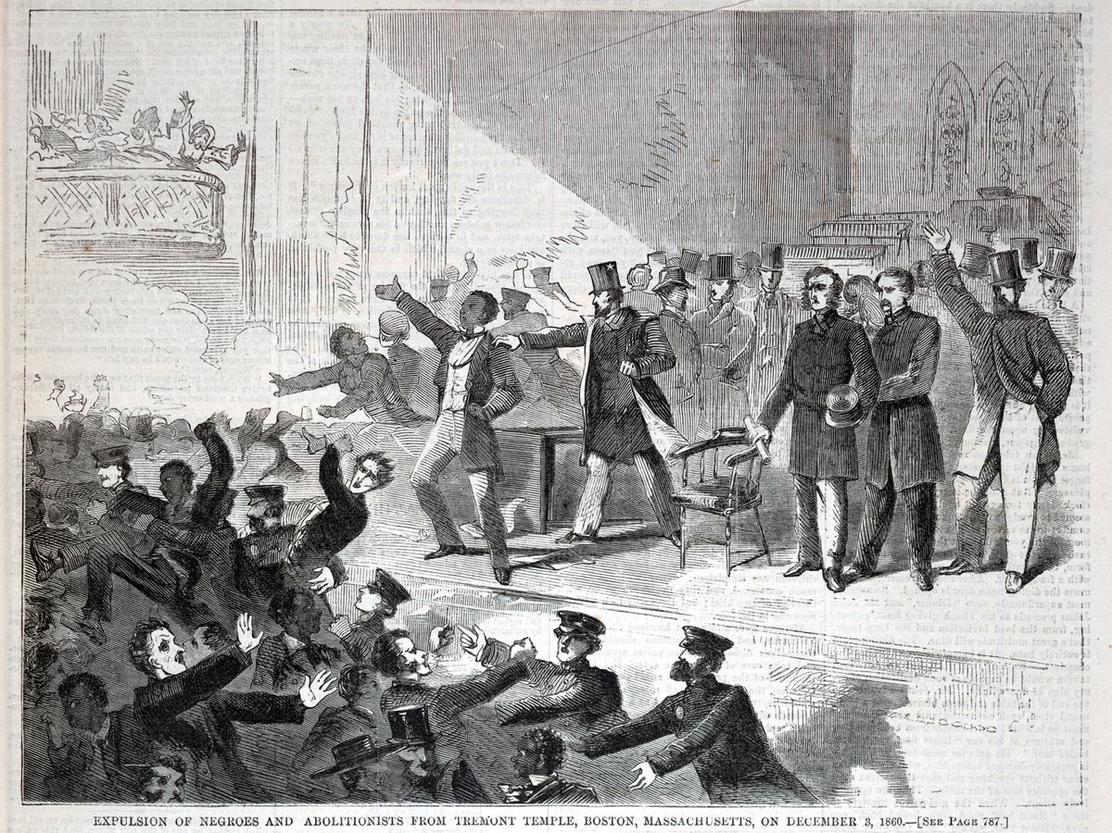
Free Speech and the Abolitionists
First Amendment: Speech and Press
Notes:
http://recordsofrights.org/records/145/espionage-act

Slide 21
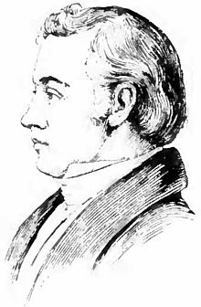
Free Speech and the Abolitionists
Today we think of abolitionists as heroes, but they were extremely unpopular in their own time. Many were afraid the effects of the abolitionist message would lead to slave revolts throughout the South, and therefore, it must be restricted or banned.
Many State laws banned anti-slavery speeches or expression, and political and community leaders often organized mobs to suppress abolitionist meetings—sometimes leading to violence and even death, like that of Elijah Lovejoy in Illinois in 1837.
First Amendment: Speech and Press
Elijah Lovejoy
Notes:
http://recordsofrights.org/records/145/espionage-act

Slide 22
Free Speech and the Abolitionists
On December 3, 1860, the one-year anniversary of John Brown’s death, a group of abolitionists met at the Tremont Temple Baptist Church in Boston for a discussion centered around the following question: “How Can Slavery Be Abolished?”
However a violent mob interrupted the meeting and shut it down.
First Amendment: Speech and Press
Notes:
http://recordsofrights.org/records/145/espionage-act

Slide 23
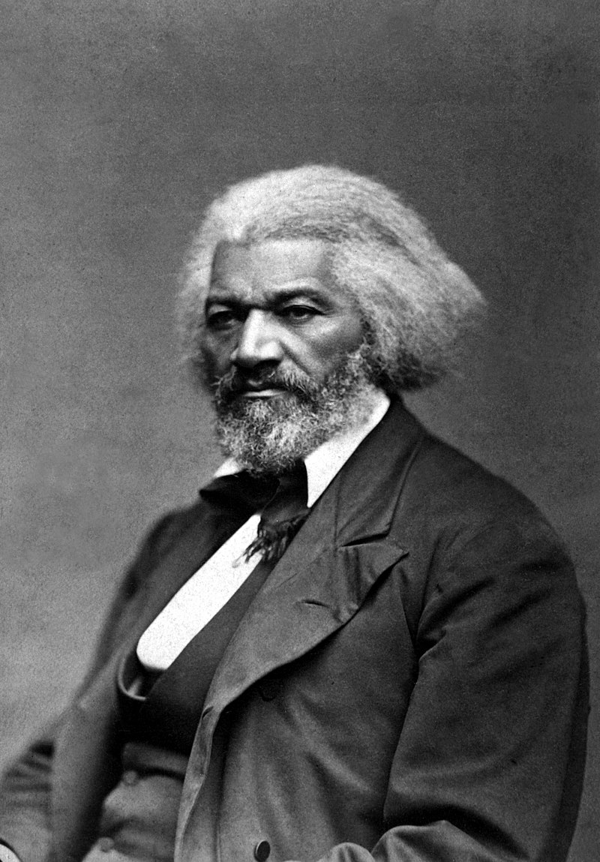
Free Speech and the Abolitionists
Six days later, Frederick Douglass delivered a previously scheduled lecture at Boston’s Music Hall.
Following his prepared remarks, Douglass ended with an admonition to his audience—and to the nation—about the importance of free speech and the exchange of ideas in a democratic society.
First Amendment: Speech and Press
Frederick Douglass
Notes:
http://recordsofrights.org/records/145/espionage-act

Slide 24
Free Speech and the Abolitionists
“No right was deemed by the fathers of the Government more sacred than the right of speech. It was in their eyes, as in the eyes of all thoughtful men, the great moral renovator of society and government.”
First Amendment: Speech and Press
Frederick Douglass
Notes:
http://recordsofrights.org/records/145/espionage-act

Slide 25
Free Speech and the Abolitionists
“Liberty is meaningless where the right to utter one’s thoughts and opinions has ceased to exist. That, of all rights, is the dread of tyrants. It is the right which they first of all strike down. They know its power. Thrones, dominions, principalities, and powers, founded in injustice and wrong, are sure to tremble, if men are allowed to reason of righteousness, temperance, and of a judgment to come in their presence.”
First Amendment: Speech and Press
Frederick Douglass
Notes:
http://recordsofrights.org/records/145/espionage-act

Slide 26
Free Speech and the Abolitionists
“Slavery cannot tolerate free speech. Five years of its exercise would banish the auction block and break every chain in the South. They will have none of it there, for they have the power. But shall it be so here?”
First Amendment: Speech and Press
Frederick Douglass
Notes:
http://recordsofrights.org/records/145/espionage-act

Slide 27
Free Speech and the Abolitionists
“Even here in Boston, and among the friends of freedom, we hear two voices: one denouncing the mob that broke up our meeting on Monday as a base and cowardly outrage; and another, deprecating and regretting the holding of such a meeting, by such men, at such a time. We are told that the meeting was ill-timed, and the parties to it unwise.”
First Amendment: Speech and Press
Frederick Douglass
Notes:
http://recordsofrights.org/records/145/espionage-act

Slide 28
Free Speech and the Abolitionists
“Why, what is the matter with us? Are we going to palliate and excuse a palpable and flagrant outrage on the right of speech, by implying that only a particular description of persons should exercise that right? Are we, at such a time, when a great principle has been struck down, to quench the moral indignation which the deed excites, by casting reflections upon those on whose persons the outrage has been committed? After all the arguments for liberty to which Boston has listened for more than a quarter of a century, has she yet to learn that the time to assert a right is the time when the right itself is called in question, and that the men of all others to assert it are the men to whom the right has been denied?”
First Amendment: Speech and Press
Frederick Douglass
Notes:
http://recordsofrights.org/records/145/espionage-act

Slide 29
Free Speech and the Abolitionists
“It would be no vindication of the right of speech to prove that certain gentlemen of great distinction, eminent for their learning and ability, are allowed to freely express their opinions on all subjects – including the subject of slavery. Such a vindication would need, itself, to be vindicated. It would add insult to injury. Not even an old-fashioned abolition meeting could vindicate that right in Boston just now. There can be no right of speech where any man, however lifted up, or however humble, however young, or however old, is overawed by force, and compelled to suppress his honest sentiments.”
First Amendment: Speech and Press
Frederick Douglass
Notes:
http://recordsofrights.org/records/145/espionage-act

Slide 30
Free Speech and the Abolitionists
“Equally clear is the right to hear. To suppress free speech is a double wrong. It violates the rights of the hearer as well as those of the speaker. It is just as criminal to rob a man of his right to speak and hear as it would be to rob him of his money.”
First Amendment: Speech and Press
Frederick Douglass
Notes:
http://recordsofrights.org/records/145/espionage-act

Slide 31
Free Speech and the Abolitionists
“I have no doubt that Boston will vindicate this right. But in order to do so, there must be no concessions to the enemy. When a man is allowed to speak because he is rich and powerful, it aggravates the crime of denying the right to the poor and humble.”
“The principle must rest upon its own proper basis. And until the right is accorded to the humblest as freely as to the most exalted citizen, the government of Boston is but an empty name, and its freedom a mockery. A man’s right to speak does not depend upon where he was born or upon his color. The simple quality of manhood is the solid basis of the right – and there let it rest forever.”
First Amendment: Speech and Press
Frederick Douglass
Notes:
http://recordsofrights.org/records/145/espionage-act

Slide 32
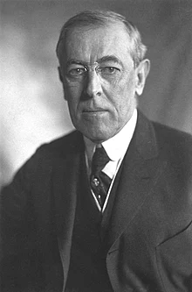
World War I Era Restrictions
Espionage Act
Sedition Act
First Amendment: Speech and Press
Woodrow Wilson
Notes:
https://debsfoundation.org/index.php/landing/debs-biography/
http://recordsofrights.org/records/145/espionage-act

Slide 33
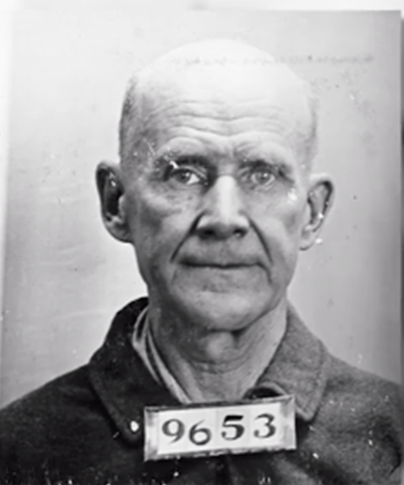
World War I Era Restrictions
After delivering an anti-war speech in June 1918, Eugene V. Debs was convicted under the Sedition Act. The Supreme Court upheld his conviction in a unanimous decision written by Justice Holmes. According to the Supreme Court, Debs couldn’t speak his conscience when it came to the war.
First Amendment: Speech and Press
Eugene V. Debs
Notes:
https://debsfoundation.org/index.php/landing/debs-biography/
http://recordsofrights.org/records/145/espionage-act

Slide 34
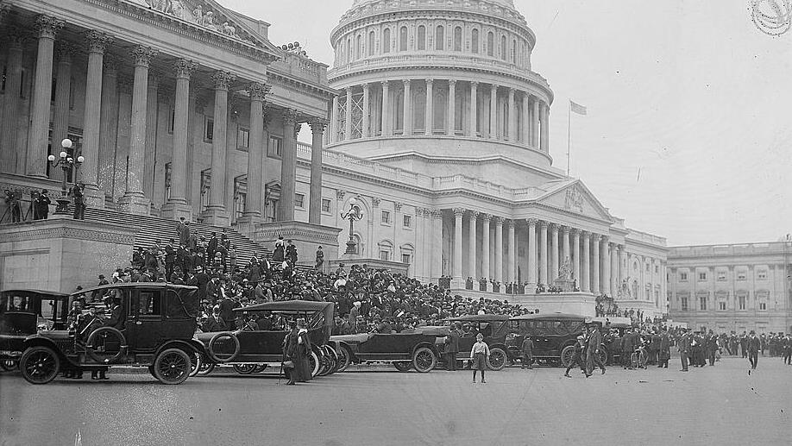
Schenck v. United States (1919)
First Amendment: Speech and Press
Anti-war protest at U.S. Capitol Building, 1917

Slide 35
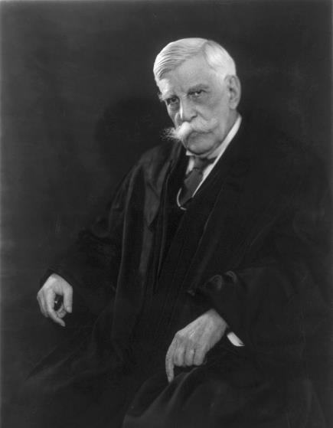
Schenck v. United States (1919)
Writing for a unanimous Court, Justice Oliver Wendell Holmes upheld the defendants’ convictions and ruled that the Espionage Act did not conflict with the First Amendment.
First Amendment: Speech and Press
Oliver Wendell Holmes

Slide 36
clear and present danger test
Were the words used “in such circumstances and are of such a nature as to create a clear and present danger that they will bring about the substantive evils that Congress has a right to prevent?”
First Amendment: Speech and Press
Oliver Wendell Holmes

Slide 37
Schenck v. United States (1919)
“a question of proximity and degree,” famously explaining, “The most stringent protection of free speech would not protect a man in falsely shouting fire in a theatre and causing a panic.”
First Amendment: Speech and Press
Oliver Wendell Holmes

Slide 38
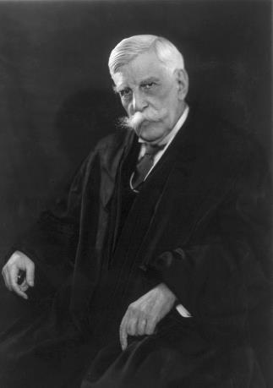
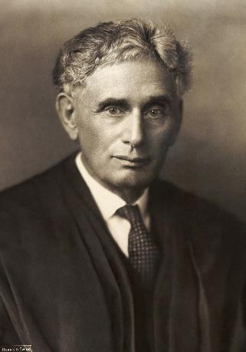
First Amendment: Speech and Press
Oliver Wendell Holmes
Louis Brandeis
The Supreme Court reversed course in future decades, increasingly protecting free speech over time—following a series of famous dissents by Justice Oliver Wendell Holmes and Justice Louis Brandeis in the 1910s and 1920s.
Notes:
https://debsfoundation.org/index.php/landing/debs-biography/
http://recordsofrights.org/records/145/espionage-act

Slide 39
United States v. Schwimmer (1929)
“[I]f there is any principle of the Constitution that more imperatively calls for attachment than any other, it is the principle of free thought—not free thought for those who agree with us but freedom for the thought that we hate.”
First Amendment: Speech and Press
Oliver Wendell Holmes

Slide 40
Abrams v. United States (1919)
“[T]he best test of truth is the power of the thought to get itself accepted in the competition of the market.”
First Amendment: Speech and Press
Oliver Wendell Holmes

Slide 41
Whitney v. California (1927)
“If there be time to expose through discussion the falsehood and fallacies, to avert the evil by the processes of education, the remedy to be applied is more speech, not enforced silence.”
First Amendment: Speech and Press
Louis Brandeis

Slide 42
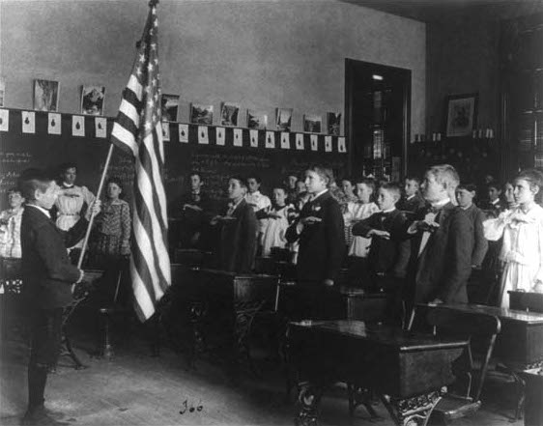
West Virginia v. Barnette (1943)
First Amendment: Speech and Press

Slide 43
West Virginia v. Barnette (1943)
Facts of the case:
During World War II, the West Virginia legislature required all students salute the American flag. The law followed the Supreme Court’s decision in Minersville School District v. Gobitis (1940), which decided that public schools could compel students to salute the flag and say the Pledge of Allegiance.
Marie and Gathie Barnette were expelled from school after they were instructed by their parents to not salute the flag or say the pledge. They were Jehovah’s Witnesses, a religious minority group who do not salute the American flag, as they believes God’s law to be superior to any man-made laws or government.
First Amendment: Speech and Press

Slide 44
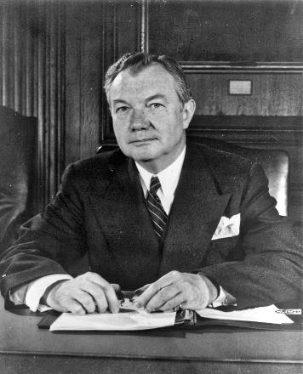
West Virginia v. Barnette (1943)
The Outcome:
On Flag Day in 1943, the Court, in a 6-3 decision written by Justice Robert Jackson, overruled Gobitis.
First Amendment: Speech and Press
Justice Robert Jackson

Slide 45
West Virginia v. Barnette (1943)
“We apply the limitations of the Constitution with no fear that freedom to be intellectually and spiritually diverse or even contrary will disintegrate the social organization” and argued patriotism flourished when ceremonies were “voluntary and spontaneous instead of a compulsory routine.”
First Amendment: Speech and Press
Justice Robert Jackson

Slide 46
West Virginia v. Barnette (1943)
“The very purpose of a Bill of Rights was to withdraw certain subjects from the vicissitudes of political controversy, to place them beyond the reach of majorities and officials and to establish them as legal principles to be applied by the courts.”
First Amendment: Speech and Press
Justice Robert Jackson

Slide 47
West Virginia v. Barnette (1943)
“If there is any fixed star in our constitutional constellation, it is that no official, high or petty, can prescribe what shall be orthodox in politics, nationalism, religion, or other matters of opinion, or force citizens to confess by word or act faith therein.”
First Amendment: Speech and Press
Justice Robert Jackson

Slide 48
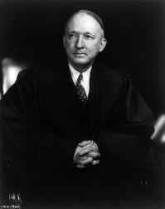
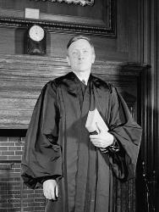
West Virginia v. Barnette (1943)
Justices Black and Douglas—two members who changed their minds since the Gobitis decision in 1940—said in a concurring opinion: “Words uttered under coercion are proof of loyalty to nothing but self-interest… Love of country must spring from willing hearts and free minds, inspired by a fair administration of wise laws enacted by the people’s elected representatives within the bounds of express constitutional prohibitions.”
First Amendment: Speech and Press
Justices Hugo Black
Justices William O. Douglas

Slide 49
Free Speech And the Civil Rights Movement
First Amendment: Speech and Press
New York Times v. Sullivan (1964)

Slide 50
New York Times v. Sullivan (1964)
Facts of the Case:
The New York Times published a full-page advertisement, placed by allies of Dr. Martin Luther King, Jr., in the Civil Rights Movement, on behalf of African Americans and clergymen in Alabama who were combatting Jim Crow laws.
The ad accused various Alabama officials of violence and other wrongdoing, but it in also contained minor factual inaccuracies. L.B. Sullivan, the Public Safety Commissioner of Montgomery, Alabama, sued the New York Times for printing the ad.
A jury awarded him $500,000 in damages—the highest libel award in Alabama’s history. This was meant to chill speech advancing civil rights and attacking Jim Crow.
First Amendment: Speech and Press

Slide 51
New York Times v. Sullivan (1964)
The Outcome
On appeal, the Supreme Court held unanimously for the newspaper, ruling that in order to survive a First Amendment challenge and win a defamation suit, a public official must show that the publisher knew a statement was inaccurate or false and was reckless in deciding to publish it without further investigation.
The Court described this new standard as “actual malice.” This standard provides strong free speech protections for speech covering issues involving public officials—keeping a “public official from recovering damages for a defamatory falsehood relating to his official conduct unless he proves that the statement was made with ‘actual malice’—that is, with knowledge that it was false or with reckless disregard of whether it was false or not.”
First Amendment: Speech and Press

Slide 52
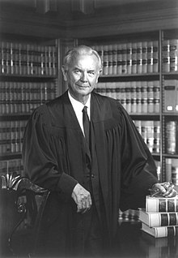
New York Times v. Sullivan (1964)
Justice William Brennan wrote the majority opinion for the Court.
Sullivan must be understood “against the background of a profound national commitment to the principle that debate on public issues should be uninhibited, robust, and wide-open, and that it may well include vehement, caustic, and sometimes unpleasantly sharp attacks on government and public officials.”
First Amendment: Speech and Press
Justices William Brennan

Slide 53
New York Times v. Sullivan (1964)
False “statement is inevitable in free debate and [it] must be protected if the freedoms of expression are to have the ‘breathing space’ that they ‘need . . . to survive.’”
First Amendment: Speech and Press
Justices William Brennan

Slide 54
First Amendment: where do we stand today?
At its core, the First Amendment today realizes the vision outlined by Jefferson, Madison, Brandeis, and Holmes enshrined by Brandenburg v. Ohio. We generally protect speech unless it is direct to (and likely to) cause immediate lawless action. That was Justice Brandeis’s key lesson in Whitney. That’s what the Supreme Court said decades later in Brandenburg.
First Amendment: Speech and Press

Slide 55
Brandenburg v. Ohio (1969)
First Amendment: Speech and Press

Slide 56
Brandenburg v. Ohio (1969)
Facts of the case:
Brandenburg was a KKK leader who gave a speech in front of TV cameras in 1964 and was arrested under Ohio state law which made it illegal to advocate "crime, sabotage, violence, or unlawful methods of terrorism as a means of accomplishing industrial or political reform.” Cameras caught speeches and cross burning, including one speech threatening “revengeance” against Jews and African Americans. It said that “Our President, Our Congress, our Supreme Court, continues to suppress the white, Caucasian race.”
A march on Washington was planned.
First Amendment: Speech and Press

Slide 57
Brandenburg v. Ohio (1969)
The Outcome:
The Court struck down the state law and prosecution under the “imminence” test, which looked at three elements: the intent to speak, the imminence of lawlessness, and the likelihood of lawlessness. And that is the lodestar of our First Amendment today.
Today, the Supreme Court protects free speech rights more strongly than at any time in our history—and American free speech protections are among the strongest in the world. What are the basic legal tests that the Supreme Court applies to free speech cases? In other words, what’s the legal framework for analyzing free speech issues?
First Amendment: Speech and Press

Slide 58
Big Idea
The government may not jail, fine, or punish people or organizations based on what they say or write, except in exceptional circumstances.
First Amendment: Speech and Press

Slide 59
When can the Government Restrict Speech?
Low-Value Speech
Managerial Domains
Content-Neutral Speech
First Amendment: Speech and Press

Slide 60
When can the Government Restrict Speech?
Low-Value Speech
In some circumstances, the Supreme Court has held that certain types of speech are of only “low” First Amendment value, such as:
Defamation
True threats
“Fighting words”
Commercial advertising
First Amendment: Speech and Press

Slide 61
When can the Government Restrict Speech?
Managerial Domain
The government can restrict speech under a less demanding test when the speaker is in a special relationship to the government.
For example, the speech of government employees and of students in public schools can be restricted, even based on content, when their speech is incompatible with their status as public officials or students.
First Amendment: Speech and Press

Slide 62
When can the Government Restrict Speech?
Content-Neutral Speech
The government can also restrict speech under a less demanding test when it does so without regard to the content or message of the speech.
Time, Place, and Manner Regulations: Content-neutral restrictions that serve legitimate governmental purposes are generally constitutional as long as they are “reasonable.”
First Amendment: Speech and Press

Slide 63
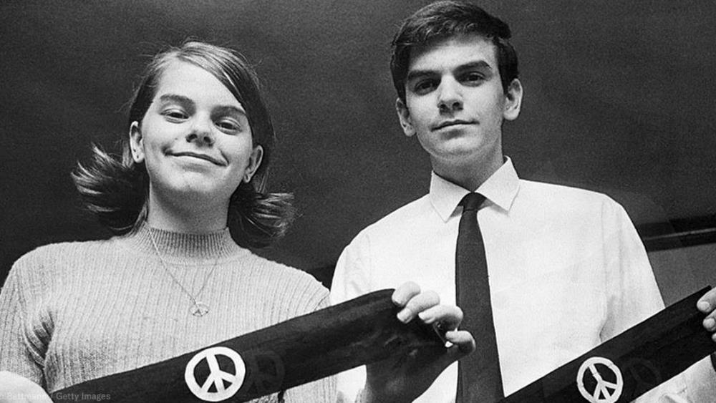
Mary Beth and John Tinker
Tinker v. Des Moines (1969)
First Amendment: Speech and Press

Slide 64
Tinker v. Des Moines (1969)
Facts of the Case:
This landmark First Amendment case involved a group of high school students who wore black armbands to school in order to protest the Vietnam War.
The students were disciplined by the school for wearing the armbands, and the students filed a lawsuit arguing that their armbands were a form of symbolic protest that should be protected under the First Amendment.
First Amendment: Speech and Press

Slide 65
Tinker v. Des Moines (1969)
The Outcome:
In a 7-2 decision, the Supreme Court held that the armbands represented expression that was protected under the First Amendment.
The Court concluded that the students retained their First Amendment rights while at school as long as their speech (or expressive acts) did not “materially or substantially interfere” with the school’s operation. In Tinker, there was no actual interference—the school only feared potential disruption. This wasn’t enough to survive a First Amendment challenge.
First Amendment: Speech and Press

Slide 66
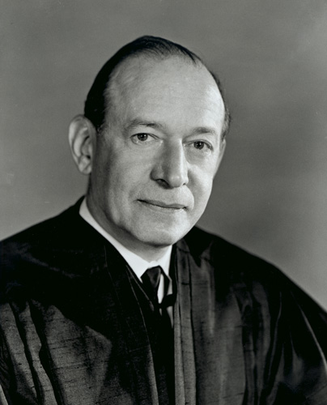
Justice Abe Fortas
Tinker v. Des Moines (1969)
“It can hardly be argued that either students or teachers shed their constitutional rights to freedom of speech or expression at the schoolhouse gate.”
First Amendment: Speech and Press

Slide 67
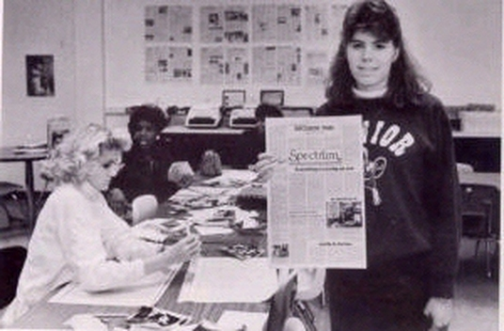
Image Source: University of Missouri-Kansas City
Hazelwood School District v. Kuhlmeier (1988)
First Amendment: Speech and Press

Slide 68
Hazelwood School District v. Kuhlmeier (1988)
Facts of the Case: In 1983 in Hazelwood, Missouri, two articles of the student newspaper were censored by the principal for discussing divorce and teenage pregnancy.
The Outcome: In a 5-3 decision, the Supreme Court ruled that the principal could exercise what is known as “prior restraint” (meaning that printed material, be it a book or newspaper article, is censored before it is printed and according to another Supreme Court landmark case, this was one of the core evils the First Amendment was meant to address)—deciding before the fact that some articles or expression could not be printed or shared, so long as the censorship is “reasonably related to legitimate pedagogical concerns.”
First Amendment: Speech and Press

Slide 69
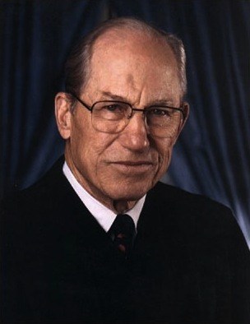
Justice Byron White
Hazelwood School District v. Kuhlmeier (1988)
“A school need not tolerate student speech that is inconsistent with its basic educational mission, even though the government could not censor similar speech outside the school.”
First Amendment: Speech and Press

Slide 70
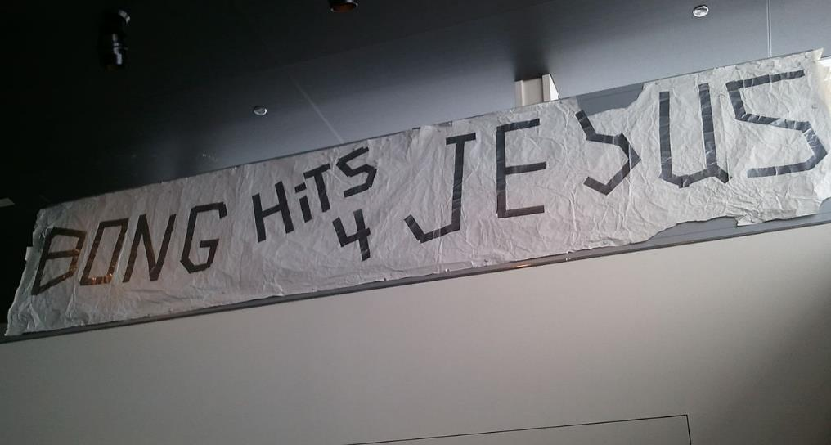
The original banner, hanging in the Newseum in Washington, DC.
Morse v. Frederick (2007)
Scholar Exchange:
First Amendment: Speech and Press

Slide 71
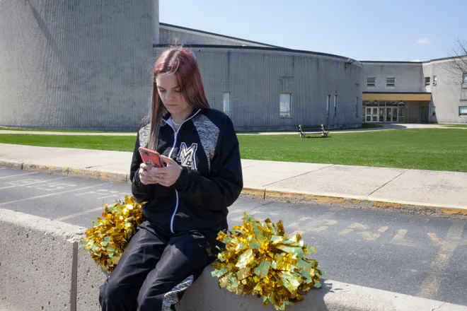
Mahanoy Area School District v. B.L. (2021)
Scholar Exchange:
First Amendment: Speech and Press
Brandi Levy Image: ACLU

