Slide 1
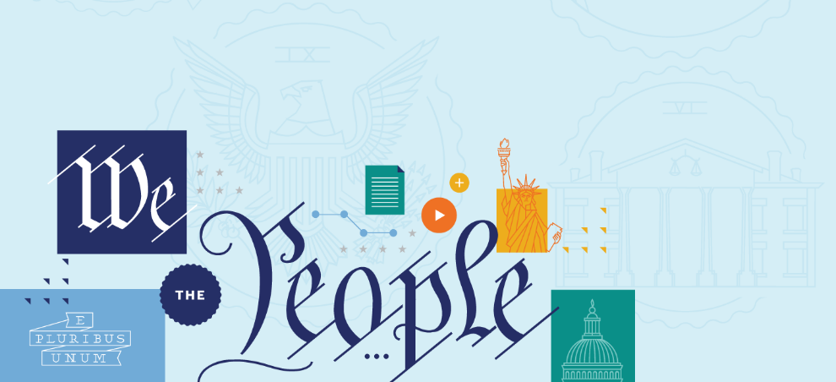
Article I: Congress –
The Legislative Branch

Slide 2
FRAMING QUESTIONS
What role does Congress have in the national government?
What powers does the Constitution grant to Congress? And what are some of the limits on congressional power?
How did the Framers come up with Congress, and what were some of the debates at the Constitutional Convention?
Has the original vision for what Congress should be changed over time?
What are some of the Supreme Court’s key decisions on congressional power? And what are some of the topics of ongoing constitutional debate?

Slide 3
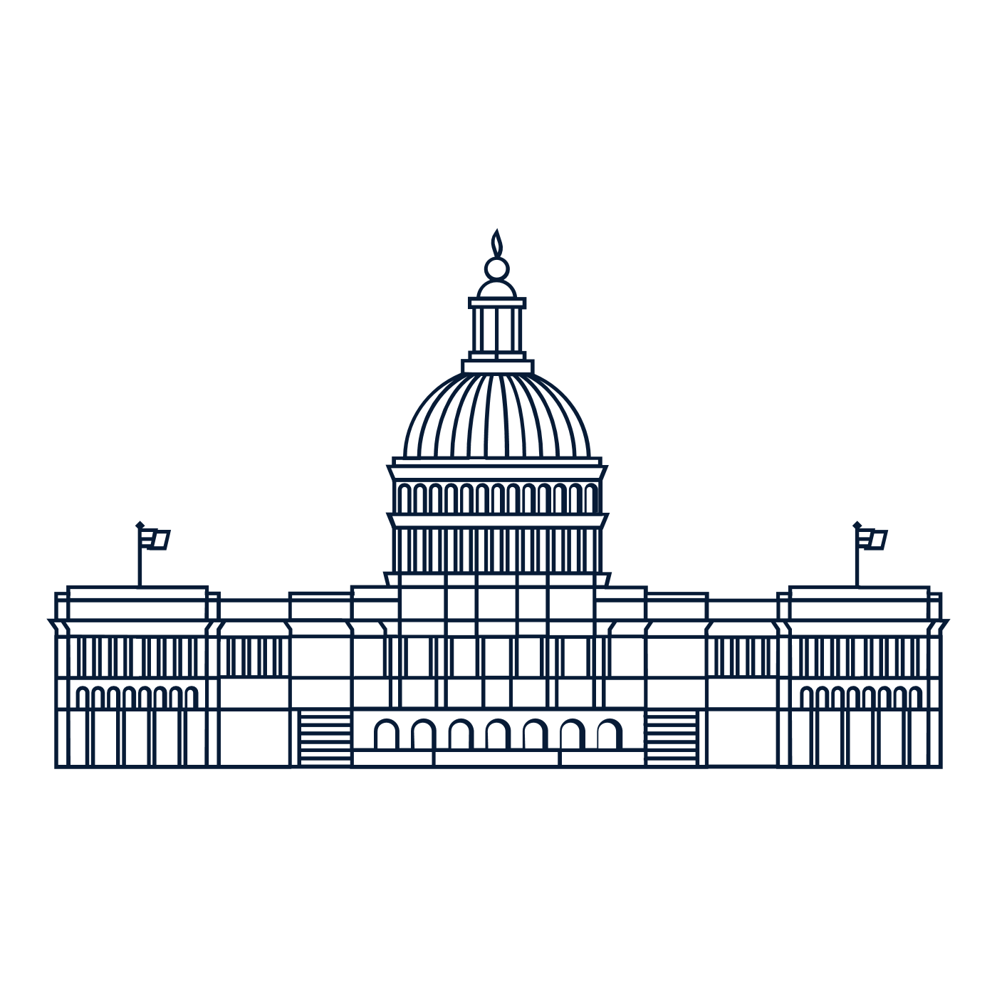
ARTICLE I
Article I establishes the national government’s legislative branch—Congress.
Within the national government, Congress is responsible for making the laws.

Slide 4
ARTICLE I
Article I establishes the national government’s legislative branch—
Congress.

Slide 5
ARTICLE I
It’s the longest part of the Constitution.
Within the national government, Congress is responsible for making the laws.
The Constitution separates Congress into two Houses (We call this “bicameralism”):
The House of Representatives and the Senate

Slide 6
HOUSE OF REPRESENTATIVES
States are represented proportionally .
There are currently 435 Members of the House of Representatives.
Members must be at least 25-years-old.
They serve for two-year terms.
They can run for reelection.
They have always been elected directly by the people.

Slide 7
SENATE
States have equal representation—two Senators for each state.
Currently there are 100 U.S. Senators.
Senators must be at least 30-years-old.
They serve for six-year terms—with one-third of the Senate elected every two years.
They can run for reelection.
Are now elected directly by the people—a change brought about by the 17th Amendment.

Slide 8
ARTICLE I, SECTION 8:
The Congress shall have Power
To lay and collect Taxes…
To borrow Money…
To regulate Commerce…
To coin Money…
To establish Post Offices and post Roads…
To declare War…
To raise and support Armies..
To provide and maintain a Navy..
To make all Laws which shall be necessary and proper…
(Note: Not all powers of Congress are listed here)

Slide 9
BIG IDEA
With Congress, the Founding generation set up a national legislature to make the nation’s laws. They looked to create a new national legislature with more authority—and ability to act—than the one that came before it, but also one of limited powers.

Slide 10


HOW A BILL IS BECOMES A LAW
Both Houses of Congress pass a bill.
The bill is then sent to the president.
President signs the bill.
President vetoes the bill.
Congress overrides the Veto.
Congress fails to override the Veto.
The bill becomes a law.

Slide 11
HOW A BILL BECOMES A LAW
Members in one House of Congress—either the U.S. House of Representatives or the U.S. Senate—introduce a bill. Both Houses of Congress must pass the bill.
Once the bill passes the House and the Senate, it’s then sent to the President.

Slide 12

HOW A BILL BECOMES A LAW
The President then has the option to veto—in other words, reject—the bill. If the President approves of the bill, then it becomes a law.
If she vetoes it, then Congress has the power to override—in other words, cancel—the President’s veto.

Slide 13
HOW A BILL BECOMES A LAW
Congress has the power to override the President’s veto by a 2/3 vote in each Houses of Congress.
If Congress succeeds in overriding the President’s veto, then the bill becomes a law.
If Congress fails to override the President’s veto, then the bill does not become a law

Slide 14
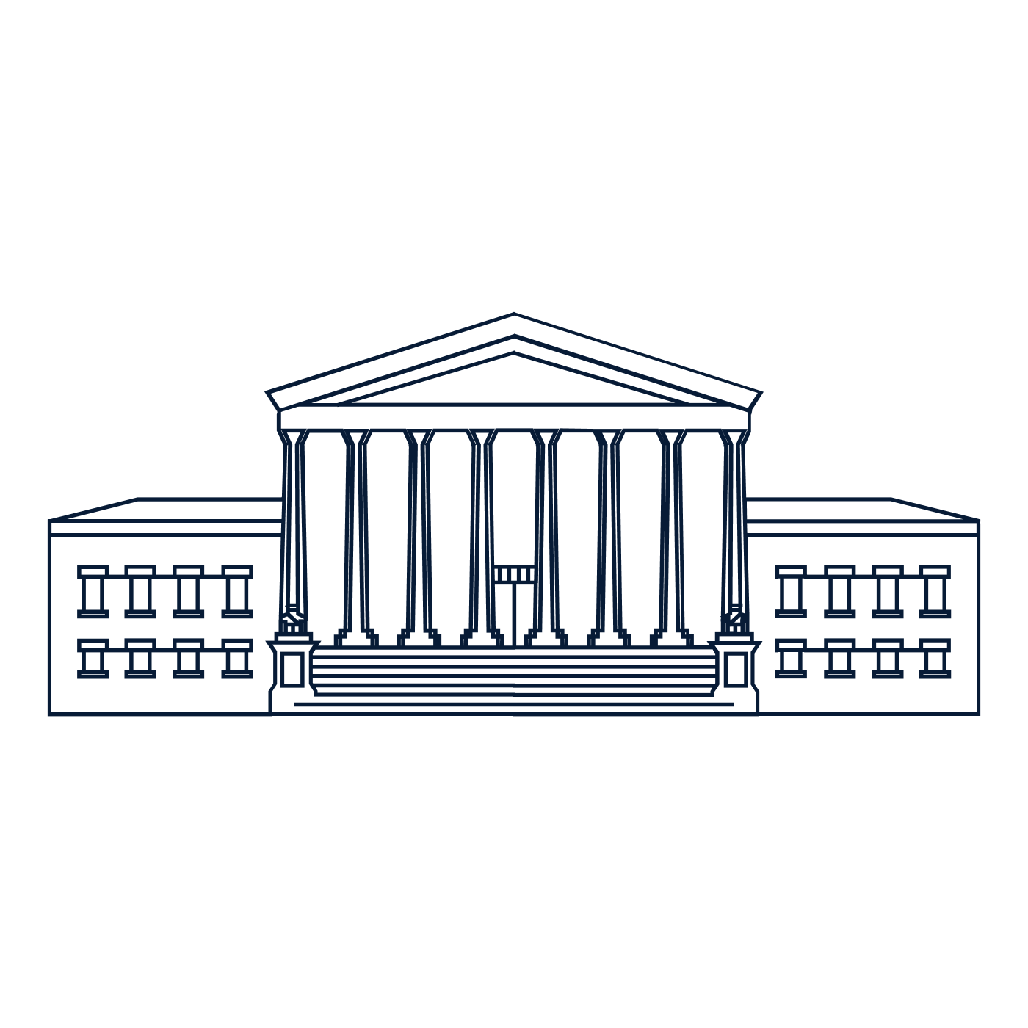
HOW A BILL BECOMES A LAW
Finally, even after a bill becomes a law, people can go to court and challenge that law—arguing that it violates the Constitution.

Slide 15
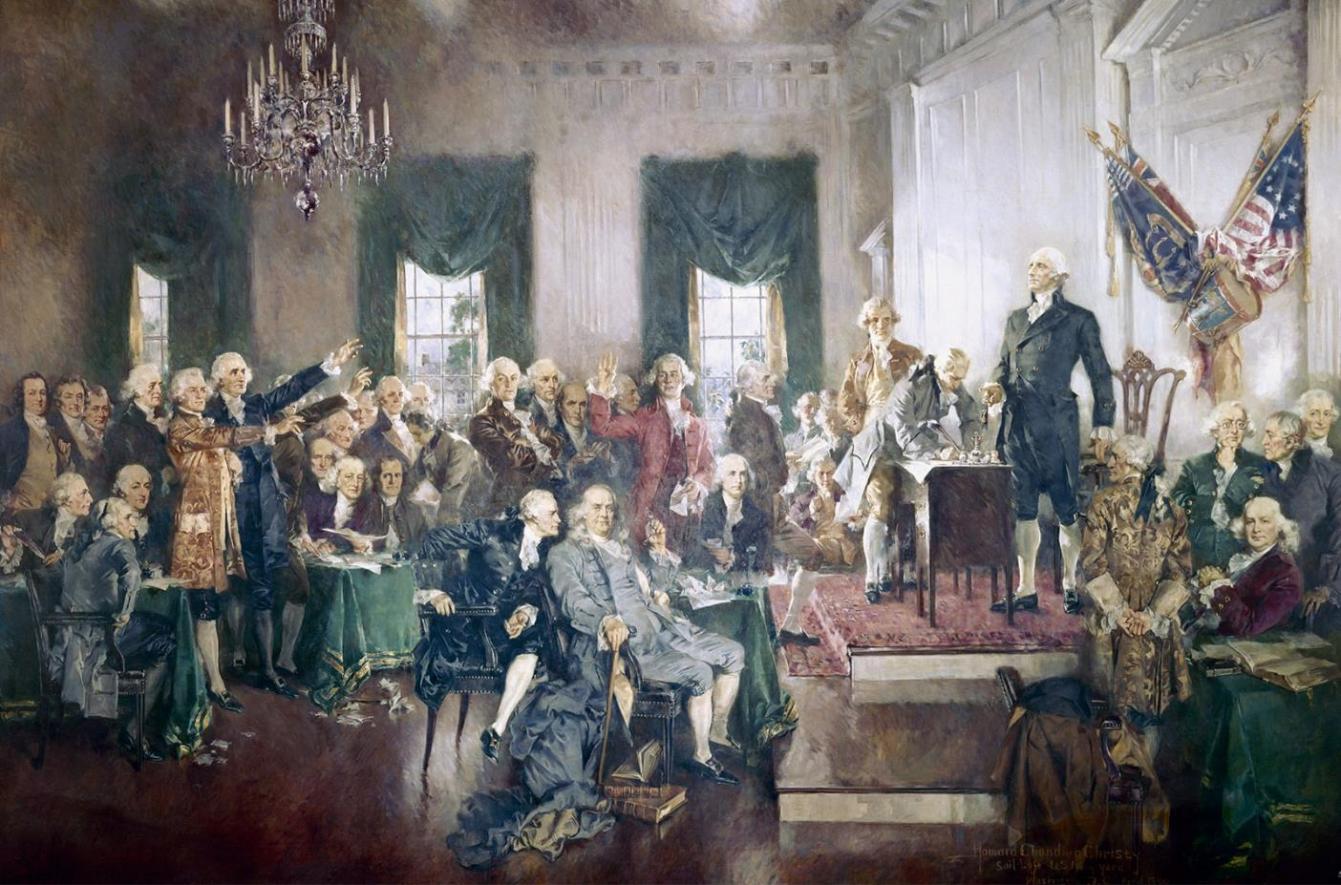
CONSTITUTIONAL CONVENTION
May to September 1787, Philadelphia, PA

Slide 16
DEBATES OVER CONGRESS
Whether to have a single House of Congress or divide Congress into two Houses.
This was an easy question!
They went with two house — Bicameralism
Whether to set the number of representatives for each state by population or by equal representation
This was a harder question for them!

Slide 17
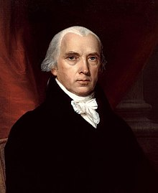
VIRGINIA PLAN
Proportional representation
Two chambers
Power to address issues that were beyond the ability of any single state government
Power to veto state laws which it found to be against the national interest
JAMES MADISON

Slide 18
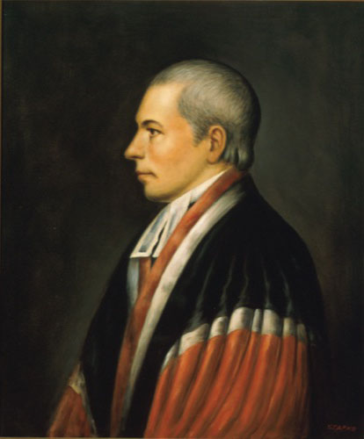
NEW JERSEY PLAN
One-house legislature
Each state—regardless of its size—receiving one vote.
Expand the powers of the national government to address the needs of a growing nation.
Basic structure of the government would remain the same.
WILLIAM PATTERSON

Slide 19
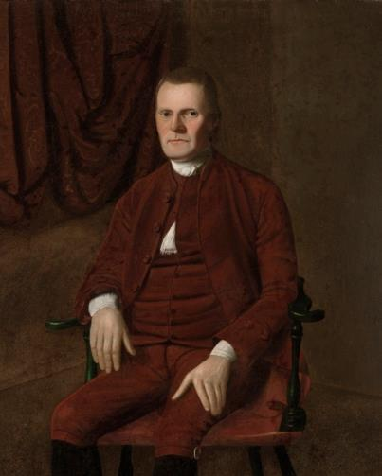
CONNECTICUT COMPROMISE
Two houses—a House of Representative and a Senate.
The House would be elected on the basis of proportional representation.
The Senate would be elected on the basis of equal representation, with each state—regardless of its size—receiving two Senators.
ROGER SHERMAN

Slide 20
DEBATES OVER CONGRESS
Powers of Congress
Under the new Constitution, many Framers wanted to grant the national legislature powers that it lacked under the Articles of Confederation.
But they also wanted to strike a difficult balance: They wanted to strengthen the national government. But they also wanted to maintain the states’ key role in governance.

Slide 21
VIRGINIA PLAN
Congress should be able to “legislate in all cases to which the separate states are incompetent, or in which the harmony of the United States may be interrupted by the exercise of individual Legislation . . . .”
JAMES MADISON

Slide 22
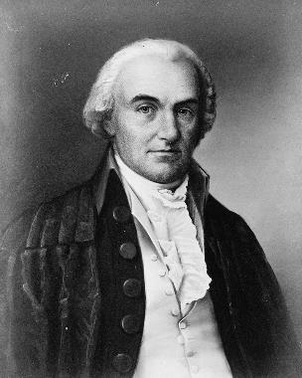
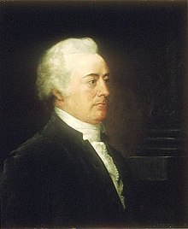
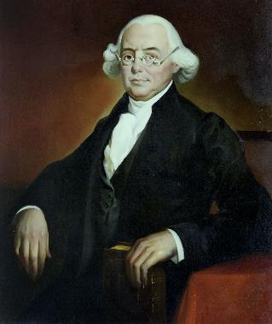
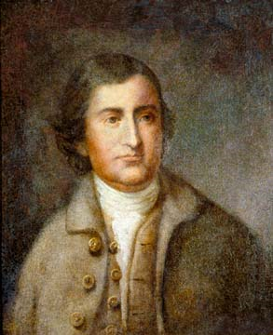
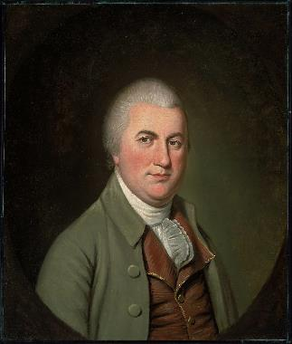
COMMITTEE OF DETAIL
OLIVER ELLSWORTH
JOHN RUTLEDGE
JAMES WILSON
EDMUND RANDOLPH
NATHANIEL GORHAM

Slide 23
COMMITTEE OF DETAIL
The Committee of Detail put together the first full draft of the Constitution—taking Resolutions that the delegates had already passed in the first two months of the Convention and trying to turn them into something that looked like a real Constitution.
The Committee began to write out specific powers—like the power to tax and spend and to regulate interstate commerce.
As part of this process, the Committee also added the Necessary and Proper Clause.

Slide 24
NECESSARY AND PROPER CLAUSE
Before the Constitutional Convention, Congress was limited to the specific powers listed in the Articles of Confederation.
Under the new Constitution, the Framers gave Congress the flexibility to pass laws “necessary and proper” to carry out its enumerated powers—in other words, those powers that were specifically listed in the Constitution. This would become a key source of Congress’s authority over time—and of ongoing constitutional debates from the Convention and the ratification debates all the way up until today.

Slide 25
POWERS OF CONGRESS
Article I, Section 8:
Over time, the most important congressional powers have proven to be its powers to:
“collect Taxes, Duties, Imposts and Excises, to pay the Debates and provide for the common Defence and general Welfare of the United States”
“regulate Commerce with foreign Nations, and among the several States”
“declare War”
“make all Laws which shall be necessary and proper for carrying into Execution the foregoing Powers, and all other Powers vested by this Constitution in the Government of the United States, or in any Department or Officer thereof.”

Slide 26
LIMITS ON THE STATES
Article I, Section 10:
Bans on
Entering into treaties with foreign nations
Coining their own money
Impairing contracts
Article VI: Supremacy Clause:
“This Constitution, and the Laws of the United States which shall be made in Pursuance thereof; and all Treaties made, or which shall be made, under the Authority of the United States, shall be the supreme Law of the Land . . . .”

Slide 27
DEBATES OVER CONGRESS OVER TIME
The Founding up to the Civil War
The Civil War and Reconstruction
Lochner era
New Deal era
The Powers of Congress Today

Slide 28
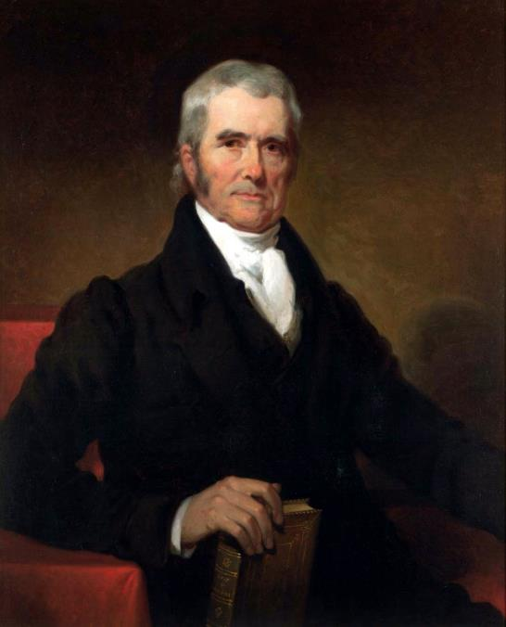
FOUNDING UP TO THE CIVIL WAR
During this period, we see the Marshall Court providing a fairly broad reading of Congress’s powers under the new Constitution.
McCulloch v. Maryland
Upheld the constitutionality of the Second Bank
Gibbons v. Ogden
Addressed the scope of the national government’s power over giving the Commerce Clause a relatively broad reading.
CHIEF JUSTICE JOHN MARSHALL

Slide 29
FOUNDING UP TO THE CIVIL WAR
Big Idea:
While the Marshall Court confirmed over and over again that the Constitution created a Congress with limited powers, it often read those powers in a way that recognized an important role for Congress in regulating commerce and promoting the growth of the nation’s economy.

Slide 30
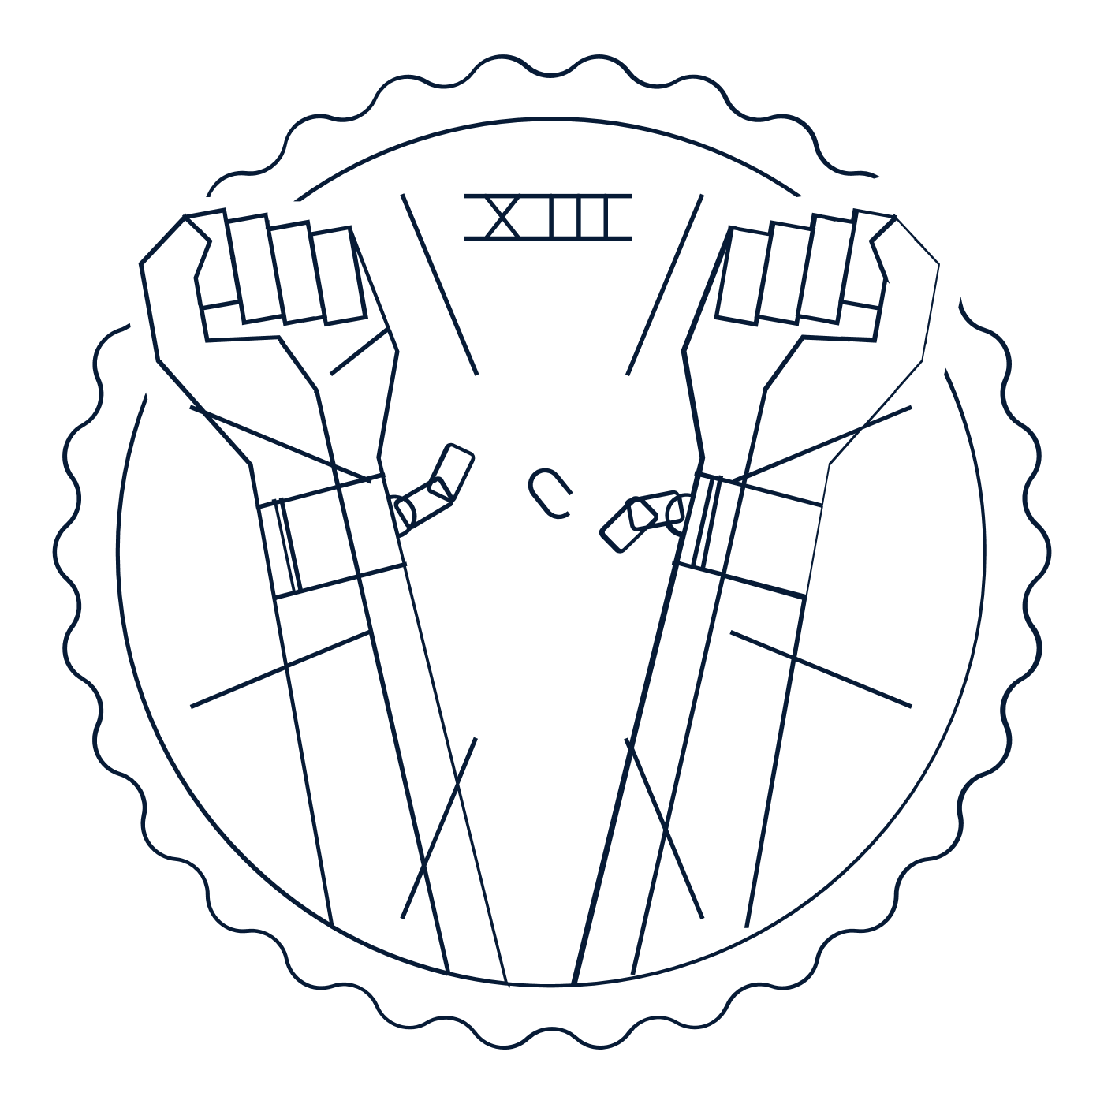


THE CIVIL WAR AND RECONSTRUCTION
13th Amendment
Abolishes slavery
14th Amendment Promises freedom and equality
15th Amendment Protects the right to vote free of racial discrimination
“The Congress shall have the power to enforce, by appropriate legislation, the provisions of this article.”
14th Amendment, Section 5

Slide 31
THE CIVIL WAR AND RECONSTRUCTION
Big Idea:
Reconstruction Amendments granted Congress new powers, but the battle over their meaning—and their promise of freedom and equality—continued.

Slide 32
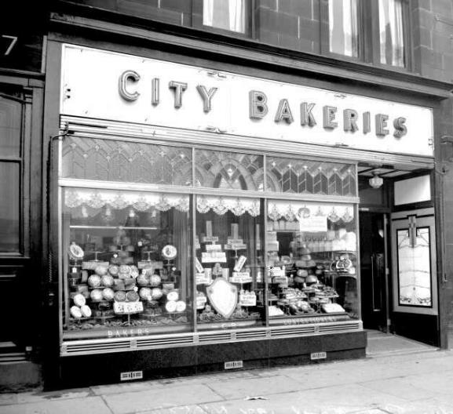
LOCHNER ERA
In the late 1800s and early 1900s the Court read the Constitution in a way that imposed certain limits on Congress’s powers.
Lochner v. New York (1905)
Struck down a New York law regulating the working conditions of bakers. So, it was a case dealing with a state law—not a law passed by Congress. But this period also touched on the scope of Congress’s power—including powers under Commerce Clause and Necessary and Proper Clause.

Slide 33
LOCHNER ERA
Hammer v. Dagenhart (1918)
In 1916, Congress passed the Keating-Owen Child Labor Act—banning the shipment of goods produced by child labor across state lines. A father of a fourteen-year-old boy, who worked in a cotton mill in Charlotte, NC, challenged the law.
And in a 5-to-4 decision, the Supreme Court agreed with the challenger, ruling the law unconstitutional. The Court concluded that this law was really about the rules covering what sorts of workers businesses could hire—not commerce itself.
For the majority, this was the sort of thing that states traditionally handled—not Congress.

Slide 34
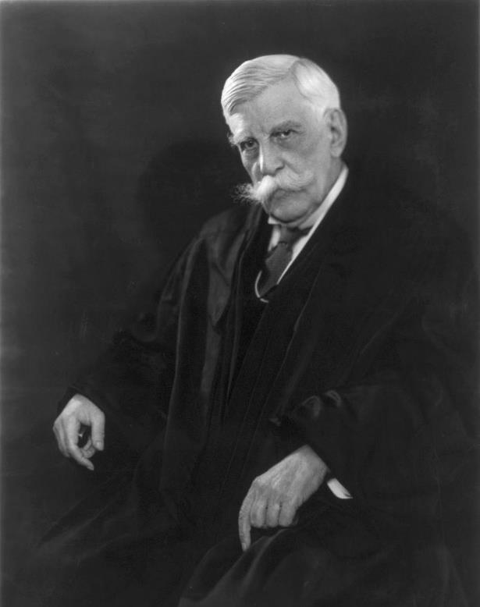
LOCHNER ERA
Dissenting in
Hammer v. Dagenhart (1918)
“It is not for this Court to pronounce when prohibition is necessary to regulation if it may ever be necessary—to say that it is permissible as against strong drink but not as against the product of ruined lives.”
JUSTICE OLIVER WENDELL HOLMES

Slide 35
LOCHNER ERA
ALA Schechter Poultry Corp. v. United States (1935)
“Sick Chickens” Case
Enacted by Congress during the Great Depression, the National Industrial Recovery Act of 1933 gave the President power to approve “codes of fair competition.” FDR approved codes establishing a forty-hour work week and a 50-cent minimum wage.
The Schechter company purchased chickens that had been shipped to New York from other states and then used the poultry for slaughter and resale within New York. They were convicted for violating FDR’s wage and hour rules.

Slide 36
LOCHNER ERA
ALA Schechter Poultry Corp. v. United States (1935)
“Sick Chickens” Case
The Supreme Court struck down the regulations fixing the hours and wages of individuals employed by an interstate business because the regulated activity was only “indirectly” related to interstate commerce: “Where the effect of intrastate transactions upon interstate commerce is merely indirect, such transactions remain within the domain of state power.”

Slide 37
LOCHNER ERA
Big Idea: During the Lochner Era, the Supreme Court faced a huge number of new laws regulating the economy. The Court responded by trimming back on the powers of Congress. While the Court kept far more laws than it struck down, it enforced a vision of a national government with limited powers.

Slide 38
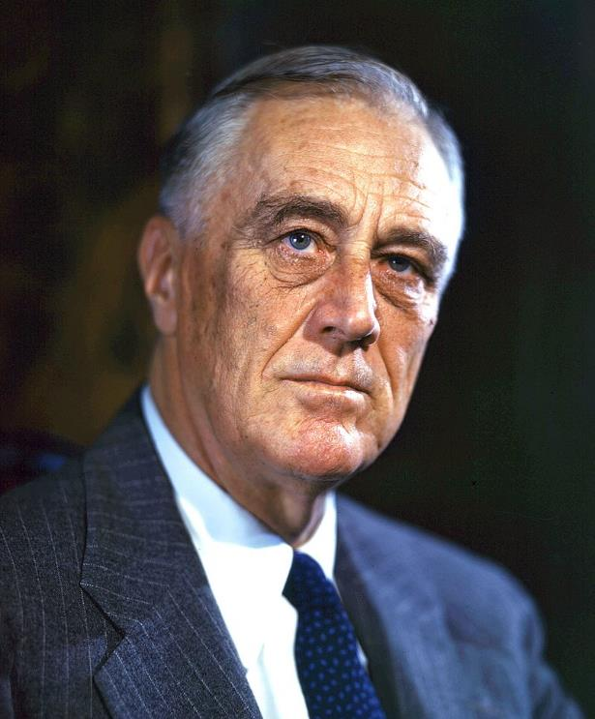
NEW DEAL ERA
Facing the challenges of the Great Depression, Congress passed a range of regulatory programs to stabilize the economy, protect workers, and promote the general welfare.
Beginning in 1937, the Supreme Court upheld these programs, rejecting decades of cases limiting Congress’s powers and reading the Constitution in a way that granted Congress broad powers to regulate the economy under the Commerce Clause.
PRESIDENT FRANKLIN D. ROOSEVELT

Slide 39
NEW DEAL ERA
National Labor Relations Board v. Jones & Laughlin Steel (1937)
Two years after the “Sick Chickens” case, the Supreme Court reversed course.
This was a national law about labor organizing and collective bargaining. The defendant was a steel plant in Pennsylvania interfering with the rights of its employees.
In a is a 5-4 decision the Court rejected Schechter’s approach when intrastate activities had “such a close and substantial relation to interstate commerce that their control is essential or appropriate to protect the commerce from burdens and obstructions.”

Slide 40
NEW DEAL ERA
United States v. Darby (1941)
The Court returned to the same constitutional issue that we saw in Hammer v. Dagenhart: Can Congress regulate the rules that businesses must follow when it comes to their workers? Darby addressed the constitutionality of the Fair Labor Standards Act—a law passed by Congress that set a minimum wage (and maximum hours) for workers. The defendant was a GA lumber manufacturer.
The Court explicitly overruled Hammer v. Dagenhart. The Court concluded that Congress did have the power to ban the shipment in interstate commerce of lumber manufactured by employees whose wages were lower than the minimum wage.

Slide 41
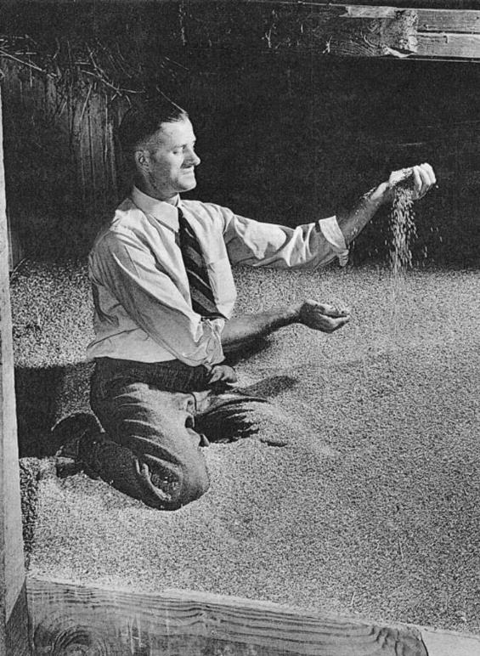
NEW DEAL ERA
Wickard v. Filburn (1942)
The Court rejected a challenge to the Agricultural Adjustment Act of 1938. This law limits the amount of wheat farmers can grow on their own farms.
The case involved the regulation of wheat which had been grown purely for local purposes. In particular, a farmer, Roscoe Filburn, who was growing wheat to feed animals on his own farm. He was not selling.

Slide 42
NEW DEAL ERA
Wickard v. Filburn (1942)
The Court upheld the law. The national government could tell Mr. Filburn to stop growing his wheat. Why?
His wheat—when joined with others doing the same thing—has a substantial effect on the wheat market. He’s using his own wheat—not buying it on the open market. And this would affect the price of wheat that others were bringing to the marketplace.
With Wickard v. Filburn, the New Deal Revolution is complete!

Slide 43
NEW DEAL ERA
Big Idea:
From the New Deal onward, the Supreme Court has read Congress’s Commerce Power very broadly—expanding the reach of Congress’s power over the economy.

Slide 44
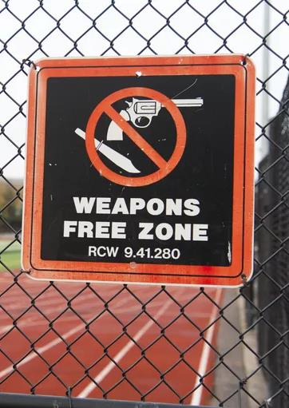
THE POWERS OF CONGRESS TODAY
Finally, in recent decades, the Supreme Court has trimmed back a bit on the powers of Congress.
Lopez v. United States (1995)
Alfonzo Lopez was arrested for carrying a concealed weapon in his high school. He was charged under the federal Gun Free Schools Act of 1990, which banned individuals from bringing guns into school zones. Lopez challenged his conviction, arguing that the law exceeded Congress’s commerce power.

Slide 45
THE POWERS OF CONGRESS TODAY
Lopez v. United States (1995)
In a 5-to-4 decision, the Supreme Court agreed with Lopez and struck down the law. The Court noted that carrying a gun into schools was not an “economic activity.” Therefore, it wasn’t the kind of private activity that Congress had authority to regulate under the Commerce Clause without a clearer link to interstate commerce.
This was the first time that the Court had struck down a law under Congress’s commerce power since the New Deal Revolution of 1937. It was a big deal! In the end, the Court used Lopez to push back against the broadest reach of the New Deal Revolution.

Slide 46
THE POWERS OF CONGRESS TODAY
Big Idea: Even after decisions like Lopez, the Supreme Court still reads the Constitution as granting the national government broad powers to regulate the economy and use its spending power to promote its preferred policies in the states. However, recent Court decisions do search for ways of enforcing certain limits on Congress’s powers—ensuring that ours remains a national government limited powers.

Slide 47
HYPOTHETICAL
Does Congress have the power to pass a law requiring everyone to wear a mask during a pandemic?

Slide 48
HYPOTHETICAL:
Does Congress have the power to pass a law requiring everyone to wear a mask during a pandemic?
Within our system of federalism, this sort of issue is usually the job of a state. It’s at the core of a state’s traditional (police) powers to pass laws that promote the health, safety, and welfare of its residents.
And this power for state governments is confirmed by well-established Supreme Court precedent—most notably in Jacobson v. Massachusetts (1905), upholding a city’s decision to require its residents to get a smallpox vaccine. But that’s state governments. Can Congress do it? Can Congress pass a national mask mandate?

Slide 49
HYPOTHETICAL:
Does Congress have the power to pass a law requiring everyone to wear a mask during a pandemic?
Can Congress pass a national mask mandate? Here’s the key constitutional question: Where in the Constitution does Congress get the power to pass a law like this?
Commerce Clause
Spending Power
Necessary and Proper Clause
AND REMEMBER: A national mask mandate can’t violate other rights enshrined in the Constitution—for instance, those written into the Bill of Rights.

Slide 50
HYPOTHETICAL:
Does Congress have the power to pass a law requiring everyone to wear a mask during a pandemic?
Commerce Clause
Pro: Congress might argue that the pandemic has a substantial effect on interstate commerce
Con: Challengers might argue that the Supreme Court has recently cut back on Congress’s Commerce Power. One key restriction is that there’s a limit to what Congress can force people to do (like force uninsured people to buy health insurance). A broad mask mandate—depending on its specifics—might violate a similar principle.

Slide 51
HYPOTHETICAL:
Does Congress have the power to pass a law requiring everyone to wear a mask during a pandemic?
Spending Power
Congress could try to use this power through some combination of offering new money as incentives, or taking away money.
The Supreme Court has traditionally read Congress’s Spending Power broadly, but:
Congress’s goal must be related to the “general welfare.”
Congress must set clear conditions
The conditions must not otherwise conflict with the Constitution.
And the conditions must not be too coercive.

Slide 52
HYPOTHETICAL:
Does Congress have the power to pass a law requiring everyone to wear a mask during a pandemic?
Necessary and Proper Clause
This Clause is more a way of reinforcing other constitutional powers than an independent source of power in its own right. In other words, this Clause simply builds on other enumerated powers like the Commerce Power. So, Congress still needs to find another specific constitutional hook.

Slide 53
HYPOTHETICAL:
Does Congress have the power to pass a law requiring everyone to wear a mask during a pandemic?
Congress would be in its strongest constitutional position if it limited the mandate to the economic context—e.g., workers on the job and people visiting businesses—and limited its duration to a set period of time or objective indicators associated with the pandemic (e.g., test positivity rate in a specific state or county).
The challengers would be in their strongest constitutional position if Congress passed a broad mandate with few limits and no clear end point.

