Slide 1

ARTICLE II: THE PRESIDENCY AND THE EXECUTIVE BRANCH

Slide 2
FRAMING QUESTIONS
What is the job of the President? What powers and responsibilities does the Constitution give to the President?
How did the Founding generation come up with the idea of the President, and what were their worries?
Which presidential powers were written down, and what has been defined over time?
What was the Founding generation’s vision for the President?
How has the President’s role in our constitutional system changed over time?
What are some of the modern debates over the Presidency? (Like executive orders)

Slide 3
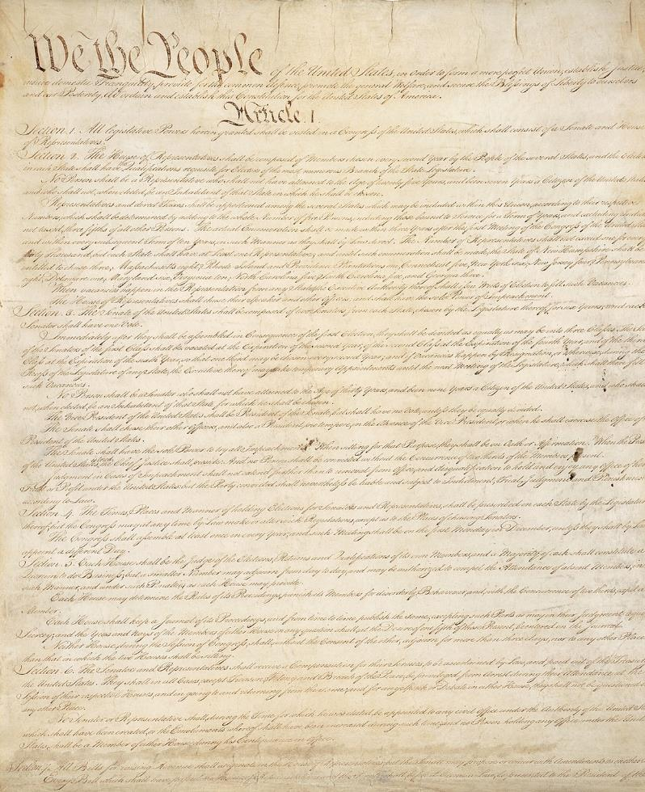
THE CONSTITUTION

Slide 4



THE BRANCHES OF GOVERNMENT
Article I
The legislative branch—Congress—makes the laws.
Article III: The judicial branch—headed by the Supreme Court—interprets the laws.
Article I I: The executive branch—
led by the President—enforces the laws.

Slide 5
ARTICLE II
Article II “vest[s]” the “executive Power . . . of the United States” in a single President.
It sets out the details for how we elect a President (namely, through the Electoral College)
Sets how we might remove one from office (namely, through the impeachment process)
Lists some of the President’s core powers and responsibilities

Slide 6
ARTICLE II
Powers of the President
Her role as “Commander in Chief of the Army and Navy of the United States.”
Her power to appoint judges and executive branch officials with the advice and consent of the Senate.
Her power to “make Treaties, provided two thirds of the Senators present concur.”
Her power to “grant Reprieves and Pardons for Offences against the United States, except in Cases of Impeachment.”
Her duty to “take Care that the Laws be faithfully executed.”

Slide 7
ARTICLE I
In Article I, the Constitution also gives the President the power to veto legislation passed by Congress. (But Congress can override the President’s veto with a 2/3 vote in both Houses of Congress.) At the same time, the Constitution’s system of checks and balances ensures that the other two branches—Congress and the Supreme Court—can check the President.

Slide 8
CHECKS AND BALANCES
The President may be able to veto a law passed by Congress. But Congress has the power to override the President’s veto—to cancel it—with a 2/3 vote in both Houses of Congress. The Constitution also gives the President the power to appoint Supreme Court Justices, but those appointments must be approved by the Senate. The same goes for new treaties with other countries

Slide 9
ARTICLE III
Finally, the Supreme Court has the power to review the President’s actions—for instance, new executive orders—and decide whether those actions were constitutional or unconstitutional.

Slide 10
22ND AMENDMENT
“No person shall be elected to the office of the President more than twice, and no person who has held the office of President, or acted as President, for more than two years of a term to which some other person was elected President shall be elected to the office of the President more than once. . . .”

Slide 11
JOB REQUIREMENTS
35 years old
A natural born citizen of the United States
A resident of the United States for 14 years

Slide 12
ARTICLE II, SECTION 4
Removal Process
“President, Vice President and all civil Officers of the United States” shall be removed from office if convicted in an impeachment trial of “Treason, Bribery, or other high Crimes and Misdemeanors.”

Slide 13
ARTICLE II, SECTION 4
Removal Process
The House of Representatives has the power to impeach—by a majority vote
The Senate has the power to hold impeachment trials and remove a President from office with a 2/3 vote.
Only three Presidents have been impeached and no President has been removed by the Senate.

Slide 14
25TH AMENDMENT
Section 1 says that when the President dies, resigns, or is removed from office, the Vice President becomes President.
Section 2 sets out the process for filling an open seat for Vice President. The President nominates a new Vice President, and both the House and the Senate must approve of the pick by majority vote in each House.

Slide 15
25TH AMENDMENT
Section 3 permits the President to temporarily transfer power by a written statement that he is “unable to discharge the powers and duties of his office.” The President can then resume his responsibility with a second written statement saying that he’s ready for duty.
Section 4 addresses the situation where a President refuses to transfer his duties when others might conclude that he is unable to fulfill them. It’s a pretty complicated process.

Slide 16
BIG IDEA
With the new President, the Founding generation set out to establish an executive head stronger than the weak Governors in charge of the states at the time, but weaker than a king.

Slide 17
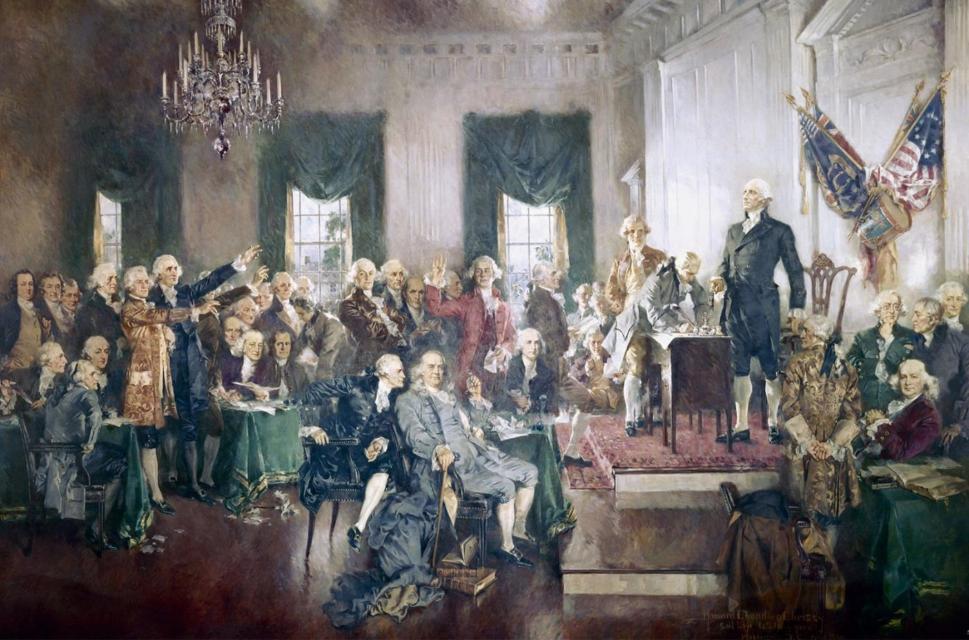
CONSTITUTIONAL CONVENTION
May to September 1787, Philadelphia, PA

Slide 18
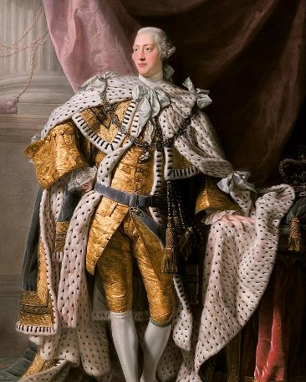
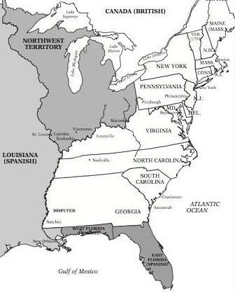
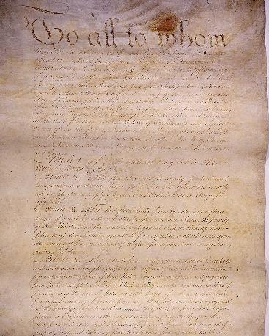
HOW TO STRUCTURE THE PRESIDENCY
Kings of Europe =
Too powerful
States’ Governors =
Too weak to govern effectively
Article of Confederation =
No true executive

Slide 19
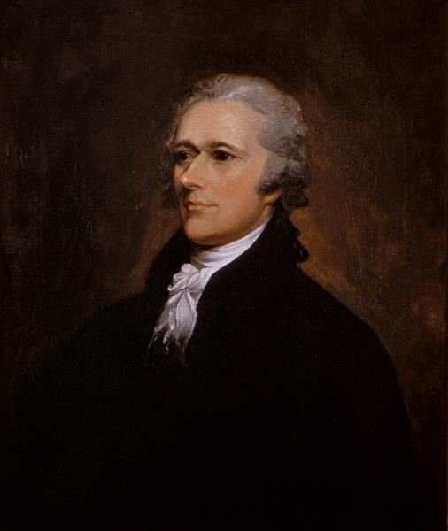
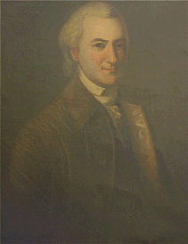
HOW TO STRUCTURE THE PRESIDENCY
Alexander Hamilton
John Dickinson
Alexander Hamilton and John Dickinson favored a single, strong national executive.

Slide 20
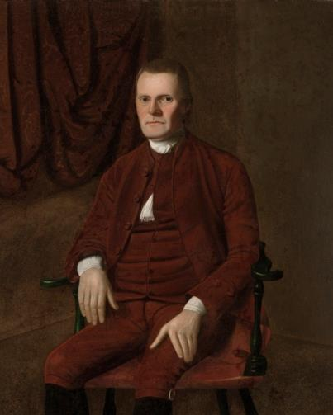
HOW TO STRUCTURE THE PRESIDENCY
Roger Sherman viewed the executive as “nothing more than an institution for carrying the will of the Legislature into effect.”
Roger Sherman

Slide 21
DEBATES OVER THE PRESIDENCY
How to elect the President
How long the President’s term should be
Whether the President should be allowed to run for reelection
How a President could be removed from office during his term (so, the question of impeachment and removal).

Slide 22
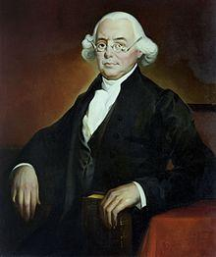
DEBATES OVER THE PRESIDENCY
The delegates repeatedly learned that a decision made on one of these issues changed their views about one (or more) of the others. Under these conditions, no single delegate or faction could control the course of the debate—although, as I said earlier, I think that James Wilson can most persuasively lay claim to being called the “Father of the American Presidency.”
James Wilson

Slide 23
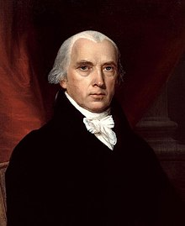
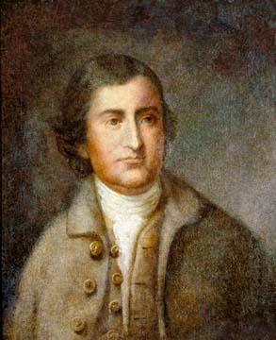
THE VIRGINIA PLAN
James Madison
Edmund Randolph

Slide 24
THE VIRGINIA PLAN
The Virginia on the Executive Branch:
There should be an Executive, chosen by Congress, to serve a single term
The Executive should have a joint veto power (with the judiciary) over acts of the National Legislature, subject to a supermajority legislative override.
The Virginia Plan did not:
Specify the length of the President’s term
Say whether the President would play any role in matters of war and diplomacy
Grant the President any powers of appointment

Slide 25
DEBATES OVER THE PRESIDENCY
Phase One (June 1-6): Produced agreement on two major points: to place the executive power in a single person, who would, in turn, have a limited veto over legislation.
Phase Two (July 17-26): Framers struggled with how best to balance a (relatively) independent executive with different options for election and length in office. Much of this discussion involved weighing the relative disadvantages of election by the legislature, the American people, or the Electoral College.
Phase Three (September 4-8): The delegates’ lingering concerns about an (elitist and corrupt) Senate led them to empower the President.

Slide 26
DEBATES OVER THE PRESIDENCY:
DEBATE ONE
First, the delegates had a heated debate over whether to have a single President or whether to divide the executive power between multiple people.

Slide 27
SHOULD THERE BE A SINGLE EXECUTIVE?
James Wilson—initially standing alone—argued vigorously “that the Executive consist of a single person.”
James Wilson

Slide 28
SHOULD THERE BE A SINGLE EXECUTIVE?
Connecticut’s Roger Sherman suggested leaving the entire subject—and the structure of the Presidency itself—to Congress.
Roger Sherman

Slide 29
SHOULD THERE BE A SINGLE EXECUTIVE?
Virginia’s Edmund Randolph—sponsor of the Virginia Plan—described “unity in the Executive magistracy” (so, a single President) as “the foetus of monarchy.” In short, he criticized Wilson for taking the British Constitution (and its king) “as our prototype.”
Edmund Randolph

Slide 30
SHOULD THERE BE A SINGLE EXECUTIVE?
Wilson countered that a single President—if structured properly—would balance the advantages of a powerful king (namely, “energy” and “dispatch”) with “responsibility” (in other words, checks by Congress and the American people).

Slide 31
SHOULD THERE BE A SINGLE EXECUTIVE?
The Result:
Wilson eventually convinced his colleagues (including Madison) of the viability of an energetic, single President. He argued that the more the President was held responsible to the American people, the more power he could safely be given.

Slide 32
DEBATES OVER THE PRESIDENCY:
DEBATE TWO
Second, the delegates debated the length of the President’s time and whether to impose term limits on the President.

Slide 33
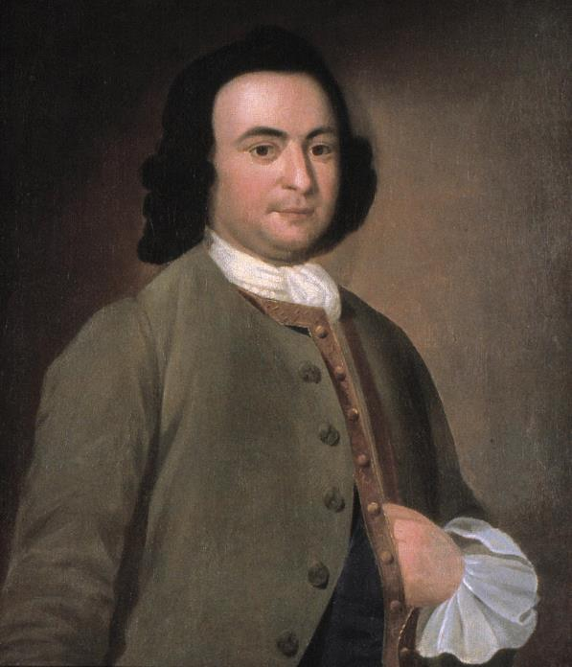
SHOULD THERE BE TERM LIMITS?
On one side was George Mason, strongly in support of term limits. He argued that it was “the very palladium of Civil liberty, that the general officers of State, and particularly the executive, should at fixed periods return to that mass from which they were first taken, in order that they may feel & respect those rights & interests, which are again to be personally valuable to them.”
George Mason

Slide 34
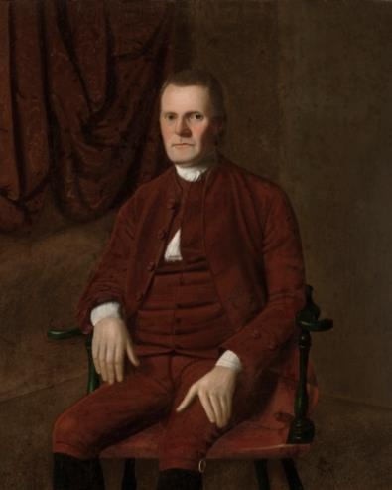
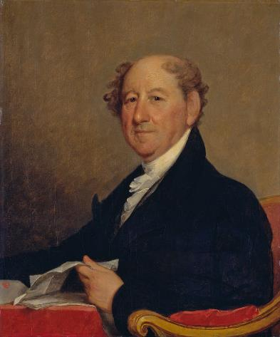
SHOULD THERE BE TERM LIMITS?
On the other side were delegates—like Roger Sherman and Rufus King—who saw eligibility for reelection as valuable.
They argued, “He who has proved himself to be most fit for Office, ought not to be excluded by the constitution from holding it.”
Roger Sherman
Rufus King

Slide 35
SHOULD THERE BE TERM LIMITS?
The Result:
The delegates settled on a four-year term, with the President able to run for reelection.

Slide 36
DEBATES OVER THE PRESIDENCY:
DEBATE THREE
Third, the delegates debated how to elect a President

Slide 37
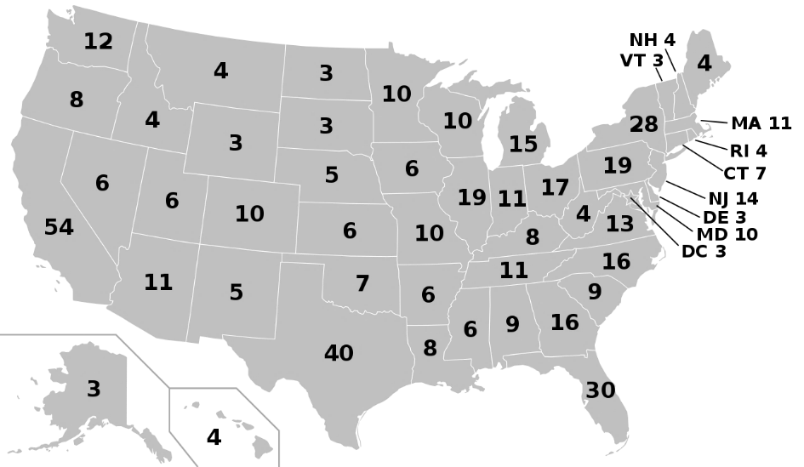
THE ELECTORAL COLLEGE TODAY
Today, the Electoral College is made up of 538 electors drawn from the states and the District of Columbia.

Slide 38

THE ELECTORAL COLLEGE TODAY
Under Article II of the Constitution, the states are given a number of electors equal to their congressional delegation.
PENNSYLVANIA
17 Members of the House of Representatives
+2 Senators
19 Electoral Votes!

Slide 39
THE ELECTORAL COLLEGE TODAY
Today, the American people vote for President and Vice President on the Election Day. Technically, these popular votes determine which electors will be appointed to the Electoral College from each state.
The electors eventually meet in December to cast their votes for President and Vice President.
If a candidate receives a majority of these votes in the Electoral College, she wins—even if she lost the popular vote.

Slide 40





THE ELECTORAL COLLEGE TODAY

Slide 41
THE ELECTORAL COLLEGE TODAY
If no candidate secures a majority in the Electoral College, then the election is sent to Congress. (As happened in the Election of 1824.)
The U.S. House of Representatives—voting as states, not individuals—selects the President and the Senate selects the Vice President.

Slide 42
HOW TO ELECT THE PRESIDENT
At the Constitutional Convention, the delegates staked out a range of positions on how to elect a President:
Direct election by popular vote
Selected by members of congress
Electors selected state governors
An electoral college

Slide 43
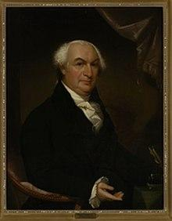
HOW TO ELECT THE PRESIDENT
Election by Congress had the advantage of placing the decision in the hands of some of the nation’s most knowledgeable leaders.
However, the concern was, as Gouverneur Morris warned, that the result would eventually be the “work of intrigue, of cabal, and of faction,” producing a President who would become a mere tool of his supporters in Congress.
Gouverneur Morris

Slide 44
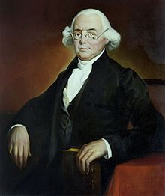
HOW TO ELECT THE PRESIDENT
Election by popular vote—proposed by James Wilson had the advantage of rooting the Presidency in popular sovereignty.
James Wilson

Slide 45
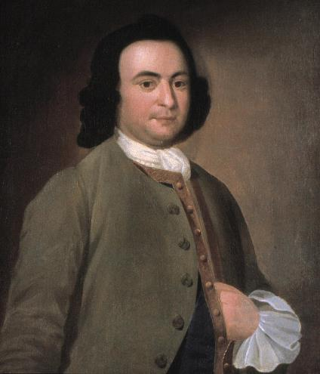
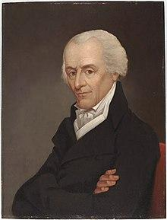
HOW TO ELECT THE PRESIDENT
Election by popular vote
Some delegates—for instance, Elbridge Gerry — opposed this idea based on sheer elitism. However, others (like George Mason) were concerned that the size of the country would make it difficult to carry out a national election—and for the average voter to know anything about an out-of-state candidates’ record.
George Mason
Elbridge Gerry

Slide 46
HOW TO ELECT THE PRESIDENT
The Electoral College’s key advantage was that it would keep the President independent of the legislature. They would have their own independent base of support that would dissolve after the election.
Key disadvantages were the logistics of getting the Electors to meet and the related expenses. The Framers also feared whether the Electors would “be men of the 1st or even the 2d grade in the States.”

Slide 47
HOW TO ELECT THE PRESIDENT
The Result:
Late in the Convention, the delegates settled on the Electoral College as a compromise between those who supported congressional election of the President and those who supported a role for the American people in selecting a President.

Slide 48
DEBATES OVER THE PRESIDENCY:
DEBATE FOUR
Fourth, the delegates debated whether to grant the President a role in the legislative process as a check on Congress.

Slide 49
PRESIDENT’S CHECK ON CONGRESS
James Madison proposed a Council of Revision—with the President sitting with members of the federal judiciary to review law passed by Congress and veto any bad ones.
James Madison

Slide 50
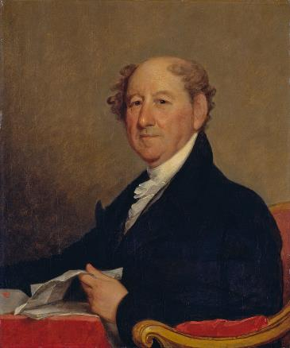
PRESIDENT’S CHECK ON CONGRESS
For Elbridge Gerry and Rufus King, Madison’s proposed Council of Revision was flawed because it would give judges an improper role in legislating, while making it difficult for them to “expound the law as it should come before them, free from the bias of having participated in its formation.”
Rufus King
Elbridge Gerry

Slide 51

PRESIDENT’S CHECK ON CONGRESS
James Wilson and Alexander Hamilton then pushed for an absolute veto for the President—one that couldn’t be overridden by a vote in Congress. But this was too much for the delegates to accept and drew the support of only Wilson, Hamilton, and Rufus King.
James Wilson
Alexander Hamilton

Slide 52
PRESIDENT’S CHECK ON CONGRESS
The Result:
Gerry’s proposal for a limited veto passed decisively, 8 to 2. So, rather than having the President serve as part of Madison’s Council of Revision, the delegates gave the President his own veto power—with Congress given the authority to override it with a 2/3 vote in both Houses of Congress.

Slide 53
DEBATES OVER THE PRESIDENCY:
DEBATE FIVE
Finally, the delegates debated the process for removing a President from office before the end of his term—in other words, the process of impeachment and removal.

Slide 54
PRESIDENTIAL REMOVAL
The Result:
In July, the delegates agreed to a version of the impeachment and removal power that was broader than the one in the final draft—with removal allowed for “mal Practice or Neglect of Duty.”
The Committee of Detail narrowed the impeachment and removal power, limiting it to “Treason or Bribery or Corruption.” The final text settled on “Treason, Bribery, or other High Crimes and Misdemeanors.”

Slide 55
CAN THE PRESIDENT DO THAT?

Slide 56
TESTS OF PRESIDENTIAL POWER
Can the President do that?
Can she put government money towards building a border wall?
Can her Administration issue a sweeping regulation to regulate air pollution?
Can she issue an executive order blocking immigration from certain countries?
What about one to require everyone in the nation to wear a mask? Or to stay at home?
Can she send American troops to another country to defend American diplomats? To protect innocent civilians from a violent dictator?
What about trying to overthrow that dictator?

Slide 57
EXECUTIVE ORDERS
The American Bar Association describes an executive order as “a signed, written, and published directive of the President.”
They are rooted in the President’s role in leading the executive branch. And the President’s Article II duty to “take care” that the laws are “faithfully executed.”

Slide 58
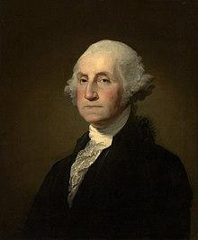
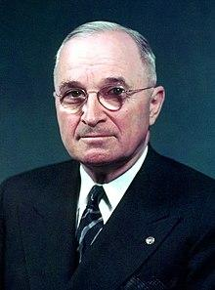
EXECUTIVE ORDERS
President Washington used them to ask his executive branch officials to prepare reports for him.
And President Truman used an executive order to desegregate the armed forces.
George Washington
Harry Truman

Slide 59
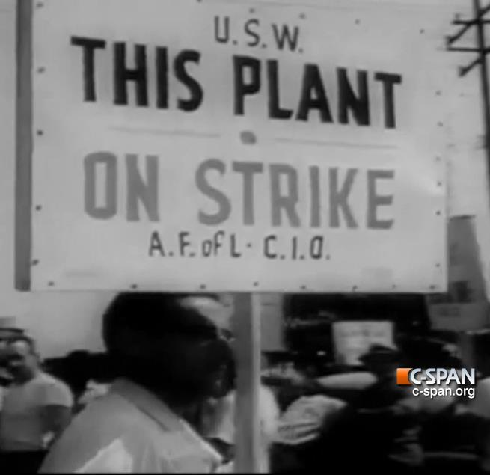
YOUNGSTOWN SHEET & TUBE CO. V. SAWYER (1952)
“THE STEEL SEIZURE CASE”
Steel workers were going on strike, and President Truman argued that a steel strike was a threat to national security because the Army needed steel to conduct the war.
Without congressional approval, Truman decided to seize the steel mills under his Article II Commander-in-Chief Power. (Using an executive order)

Slide 60
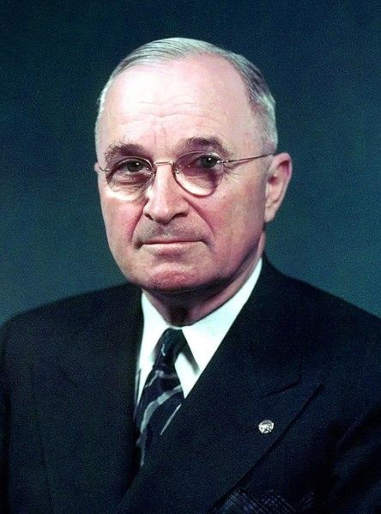
YOUNGSTOWN SHEET & TUBE CO. V. SAWYER (1952)
“THE STEEL SEIZURE CASE”
Truman argued that Article II made him commander-in-chief. Read broadly, this power gave him broad authority to take actions necessary to fight (and win) a war. If the steel workers went on strike, that would undermine the war effort. Therefore, the President had the power to step in and seize the steel mills.
President Harry Truman

Slide 61
ARTICLE II, SECTION 2
COMMANDER-IN-CHIEF CLAUSE
“The President shall be Commander in Chief of the Army and Navy of the United States, and of the Militia of the several States, when called into the actual Service of the United States.”

Slide 62
YOUNGSTOWN SHEET & TUBE CO. V. SAWYER (1952)
“THE STEEL SEIZURE CASE”
This dispute ended up at the Supreme Court, and the Court ruled against Truman, concluding that he couldn’t seize the steel mills on his own.
Some Justices agreed with Truman, but the majority ruled that the President’s Commander-in-Chief Power didn’t permit him to seize a steel mill inside the United States—even if it helped the war effort. (The majority opinion mostly focused on the separation of powers.)
The President needed congressional approval to do that.

Slide 63
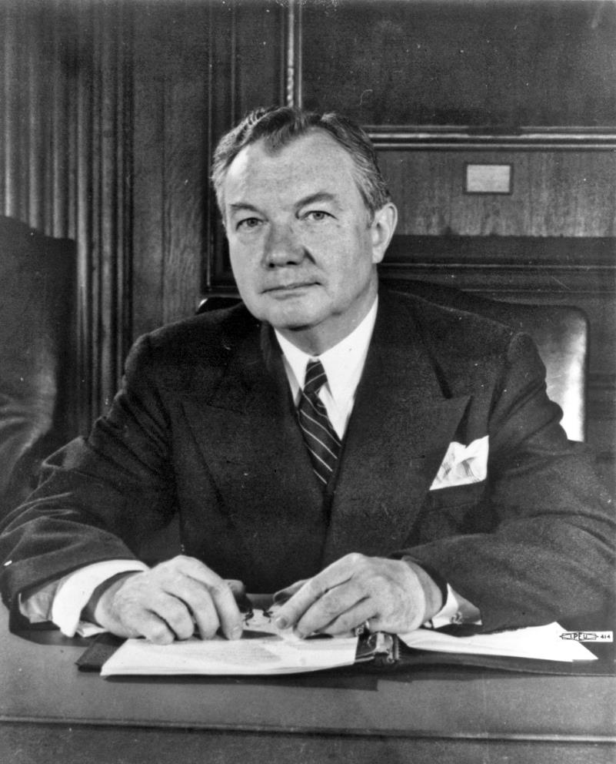
Justice Robert Jackson

Slide 64
YOUNGSTOWN SHEET & TUBE CO. V. SAWYER (1952)
“THE STEEL SEIZURE CASE”
Justice Jackson, identified three different categories for analyzing presidential power.
When the President acts with congressional approval, he has the maximum authority to act.
When he acts in the face of congressional disapproval, he has the least authority to act.
And when Congress has neither approved nor disapproved of the President’s actions, the President then acts in a “zone of twilight”—somewhere between those two situations.

Slide 65
YOUNGSTOWN SHEET & TUBE CO. V. SAWYER (1952)
“THE STEEL SEIZURE CASE”
Applying his analysis to The Steel Seizure Case, Jackson reasoned:
Congress hadn’t authorized the seizure of the steel mills.
And the President had no non-military—in other words, no independent source of— authority to act. (Like an existing law passed by Congress.)
Therefore, Jackson concluded that the President had acted unconstitutionally.

Slide 66
YOUNGSTOWN SHEET & TUBE CO. V. SAWYER (1952)
“THE STEEL SEIZURE CASE”
Big Idea:
When the President acts side by side with Congress, his power is at its highest level. (The Supreme Court tends to uphold his actions.) However, when the President acts on his own—especially in the face of congressional disapproval—his powers are at their lowest level. (And the Supreme Court may rule against him.)

Slide 67
WHERE IS THE PRESIDENT GETTING HER AUTHORITY ACT?
Sometimes the President argues that the Constitution itself grants her the power to act.
Sometimes she draws on laws passed by Congress and sometimes she looks to previous court decisions to guide her actions.
Regardless, she must root her authority in some source of law. Otherwise, her executive actions are invalid.

Slide 68
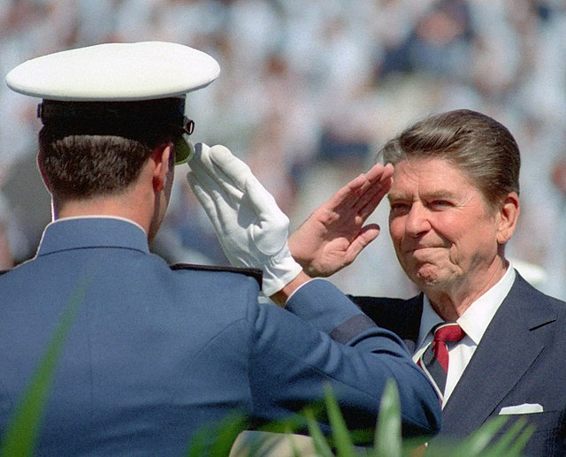
THE PRESIDENT AND THE MILITARY

Slide 69
ARTICLE I, SECTION 8
“The Congress shall have the power…
To declare War…”

Slide 70
ARTICLE II, SECTION 2
“The President shall be Commander in Chief of the Army and Navy of the United States, and of the Militia of the several States, when called into the actual Service of the United States.”

Slide 71

COMMANDER-IN-CHIEF CLAUSE
“These cryptic words have given rise to some of the most persistent controversies in our constitutional history,”
Justice Robert Jackson

Slide 72
COMMANDER-IN-CHIEF CLAUSE
How far does the president’s authority go?
Scholars generally agree that the Commander-in-Chief Clause has two separate—but related—purposes.
First, it ensures civilian control over the military. In other words, it ensures that we don’t live in a military state.
Second, it places this control in the hands of a single person—a President elected by the American people.
Scholars also generally agree that only Congress can formally declare war.

Slide 73
COMMANDER-IN-CHIEF CLAUSE
When can the president use force?
Presidents may use military force if specifically authorized by Congress. Authorization may come from a formal declaration of war, but it can also come from some other form of congressional approval.
Presidents are thought to have independent authority to use military force in response to sudden attacks on the United States.
Presidents may use his constitutional authority to deploy U.S. forces in situations that do not amount to war.

Slide 74
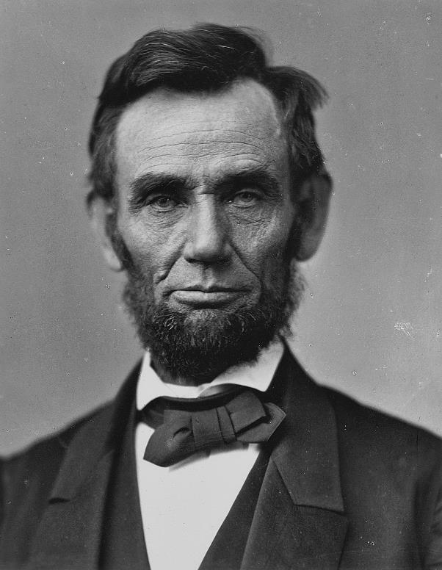
THE PRIZE CASES (1863)
President Lincoln had set up a blockade of Southern ports without a formal declaration of war by Congress
President Abraham Lincoln

Slide 75
THE PRIZE CASES (1863)
The Court upheld President Lincoln’s blockade in a 5-4 decision. The Court explained, “The President was bound to meet [a war] in the shape it presented itself, without waiting for Congress to baptize it with a name.”
The dissent—authored by Justice Nelson—countered that only Congress had the constitutional power to declare war. Congress would later pass a law approving of President Lincoln’s actions.

Slide 76
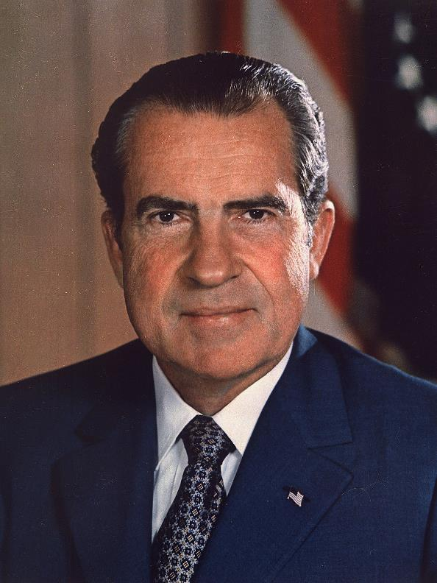
WAR POWERS RESOLUTION (1973)
Congress passed the War Powers Resolution in response to the Vietnam War. In particular, Congress was upset with President Nixon after he sent bombers into Cambodia without congressional approval—an act that Nixon’s critics viewed as expanding the Vietnam War and taking military action against a separate nation, a potential act of war. Congress and the President had sparred over the scope of presidential power throughout the Vietnam War.
President Richard Nixon

Slide 77
WAR POWERS RESOLUTION (1973)
The War Power Resolution said:
In the case of a sudden attack, the President could act without congressional approval. The President would have to notify Congress within 48 hours of the time that she sent troops without congressional approval. The President could then (generally) keep those troops on the ground for 30 days. Otherwise, the President needed to get congressional approval before using military force.

Slide 78
WAR POWERS RESOLUTION (1973)
Presidents have argued that the War Powers Resolution violates the President’s Commander-in-Chief Power and is, therefore, unconstitutional.
They argue that Article II’s Commander-in-Chief Clause gives the President control over the nation’s military operations, and that he can generally act as he thinks best to protect the nation—including decisions to send troops into the field. On this view, the president can take a variety of actions to preserve national security without formal approval by Congress.

Slide 79
WAR POWERS RESOLUTION (1973)
At the same time, others side with Congress.
They argue that the Founding generation granted Congress a central role in determining when the nation used military force and they wrote it into the Constitution itself—with Article I’s Declare War Clause. On this view, the President’s powers have grown too much in recent decades—far beyond what the Founding generation imagined. Congress has abandoned its responsibilities in this area. The War Powers Resolution is a way of reinvigorating Congress’s role in military policy.

Slide 80
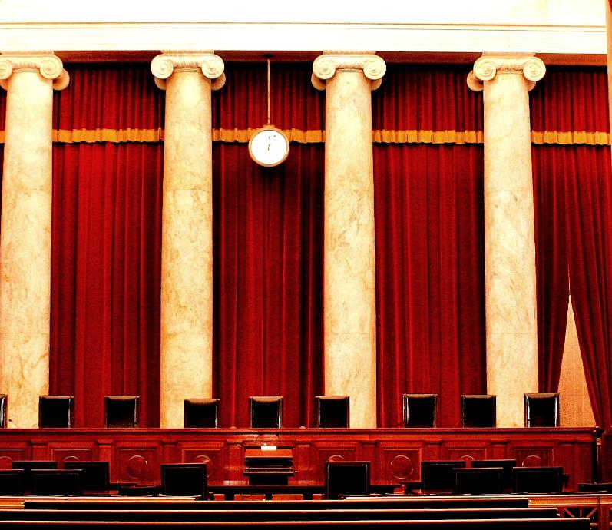
WAR POWERS RESOLUTION (1973)
Importantly, the Supreme Court hasn’t weighed in on the Resolution’s constitutionality. So, this remains a topic of ongoing constitutional debate—and institutional conflict.
?

Slide 81
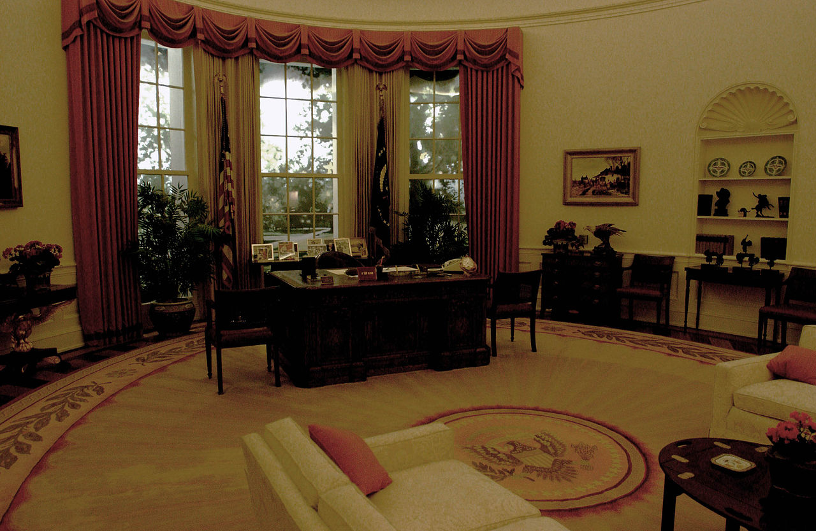
EXECUTIVE POWER

Slide 82
ARTICLE II, SECTION 1
“The executive power shall be vested in a President of the United States.”

Slide 83
MEANING OF EXECUTIVE POWER
Key constitutional debates turn on the meaning of the phrase “executive power.”
What does it mean?
What does it include?

Slide 84
MEANING OF EXECUTIVE POWER
Some have argued that this language simply means that the Constitution establishes a single President, and that’s about it. In this view, this key language—“the executive power of the United States”—didn’t have a set meaning at the Founding. It simply refers to the presidential powers that the Constitution specifically lists in the document itself—for instance, those spelled out in writing in Article II.

Slide 85
MEANING OF EXECUTIVE POWER
At the same time, others have argued that the Constitution—and this language—does more than that, granting the President a set of powers not specifically listed in the Constitution that establish areas in which the President can act and, importantly, Congress cannot.
On this view, the “executive power” meant something specific at the Founding—the sorts of things that the Founding generation would have expected an executive to do.

Slide 86
MEANING OF EXECUTIVE POWER
These questions pits Congress’s power to check the President against the President’s authority to lead the executive branch without congressional interference.
If advocates for congressional power win this debate, Congress would have the power to limit the President’s discretion to fire executive branch officials—and, as a result, check her authority to lead the executive branch however she deems fit.
At the same time, if advocates of presidential power win, it’s possible that the Supreme Court would have to strike down various laws that limit the President’s authority to control certain parts of the executive branch.

Slide 87
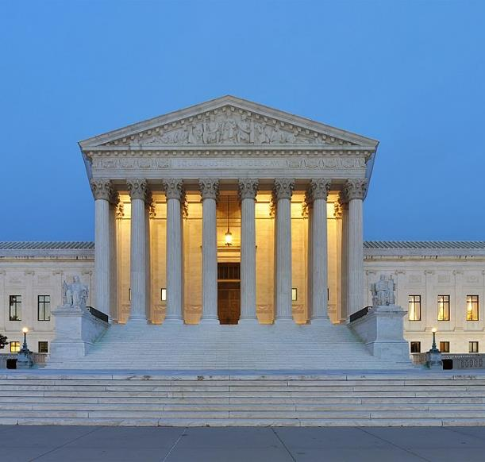
PRESIDENTIAL POWER AND
THE SUPREME COURT
Myers v. United States (1926)
In a case involving presidential dismissal of a postmaster, the Court weighed in on the side of broad presidential power to fire executive branch officials—claiming that Article II’s Vesting Clause granted the President authority to execute the law and to remove executive officials.

Slide 88
PRESIDENTIAL POWER AND
THE SUPREME COURT
Humphrey’s Executor v. United States (1935)
In a case involving the Federal Trade Commission, the Court held that Congress could limit the President’s ability to remove a commissioner.

Slide 89
PRESIDENTIAL POWER AND
THE SUPREME COURT
Morrison v. Olson (1988)
The Court sustained a law that said the executive could remove independent prosecutors for just cause only.

Slide 90
PRESIDENTIAL POWER AND
THE SUPREME COURT
Seila Law LLC v. Consumer Financial Protection Bureau (2020)
In a 5-4 decision Seila Law (and in another recent case called PCAOB), the Roberts Court has moved back in the other direction— striking down certain laws that try to make it more difficult for the President to fire the heads of government agencies.

Slide 91
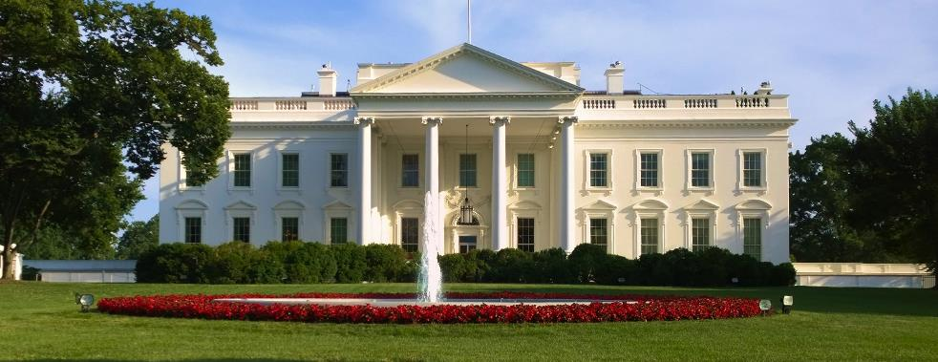
PRESIDENTIAL POWER OVER TIME
The Founding generation assumed that the legislative branch—in other words, Congress—would be the most powerful branch. However, many scholars from across the ideological spectrum argue that over time, presidential power has expanded—with many arguing that the Presidency has proven to be the most powerful branch of government.

