Slide 1
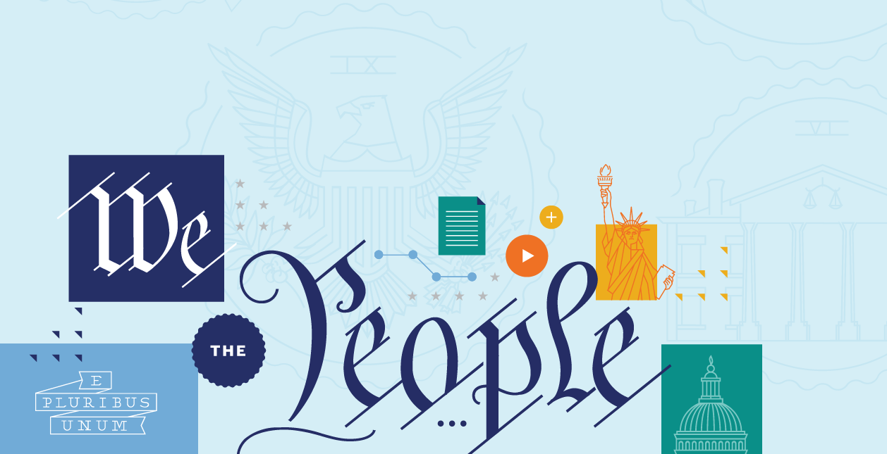
ARTICLE III: SUPREME COURT IN REVIEW: FROM JUDICIAL SELECTION TO CURRENT CASES

Slide 2
POP QUIZ
How many Justices are on the Supreme Court?
Who nominates and confirms the Justices?
What are the three levels of the federal system?
What are the qualifications for Justices?

Slide 3
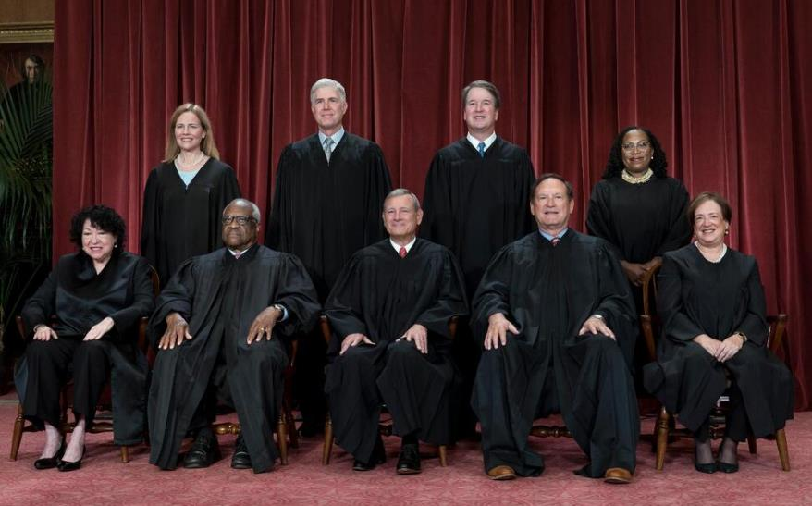
SCOTUS “CLASS PHOTO”
The Roberts Court in 2022

Slide 4

SCOTUS “CLASS PHOTO”
8
6
7
9
John G. Roberts, Jr.
Clarence Thomas
Samuel A. Alito, Jr.
Sonia Sotomayor
Elena Kagan
Neil M. Gorsuch
Brett M. Kavanaugh
Amy Coney Barrett
Ketanji Brown Jackson
4
2
1
3
5
The chief justice is seated front and center. The associate justices are positioned in order of seniority.

Slide 5
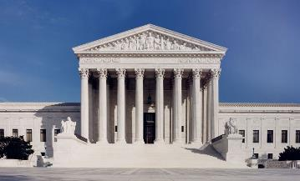
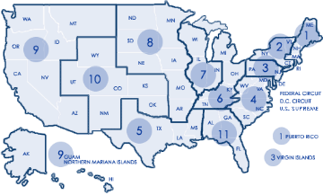
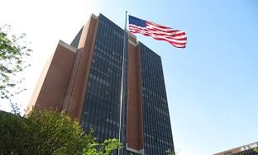
Supreme Court
This is the highest level in the national courts system
They have original jurisdiction in limited cases, but most cases are appeals through certiorari process
The SCOTUS is made up of nine justices
Court of Appeals
This is the intermediate level in the national courts system
There are 12 circuit courts
They have no original jurisdiction, only appellate
Cases are heard by a three-judge panel
District Courts
This is the lowest level in the national courts system
There are 94 district courts
They have original jurisdiction in most cases
A single judge presides over a case

Slide 6
FRAMING QUESTIONS
What is judicial review, and where did it come from?
What is judicial independence, and why do we have it?
How does a case get to the Supreme Court?
How does the judicial nomination process work, and how does a Justice end up on the Supreme Court?
What’s the difference between judicial review and judicial supremacy?
What are some of the important debates about judicial power throughout American history?

Slide 7
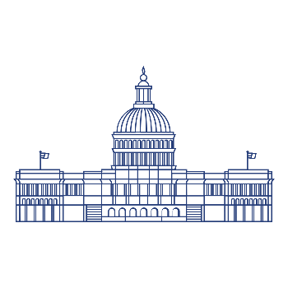

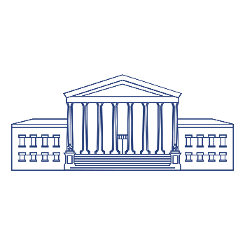
THE BRANCHES OF GOVERNMENT
Article I
The legislative branch—Congress—makes the laws.
Article III: The judicial branch—headed by the Supreme Court—interprets the laws.
Article I I: The executive branch—
led by the President—enforces the laws.

Slide 8
JUDICIAL REVIEW
The Supreme Court has the power to review the constitutionality of acts of the national and state governments.

Slide 9
JUDICIAL SUPREMACY
The idea that the Supreme Court is the final voice on questions of whether actions by the national government or state governments are constitutional.

Slide 10
ARTICLE III
Section 1
The judicial Power of the United States, shall be vested in one supreme Court, and in such inferior Courts as the Congress may from time to time ordain and establish. The Judges, both of the supreme and inferior Courts, shall hold their Offices during good Behaviour, and shall, at stated Times, receive for their Services, a Compensation, which shall not be diminished during their Continuance in Office.

Slide 11
CONGRESS AND THE COURT
Congress controls the details of the national court system. Congress has considerable authority to:
Change the size of the Supreme Court
Shape the jurisdiction of the federal courts—in other words, what cases federal judges can (or must) hear.
Shape the details of the federal court system as a whole—in other words, how many federal judges, how many courts of appeals, how many district courts, etc.

Slide 12
JUDICIAL INDEPENDENCE
Judicial Independence is the idea that the federal courts must be independent from the control of the other branches.
This is done by giving judges and Justices life tenure and guaranteeing their salaries. Judges can only be removed through the impeachment and removal process.

Slide 13
ARTICLE III
Section 2
The judicial Power shall extend to all Cases, in Law and Equity, arising under this Constitution, the Laws of the United States, and Treaties made, or which shall be made, under their Authority;--to all Cases affecting Ambassadors, other public Ministers and Consuls;--to all Cases of admiralty and maritime Jurisdiction;--to Controversies to which the United States shall be a Party;--to Controversies between two or more States;--between a State and Citizens of another State;--between Citizens of different States;--between Citizens of the same State claiming Lands under Grants of different States, and between a State, or the Citizens thereof, and foreign States, Citizens or Subjects…

Slide 14
ARTICLE III
Section 2 (Continued)
…In all Cases affecting Ambassadors, other public Ministers and Consuls, and those in which a State shall be Party, the supreme Court shall have original Jurisdiction. In all the other Cases before mentioned, the supreme Court shall have appellate Jurisdiction, both as to Law and Fact, with such Exceptions, and under such Regulations as the Congress shall make…

Slide 15
ARTICLE III
Section 2 (Continued)
…The Trial of all Crimes, except in Cases of Impeachment; shall be by Jury; and such Trial shall be held in the State where the said Crimes shall have been committed; but when not committed within any State, the Trial shall be at such Place or Places as the Congress may by Law have directed.

Slide 16
WHAT SORTS OF CASES CAN THE FEDERAL COURTS HEAR?
Cases that involve people from two different states
Cases that involve the Constitution or a national law (or regulation)
Cases where the Court has original jurisdiction

Slide 17
ORIGINAL JURISDICTION
Article II, Section 2:
“In all Cases affecting Ambassadors, other public Ministers and Consuls, and those in which a State shall be Party, the supreme Court shall have original Jurisdiction.”

Slide 18
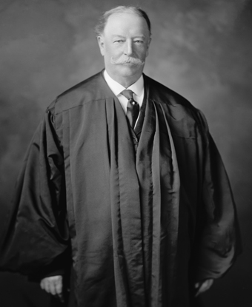
JUDICIARY ACT OF 1925
“JUDGES BILL”
The Bill, driven by Chief Justice Taft, gave the Court broad control over the cases it hears. (Before 1925, the Court had very limited control over the cases that came before it, and it had to hear a ton of cases each Term.)
Today, the Supreme Court often takes fewer than 100 cases in a single term—even settling in with a little over 60 in recent years.
Chief Justice William Howard Taft

Slide 19

BIG IDEA
The Constitution’s Article III establishes the national government’s judicial branch—the federal judiciary, headed by a single Supreme Court. Within the national government, the judicial branch is responsible for interpreting the laws. Importantly, the Constitution also promotes the principle of judicial independence—granting federal judges life tenure. Federal courts—including the Supreme Court—exercise the power of judicial review. This power gives courts the authority to rule on the constitutionality of laws passed (and actions taken) by the elected branches.

Slide 20
HOW DOES A CASE GET TO THE SUPREME COURT?

Slide 21
TERM SCHEDULE
The Court’s term typically lasts from the first Monday of October to the end of June.
The Court sets oral arguments for cases, which usually run through April and occur the first two weeks of each month.
Opinions are released throughout the term, with the final opinions (often on the most important and controversial cases) coming in the end of June—although there’s no deadline because the Justices set their own docket (and schedule)!
Remember, all of this is not in the Constitution itself, but the result of over two centuries of Supreme Court practice.

Slide 22
HOW DOES A CASE GET TO THE SUPREME COURT?
Most constitutional cases start with a simple argument:
THE GOVERNMENT HAS VIOLATED THE CONSTITUTION.
Someone—often a single ordinary American—comes to Court and argues that a law or arrest or regulation violates the Constitution.

Slide 23
HOW DOES A CASE GET TO THE SUPREME COURT?
The Supreme Court receives about 10,000 petitions a year.
The Justices use the “Rule of Four” to decide if they will take the case. If four of the nine Justices feel that the case has value, they will issue a writ of certiorari.
When all is said and done the Supreme Court will hear about 65-70 cases a year. This tells us that most petitions are denied.

Slide 24
Supreme Court
This is the highest level in the national courts system
They have original jurisdiction in limited cases, but most cases are appeals through certiorari process
The SCOTUS is made up of nine justices
Court of Appeals
This is the intermediate level in the national courts system
There are 12 circuit courts
They have no original jurisdiction, only appellate
Cases are heard by a three-judge panel
District Courts
This is the lowest level in the national courts system
There are 94 district courts
They have original jurisdiction in most cases
A single judge presides over a case

Slide 25
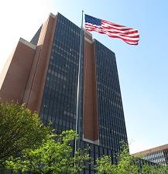
DISTRICT COURT
In nearly every case, someone brings a new case in (what’s called) a district court.
This is the lowest level of court in the national courts system. There are 94 in the US.
It’s where nearly every case starts—and where most of them end!
A single judge presides over (or manages) the case.
And the case is decided by either a judge or a jury.
Someone wins, and someone loses.
United States District Court for the Eastern District of Pennsylvania,
located in Philadelphia
(across the street from the NCC!)

Slide 26
THE COURT OF APPEALS
The loser might decide to appeal—or challenge—the district court’s ruling by having the next level of court (the court of appeals) take a look at the case.
If someone appeals their case this court, the judges have to decide it. Generally speaking, they have two options:
Say that the district court got it right or
Say that the district court got it wrong—and then explain why and reach a new decision.

Slide 27

THE COURT OF APPEALS
There are 13 Circuit Courts of Appeals--twelve geographic circuits and the Federal Circuit

Slide 28
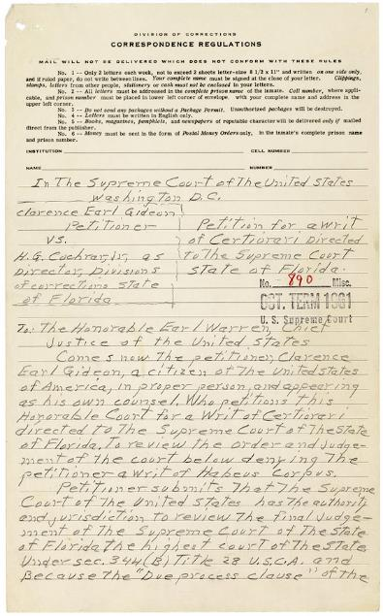
FILING FOR CERT
Finally, the loser in the court of appeals might try to get the Supreme Court to decide her case.
They can “petition for a writ of certiorari” or “file for cert.”
This simply means that the loser (in the court of appeals) wants the Supreme Court to take their case and decide it.
Petition for a Writ of Certiorari from Clarence Gideon to the Supreme Court of the United States, 1962

Slide 29
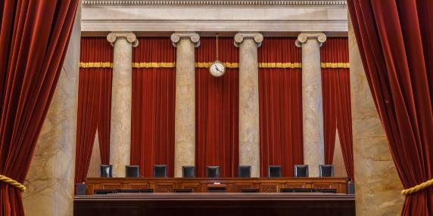

GRANTING CERT
The Justices read the challenger’s “cert. petition”—asking the Court to take the case. Four of the nine Justices must vote to take a case –“The Rule of Four.” When the Court takes a case, we call that “granting cert.”
The Supreme Court rejects nearly every petition. The Court accepts only 60 to 100 of the more than 7,000 to 10,000 that it is asked to review each year.

Slide 30
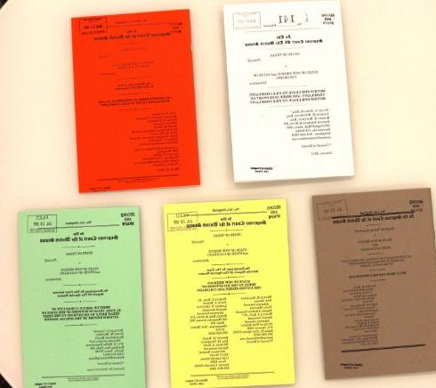
BRIEFS
Each side file briefs, or little books that lawyers write, presenting their constitutional arguments.
Others affected by the case can also write briefs—known as “Friend of the Court” or “amicus” briefs.
The Justices then read the briefs in the case.

Slide 31
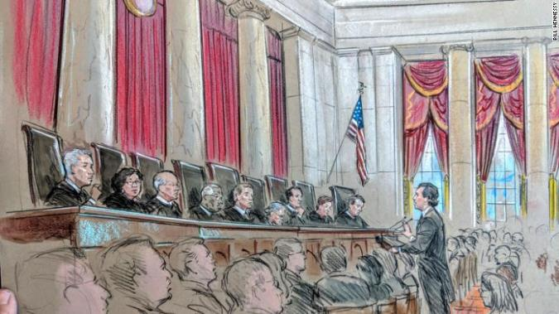
ORAL ARGUMENTS
The Supreme Court holds oral arguments. This is when the lawyers on each side get to state their case and the Justices get to ask questions.

Slide 32
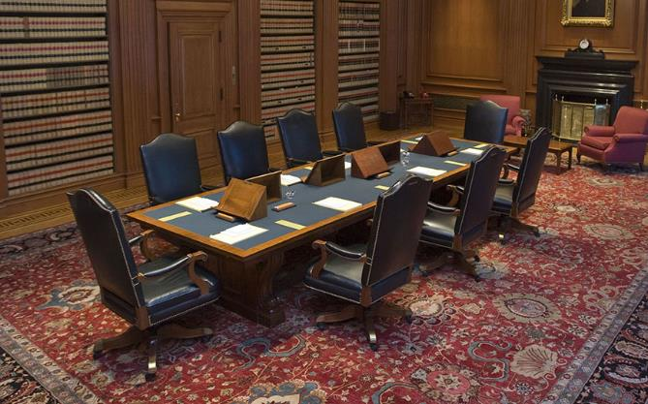
THE “FRIDAY CONFERENCE”
The Justices then get together once a week to discuss and vote on the cases. This is known as the “Friday Conference”—and these conferences are held in secret.

Slide 33
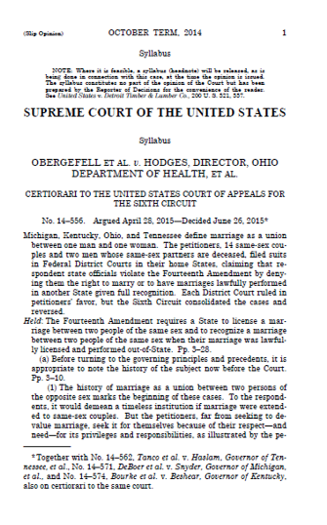
OPINIONS
In nearly every case, one Justice writes a majority opinion—which has the support of a majority of the Justices. Either the Chief Justice or the most senior justice in the majority will assign who writes the opinion.
In some cases, one or more Justices might write a dissenting opinion.
And finally, one or more Justices might write a concurring opinion, offering additional thoughts on the constitutional issue in the case.

Slide 34
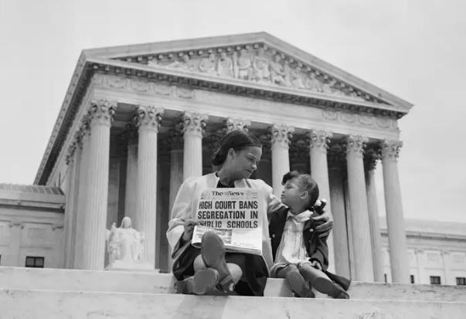
ANNOUNCEMENT
After the Justices finalize their votes and opinions in the case, the Court’s decision is then released to the public.

Slide 35
HOW DOES A PERSON BECOME A SUPREME COURT JUSTICE?

Slide 36
HOW DOES A PERSON BECOME A SUPREME COURT JUSTICE?
Article II, Section 2
The President “shall nominate, and by and
with the Advice and Consent of the Senate, shall appoint . . . Judges of the supreme Court.”

Slide 37
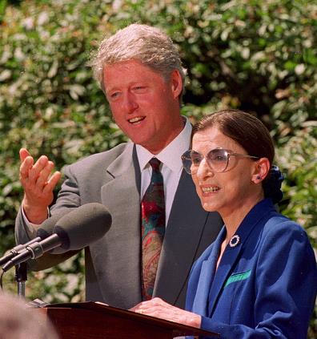
NOMINATION
A seat on the Supreme Court opens up.
The President considers a number of potential people for the position—reading about them, asking for advice from others, interviewing potential choices, etc.
The President selects someone.
That person accepts the nomination.

Slide 38
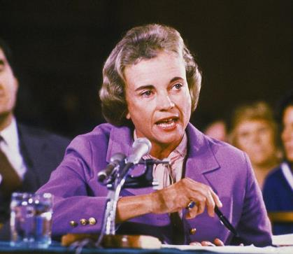
CONFIRMATION
The Senate Judiciary Committee holds confirmation hearings during which senators ask the nominee questions.
The Judiciary Committee votes on whether to recommend confirmation to the rest of the Senate.
The nomination is then sent to the full Senate, who debates the nominee and votes on her confirmation: “yes” or “no.”

Slide 39
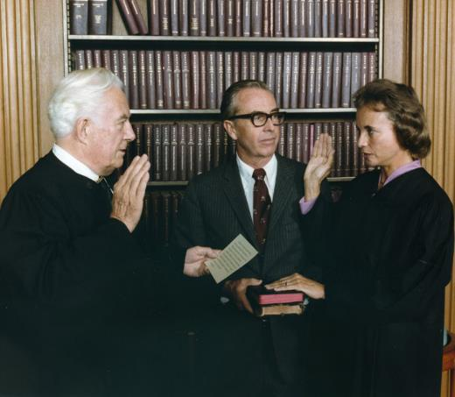
CONFIRMATION
If she wins Senate approval, she then becomes a Supreme Court Justice.
If not, the whole process starts all over again!

Slide 40
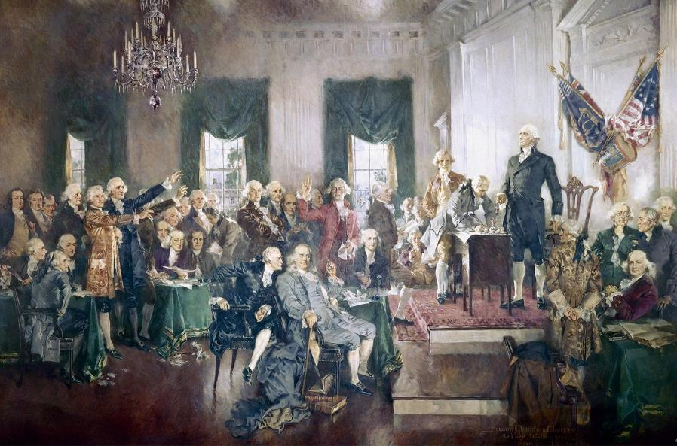
CONSTITUTIONAL CONVENTION
May to September 1787, Philadelphia, PA

Slide 41
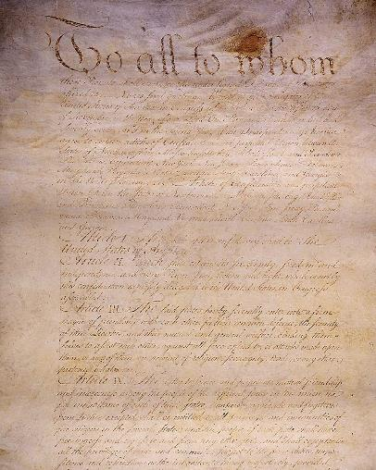
JUDICIARIES IN EARLY AMERICA
Many early state constitutions were radical in their embrace of legislative supremacy.
And under the Articles of Confederation—our nation’s first framework of government—there was no separate national court system.
ARTICLES OF CONFEDERATION

Slide 42
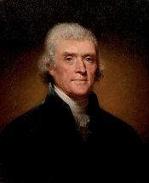
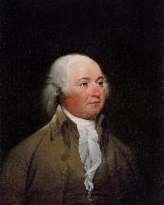
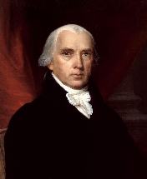
JUDICIARIES IN EARLY AMERICA
Critics—including Thomas Jefferson, John Adams, and James Madison—began calling for new checks on legislative power.
By the 1780s, several state judiciaries—for instance, those in New Jersey, Virginia, New York, Rhode Island, and North Carolina—began experimenting with judicial review.

Slide 43
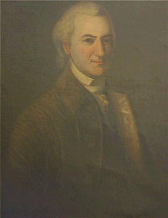
JUDICIARIES IN EARLY AMERICA
Still, for many early Americans, vesting judges with the authority to declare laws unconstitutional was unwise.
As late as 1787, John Dickinson still could say of judicial review that “no such power ought to exist.”
JOHN DICKINSON

Slide 44

DEBATES AT THE CONVENTION
The delegates spent little time discussing the federal judiciary or the issue of judicial review.
But many delegates assumed that the federal judiciary would exercise judicial review in some form.
James Madison (among others) looked for a variety of ways to curb legislative power
JAMES MADISON

Slide 45
DEBATES AT THE CONVENTION
On the one hand, many had grown worried about legislative supremacy and thought that an independent judiciary could help check the excesses of Congress.
Furthermore, proponents of a fairly strong judiciary valued a federal judiciary’s ability to:
Settle certain constitutional issues.
Promote the uniform application of national law.
Check an abusive Congress (and President).
And promote the idea of the Constitution as the supreme law of the land—created by the people (not Congress) and enforcing the fundamental law over ordinary laws passed by Congress.

Slide 46
DEBATES AT THE CONVENTION
On the other hand, many in the Founding generation also thought that judicial review—even if permitted—should rarely be exercised and that the judiciary should normally differ to the popularly elected branches.
And critics of a stronger federal judiciary argued that judicial review was in tension with democracy. They feared that the federal judiciary—and judicial review itself—might help usher in an aristocratic national government. One that would grow stronger by taking powers away from the states and the people. And consolidating all political power at the national level.

Slide 47
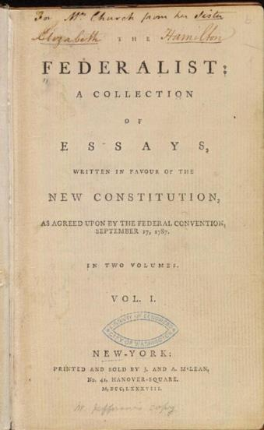
FEDERALIST NO. 78
Federalist No. 78
“The Judicial Department”
Published May 28, 1788
Written by Alexander Hamilton

Slide 48
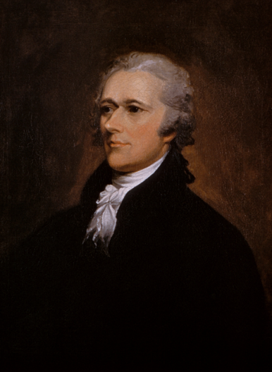
FEDERALIST NO. 78
Hamilton famously defined the judiciary as the “weakest” of the three branches.
But he also emphasized the importance of judicial review and an independent judiciary to our constitutional system as a whole.
ALEXANDER HAMILTON

Slide 49
FEDERALIST NO. 78
Hamilton emphasized the duty of the courts to declare “all acts contrary to the manifest tenor of the Constitution void.”
ALEXANDER HAMILTON

Slide 50
FEDERALIST NO. 78
“The interpretation of the laws is the proper and peculiar province of the courts. A constitution is, in fact, and must be regarded by the judges, as a fundamental law. It therefore belongs to them to ascertain its meaning, as well as the meaning of any particular act proceeding from the legislative body.”
ALEXANDER HAMILTON

Slide 51
FEDERALIST NO. 78
“There is no position which depends on clearer principles, than that every act of a delegated authority, contrary to the tenor of the commission under which it is exercised, is void. No legislative act, therefore, contrary to the Constitution, can be valid.”
ALEXANDER HAMILTON

Slide 52
FEDERALIST NO. 78
In Hamilton’s view, the elected branches may claim to speak for “We the People.” But no branch of government speaks as the perfect voice of the American people.
Only the Constitution itself is an authentic expression of the American people’s voice. The Constitution itself—its very legitimacy—is rooted in popular sovereignty. And Article VI’s Supremacy Clause makes it the supreme law of the land.
ALEXANDER HAMILTON

Slide 53
FEDERALIST NO. 78
So, the federal judiciary has a special duty to heed the people’s commands and protect their rights—sometimes using judicial review to check the actions of the elected branches.
At the same time, Hamilton argued that the federal judiciary would be the weakest branch of government.
ALEXANDER HAMILTON

Slide 54
FEDERALIST NO. 78
“In a government in which they are separated from each other, the judiciary, from the nature of its functions, will always be the least dangerous to the political rights of the Constitution; because it will be least in a capacity to annoy or injure them. The Executive not only dispenses the honors, but holds the sword of the community. The legislature not only commands the purse, but prescribes the rules by which the duties and rights of every citizen are to be regulated. The judiciary, on the contrary, has no influence over either the sword or the purse; no direction either of the strength or the wealth of the society; and can take no active resolution whatever. It may truly be said to have neither FORCE nor WILL, but merely judgment; and must ultimately depend upon the aid of the executive arm even for the efficacy of its judgments.”
ALEXANDER HAMILTON

Slide 55
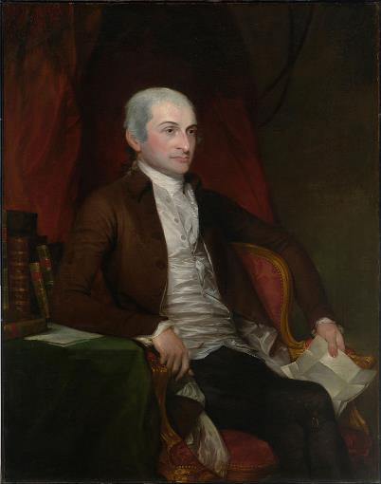
EARLY SUPREME COURT
The Supreme Court was in the basement of Congress.
The Justices lived together in cramped spaces for the brief periods in which the Court met and otherwise, the Justices rode circuit—meaning that each Justice was assigned to oversee a federal circuit and literally had to ride out to it to attend court sessions.
John Jay preferred being Governor of New York to Chief Justice!
JOHN JAY

Slide 56
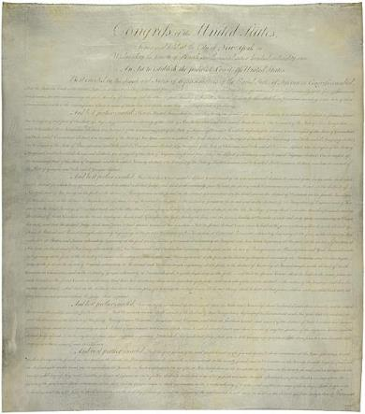
JUDICIARY ACT OF 1789
The Judiciary Act created:
The federal courts system itself.
The system of circuit riding.
The various judicial districts.
The Office of the Attorney General.
The offices of the U.S. attorneys and U.S. marshals in each judicial district.
And finally, the Supreme Court itself—with its six Justices: one Chief Justice and five Associate Justices.
First Page of the Judiciary Act of 1789

Slide 57
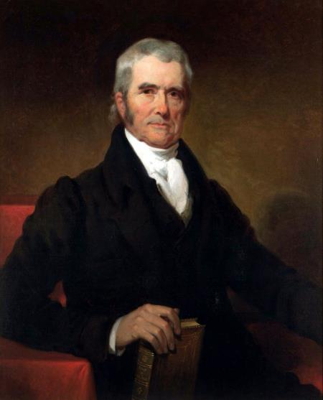
MARBURY V MADISON (1803)
Big Idea:
Chief Justice John Marshall establishes the power of “judicial review” by giving the reasons the Court can strike down acts of Congress.
CHIEF JUSTICE JOHN MARSHALL

Slide 58
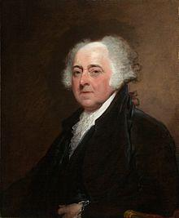
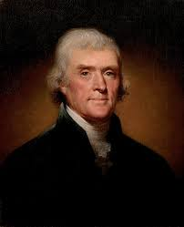
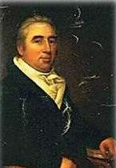
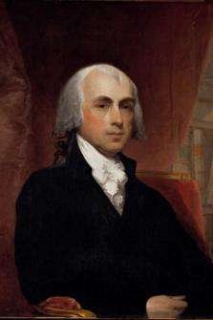
MARBURY V MADISON (1803)
The Players:
John Adams
Thomas
Jefferson
John Marbury
James Madison

Slide 59
MARBURY V MADISON (1803)
Before leaving office—after losing an election to Thomas Jefferson, President John Adams appointed a man named William Marbury to serve as a Justice of the Peace. Marbury’s commission was signed and sealed by President Adams, but it was never delivered to Marbury.
When Jefferson became President, he ordered his Secretary of State James Madison to not deliver the commissions.
Marbury brought a lawsuit to compel Madison to deliver his commission. He asked the Supreme Court to issue a writ of “mandamus.”
This was an order directing Madison (but really Jefferson) to carry out his lawful and non-discretionary duty to deliver Marbury’s commission. The Supreme Court got this power from the Judiciary Act of 1789.

Slide 60

MARBURY V MADISON (1803)
John Marshall wrote the Supreme Court’s opinion in Marbury for a unanimous Court.
As to this specific case, the Court exercised the power of judicial review and declared the relevant part of the Judiciary Act unconstitutional. Marshall concluded that the Supreme Court did not have the power to force Madison to deliver Marbury his commission.
CHIEF JUSTICE JOHN MARSHALL

Slide 61
MARBURY V MADISON (1803)
First, that by signing the commission of the Mr. Marbury, President Adams appointed him a justice of peace for D.C. This gave Marbury a legal right to the office for five years.
Second, that having the legal title to this office, Marbury also had a right to the commission and the refusal to deliver it was a plain violation of that right.
Third, that Marbury was entitled to the remedy for which he applies. He should get the job!
However, fourth, and finally, the Supreme Court itself didn’t have the power to provide that remedy. The Court itself didn’t have the power to give him the job!
CHIEF JUSTICE JOHN MARSHALL

Slide 62
MARBURY V MADISON (1803)
Marshall says that Marbury clearly has the right to his commission and to hold office.
But Marshall also denies that the Supreme Court itself has the power to act because the relevant part of the Judiciary Act is unconstitutional.
This permits Marshall to exercise the power of judicial review—establishing an important precedent at the Supreme Court.
CHIEF JUSTICE JOHN MARSHALL

Slide 63
MARBURY V MADISON (1803)
“It is emphatically the province and duty of the judicial department to say what the law is.”
CHIEF JUSTICE JOHN MARSHALL

