Slide 1
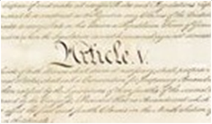


ARTICLE V: THE AMENDMENT PROCESS —
WHAT IS YOUR 28TH AMENDMENT?
Article V: The Amendment Process

Slide 2
If you were to introduce a new Amendment—
the 28th Amendment—what would you propose?
Article V: The Amendment Process

Slide 3
BIG QUESTIONS
Why did the Founding generation include a formal process for amending the Constitution?
How does the Constitution’s amendment process work, and why did the Founders make it so hard to amend the Constitution?
What’s the relationship between the Constitution’s Article V amendment process and key foundational principles like popular sovereignty and the rule of law?
What key changes have the American people made to the Constitution over time and what does that tell us about the key constitutional issues in American history?
Article V: The Amendment Process

Slide 4
ARTICLE V
The Congress, whenever two thirds of both Houses shall deem it necessary, shall propose Amendments to this Constitution, or, on the Application of the Legislatures of two thirds of the several States, shall call a Convention for proposing Amendments, which, in either Case, shall be valid to all Intents and Purposes, as Part of this Constitution, when ratified by the Legislatures of three fourths of the several States, or by Conventions in three fourths thereof, as the one or the other Mode of Ratification may be proposed by the Congress; Provided that no Amendment which may be made prior to the Year One thousand eight hundred and eight shall in any Manner affect the first and fourth Clauses in the Ninth Section of the first Article; and that no State, without its Consent, shall be deprived of its equal Suffrage in the Senate.
Article V: The Amendment Process

Slide 5
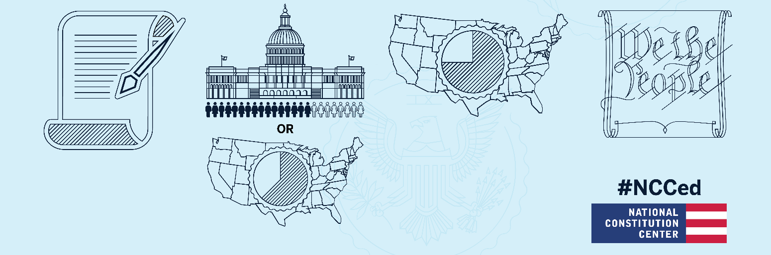
THE AMENDMENT PROCESS
Proposal Phase
Ratification Phase
Article V: The Amendment Process
The proposed amendment must be ratified by 3/4 of the states.
States can ratify via a vote in their state legislature,
or
a ratifying convention.
The Amendment is Now Part of the Constitution
An amendment to the Constitution is proposed
The proposed amendment must be approved by
2/3 of the members of both houses of congress
or
2/3 of the states.

Slide 6
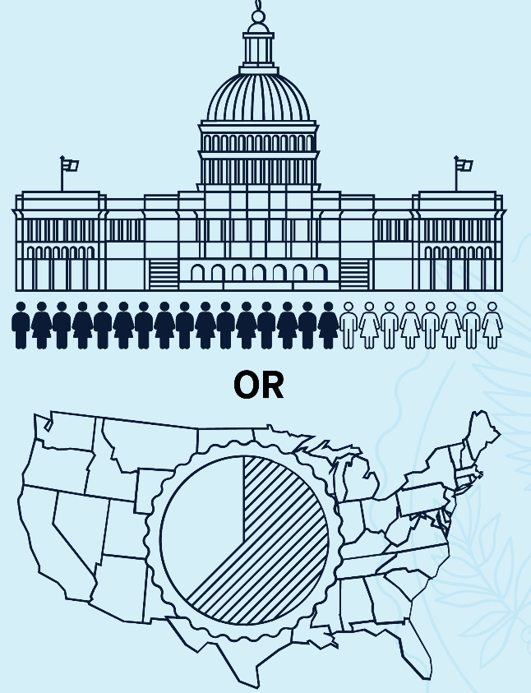
PROPOSAL PHASE
The proposed amendment must be approved by:
2/3 of the members of both houses of Congress
(this has been the pathway of every amendment, so far)
or
2/3 of the states.
Article V: The Amendment Process

Slide 7
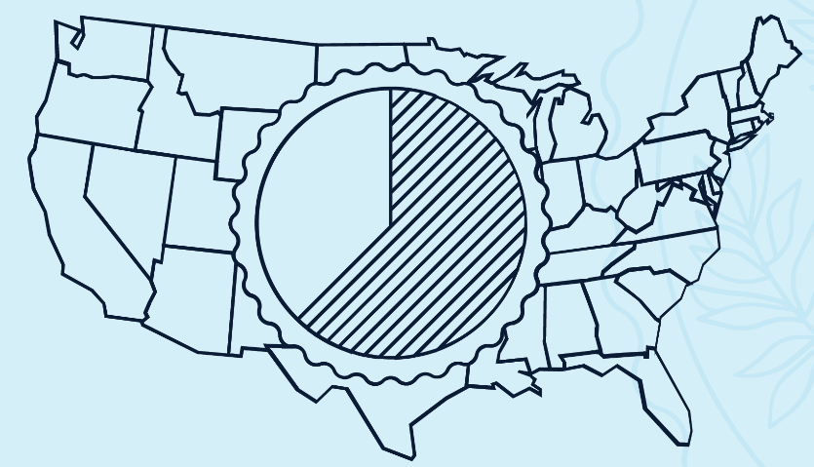
PROPOSAL PHASE
If Congress refuses to act on proposals for constitutional reform, state legislatures have the power under Article V to force Congress to “call a Convention for proposing Amendments” whenever “the Legislatures of two thirds of the Several States” apply for one. So far, no amendment has triggered this process.
Article V: The Amendment Process

Slide 8

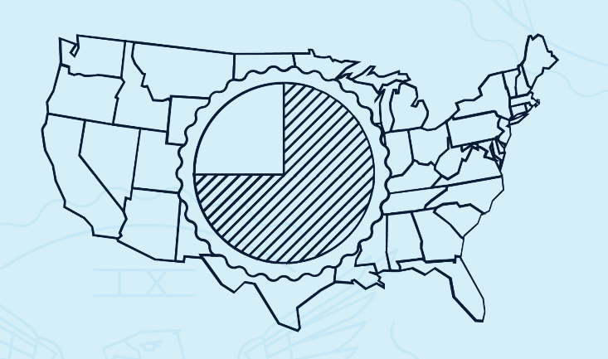
RATIFICATION PHASE
The proposed amendment must be ratified by 3/4 of the states.
Article V: The Amendment Process
Article V sets out two pathways for state ratification—with Congress having the power to choose which pathway to use:
Votes in the state legislatures
(Used to ratify 26 out of the 27 amendments)
A ratifying convention
(Used once—to ratify the 21st Amendment)

Slide 9
POPULAR SOVEREIGNTY
The Article V amendment process is rooted in the Founding generation’s commitment to popular sovereignty.
Popular Sovereignty: Beginning with the words “We the People,” the Constitution establishes a government that’s driven by us—not a monarch and not an aristocracy—but by us, the American people.
Article V: The Amendment Process

Slide 10
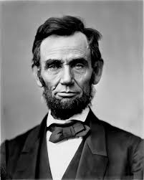
POPULAR SOVEREIGNTY
“government of the people, by the people, for the people.”
Article V: The Amendment Process
ABRAHAM LINCOLN

Slide 11
WHEN HAVE WE AMENDED THE CONSTITUTION?
Historical events
Social movements
Critics of the Constitution
Controversial Supreme Court decisions
Lessons learned over time
Article V: The Amendment Process

Slide 12
WHEN HAVE WE AMENDED THE CONSTITUTION?
Historical events
The Civil War led to the Reconstruction Amendments; the 13th, 14th, and 15th Amendments.
Critics of the Constitution
Anti-Federalists pushed for the Bill of Rights
Article V: The Amendment Process

Slide 13
WHEN HAVE WE AMENDED THE CONSTITUTION?
Social movements
The Women’s Suffrage Movement led to 19th Amendment.
The Civil Rights Movement led to the 24th Amendment, ending the poll tax.
Article V: The Amendment Process

Slide 14
WHEN HAVE WE AMENDED THE CONSTITUTION?
Controversial Supreme Court Decisions
The Dred Scott decision led to the 13th and 14th Amendments.
Chisholm v. Georgia decision led to the 11th Amendment
Pollock decision led to the 16th Amendment.
Article V: The Amendment Process

Slide 15
WHEN HAVE WE AMENDED THE CONSTITUTION?
Lessons Learned Over Time
FDR’s unprecedented four terms in office showed the need for presidential term limits and led to the 22nd Amendment.
The Election of 1800 showed the need for revisions to the Electoral College, leading to the 12th Amendment.
The assassination of JFK showed the need for an amendment to deal with presidential incapacity, leading to the 25th Amendment.
Article V: The Amendment Process

Slide 16
BILL OF RIGHTS AMENDMENTS
The first ten amendments were proposed by the First Congress and ratified shortly thereafter.
Theses Bill of Rights amendments protect some of our most cherished liberties, including free speech, a free press, religious freedom, and the right to a jury trial—among many others.
These amendments originally applied to the national government only—not the states. (The 14th Amendment would later extend many of these rights to protect us against state abuses. Scholars call this process “incorporation.”)
Article V: The Amendment Process

Slide 17
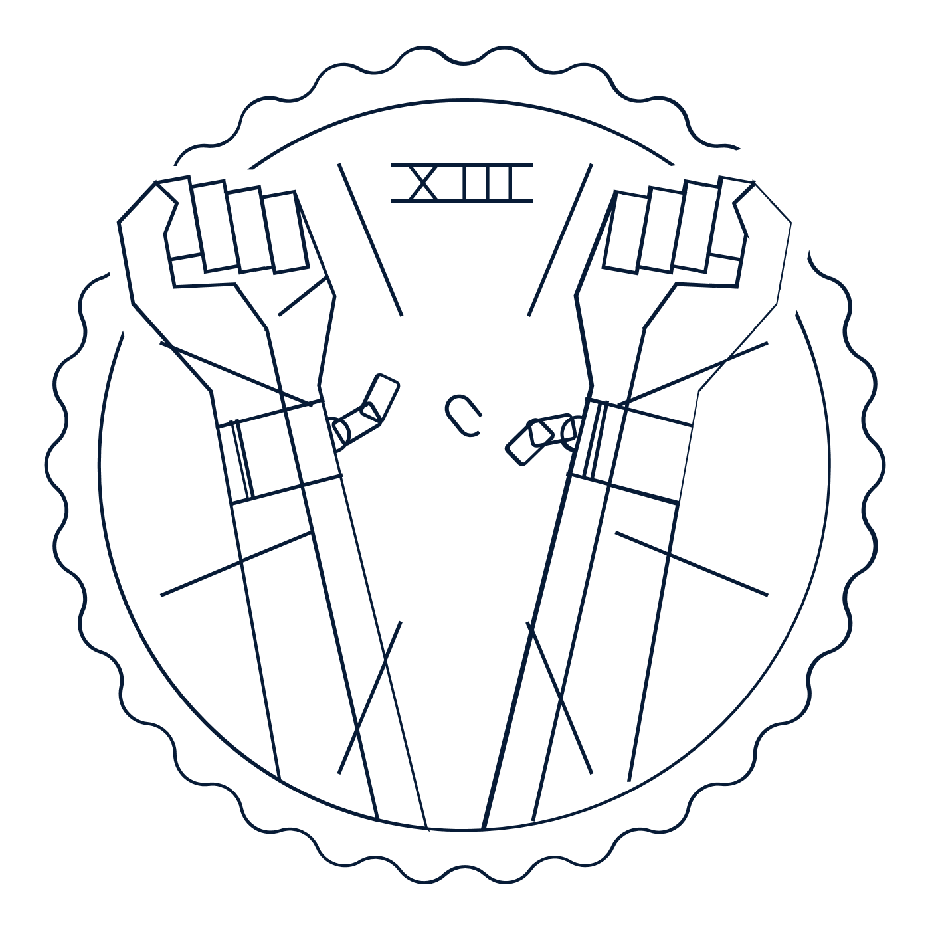


RECONSTRUCTION AMENDMENTS
After the Civil War, we ratified a series of three amendments that transformed the Constitution forever. Many scholars refer to these transformational amendments as our nation’s “Second Founding.”
Article V: The Amendment Process
13TH AMENDMENT
14TH AMENDMENT
15TH AMENDMENT
Wrote promises of freedom and equality into the Constitution
1868
Banned racial discrimination in voting
1870
Abolished slavery
1865

Slide 18
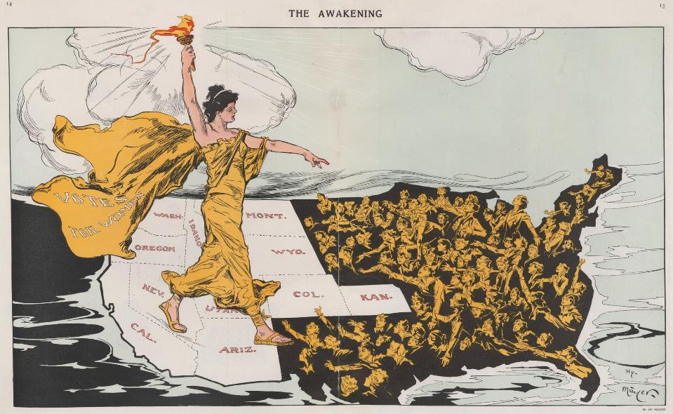
OTHER AMENDMENTS
19th Amendment: Protected women against discrimination at the ballot box
Article V: The Amendment Process

Slide 19
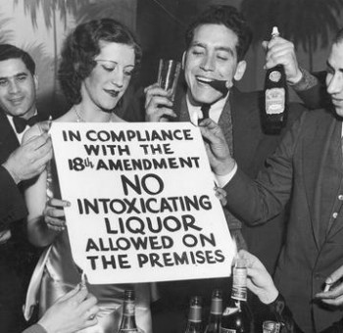
OTHER AMENDMENTS
18th Amendment: Banned the sale, manufacture, and transportation of alcohol throughout the nation
21st Amendment: Repealed that failed experiment in Prohibition
Article V: The Amendment Process

Slide 20
OTHER AMENDMENTS
12th Amendment: Altered the Electoral College
16th Amendment: Gave the national government the power to collect an income tax
17th Amendment: Gave the American people the power to vote directly for their Senators
22nd Amendment: Limited the President to two terms
23rd Amendment: Gave D.C. voters the power to vote for President
24th Amendment: Abolished poll taxes in national elections
26th Amendment: Protected the voting rights of those 18 and older from age discrimination
Article V: The Amendment Process

Slide 21
BIG IDEA
The Founding generation didn’t believe that it had a monopoly on constitutional wisdom. Therefore, the Founders set out a formal amendment process that allowed later generations to revise our nation’s charter and “form a more perfect Union.” They wrote this process into Article V of the Constitution.
Article V: The Amendment Process

Slide 22
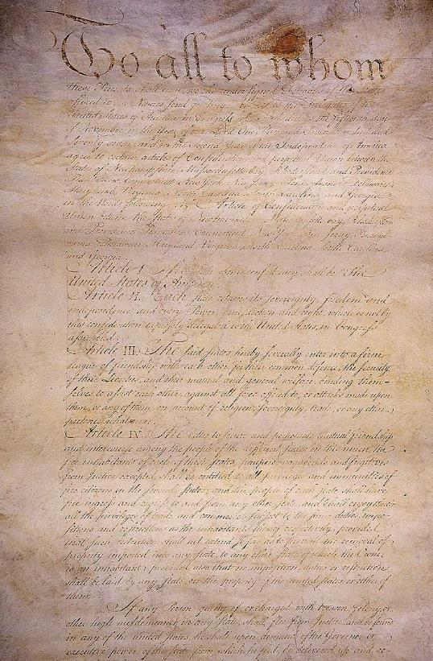
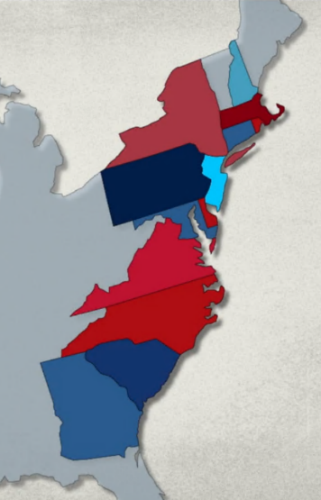
THE ARTICLES OF CONFEDERATION
Under the Articles, any amendment required the unanimous vote of all thirteen states.
Practically speaking, this made the Articles impossible amend.
Article V: The Amendment Process

Slide 23
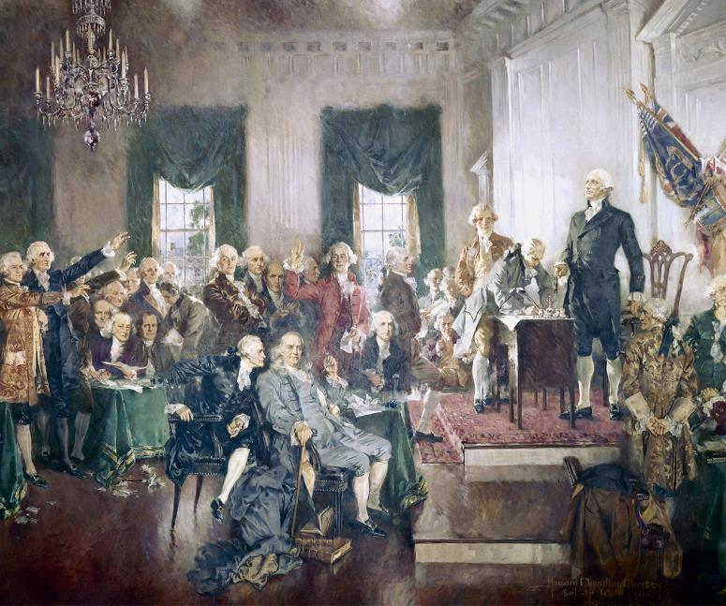
CONSTITUTIONAL CONVENTION
May to September 1787, Philadelphia, PA
At the Convention, the delegates looked to write into the new Constitution an amendment process that was still demanding—but also much easier to meet than the unanimity requirement of the Articles of Confederation.
Article V: The Amendment Process

Slide 24
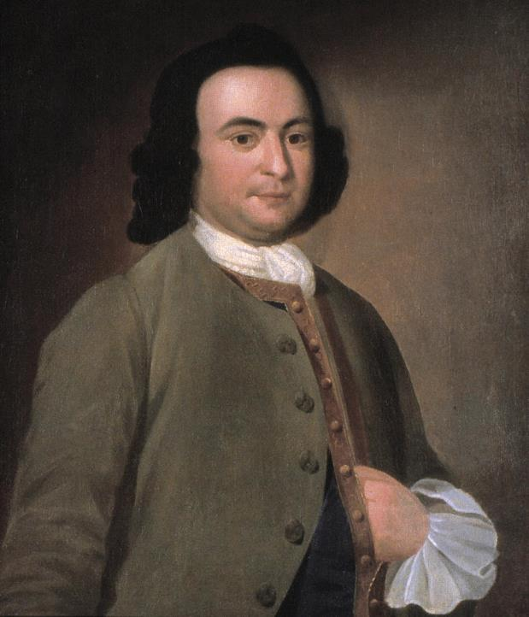
CONSTITUTIONAL CONVENTION
As George Mason explained at the Convention, the delegates wrote Article V to ensure
“an easy, regular[,] and Constitutional way” of amending the Constitution. He hoped that the Constitution might be “altered with as much regularity, and as little confusion, as any act of Assembly.”
Article V: The Amendment Process
GEORGE MASON

Slide 25
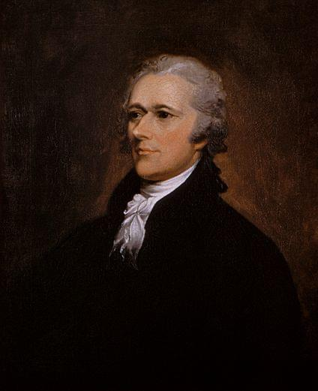
CONSTITUTIONAL CONVENTION
The Article V amendment process advanced a “fundamental principle of republican government”—“the right of the people to alter . . . the established constitution whenever they find it inconsistent with their happiness.”
-Federalist #78
Article V: The Amendment Process
ALEXANDER HAMILTON

Slide 26
CONSTITUTIONAL CONVENTION
Framers wrote a few different ways of amending the Constitution into our nation’s charter.
They abandoned the unanimity requirement of the Articles of Confederation’s, but reforms do require more than majority support.
They also wanted reformers in the states to have a way of getting around Congress. They feared that Congress may seize too much power and block efforts to check it—the delegates rejected a proposal to give Congress a veto over any proposed amendment.
Article V: The Amendment Process

Slide 27

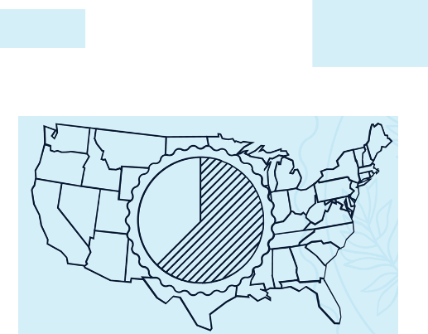
CHECKS ON CONGRESS IN THE AMENDMENT PROCESS
Proposal Phase
Congress can propose an amendment if reformers secure 2/3 votes in both Houses of Congress. But even then, Congress doesn’t get a final say. Congress must still send the proposed amendment to the states for ratification.
The state legislatures the power to force Congress to “call a Convention for proposing Amendments” whenever “the Legislatures of two thirds of the Several States” apply for one.
Article V: The Amendment Process

Slide 28
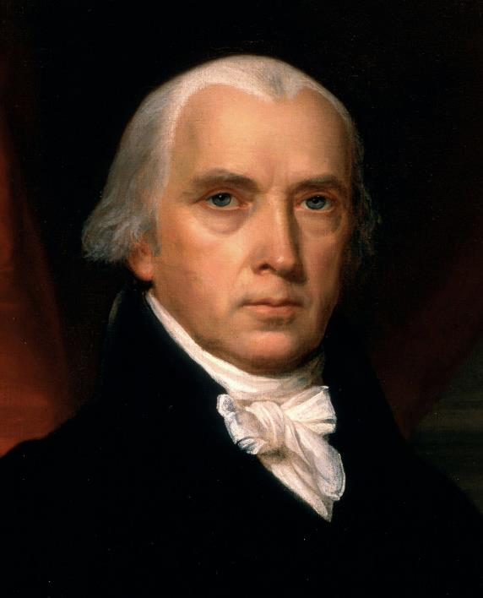
CHECKS ON CONGRESS IN THE AMENDMENT PROCESS
Article V “equally enables the general and state governments, to originate the amendment of errors, as they may be pointed out by the experience on one side or on the other.”
-Federalist #43
Article V: The Amendment Process
JAMES MADISON

Slide 29
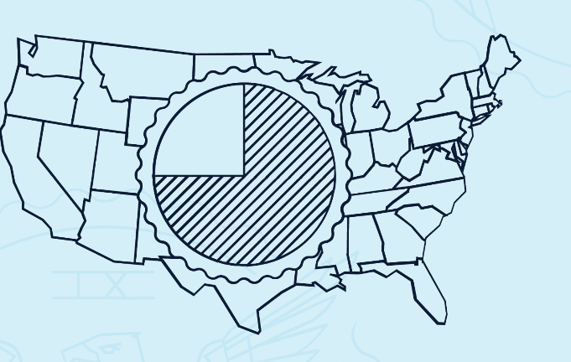
CHECKS ON CONGRESS IN THE AMENDMENT PROCESS
Ratification Phase
The delegates also set out two pathways for ratifying a new amendment—with Congress having the power to choose which pathway to use—ratification “by the Legislatures of three fourths of the several States, or by Convention in three fourths thereof.”
Congress disappears from the process after choosing the mode of ratification. The ultimate ratification decision falls to the states.
Article V: The Amendment Process

Slide 30
CHECKS ON CONGRESS IN THE AMENDMENT PROCESS
The “national authority” would have “no option” but to go along with the states whenever they used their powers under the proposal or ratification stages of the Article V process.
-Federalist #85
Article V: The Amendment Process
ALEXANDER HAMILTON

Slide 31
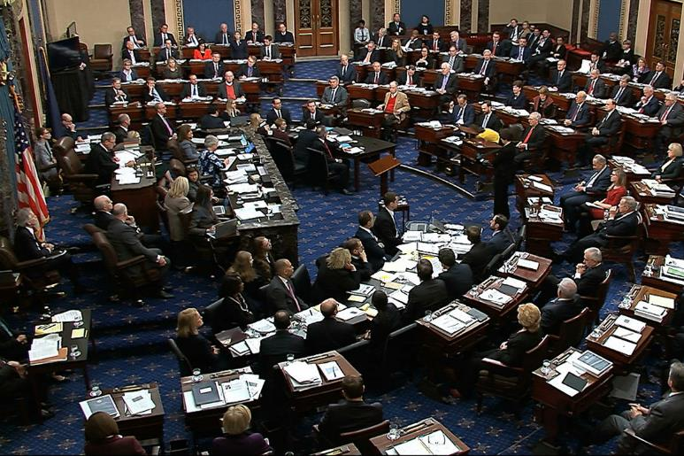
LIMITS ON THE ARTICLE V AMENDMENT PROCESS
Protection of a state’s equal representation in the Senate.
Article V: The Amendment Process
Article V
…no State, without its consent, shall be deprived of its equal Suffrage in the Senate.

Slide 32
LIMITS ON THE ARTICLE V AMENDMENT PROCESS
Protection of the “Slave Trade” Clause
Article I, Section 9:
The Migration or Importation of such Persons as any of the States now existing shall think proper to admit, shall not be prohibited by the Congress prior to the Year one thousand eight hundred and eight, but a Tax or duty may be imposed on such Importation, not exceeding ten dollars for each Person.
Article V:
…no Amendment which may be made prior to the Year One thousand eight hundred and eight shall in any Manner affect the first and fourth Clauses in the Ninth Section of the first Article.
Article V: The Amendment Process

Slide 33
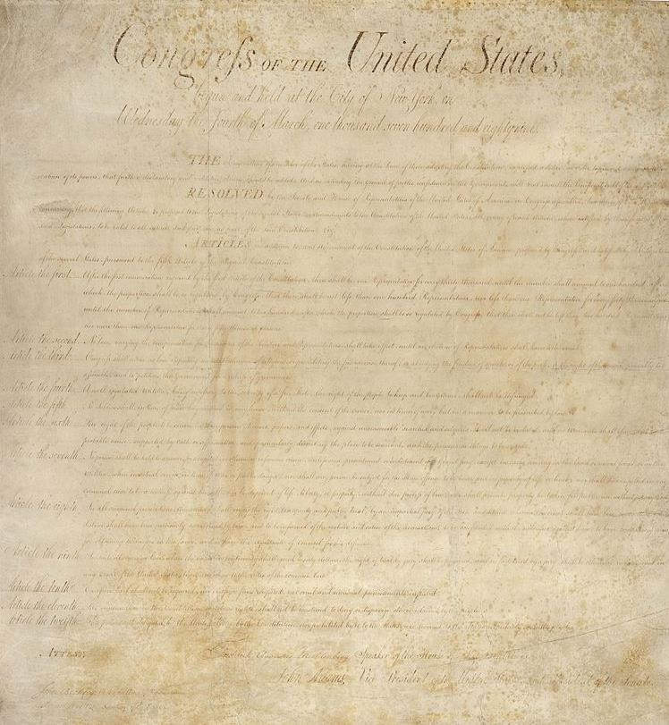
27TH AMENDMENT, 1789-1992
No law, varying the compensation for the services of the Senators and Representatives, shall take effect, until an election of representatives shall have intervened.
Article V: The Amendment Process
THE BILL OF RIGHTS

Slide 34
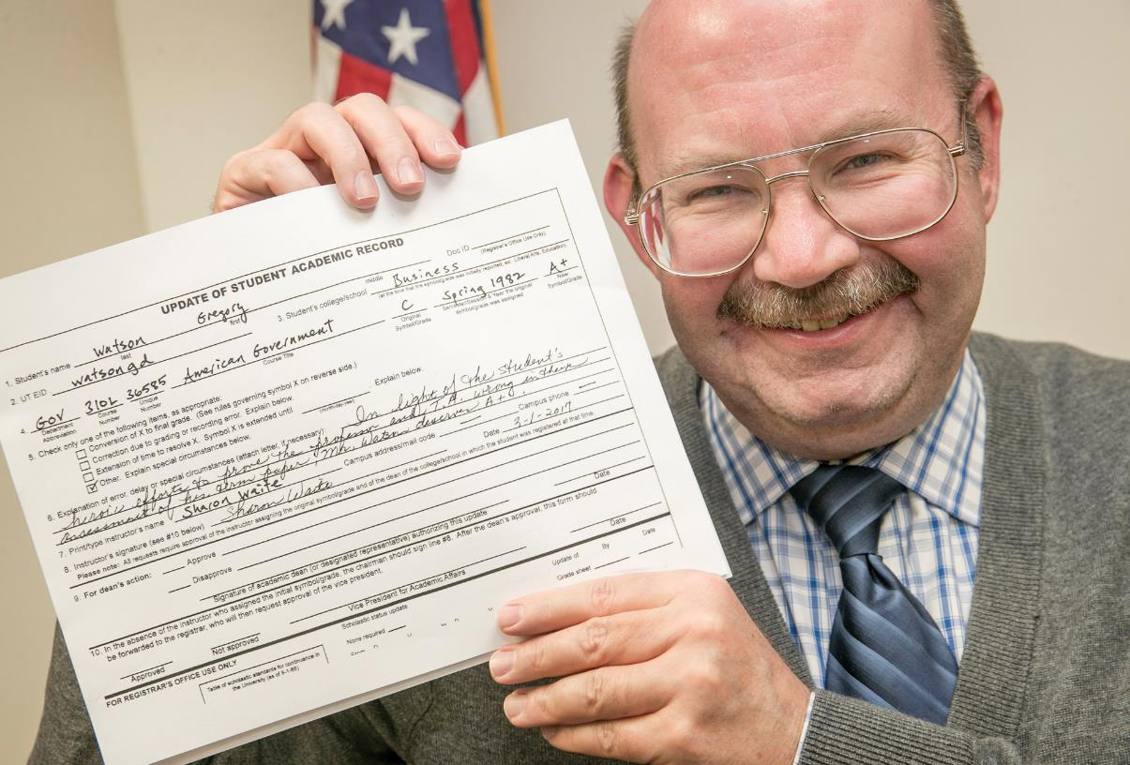
27TH AMENDMENT, 1789-1992
Article V: The Amendment Process
Gregory Watson shows off the A+ on his Update of Student Academic Record application at his office at the Texas Capitol. Photo by Jay Janner / Austin American-Statesman.

Slide 35
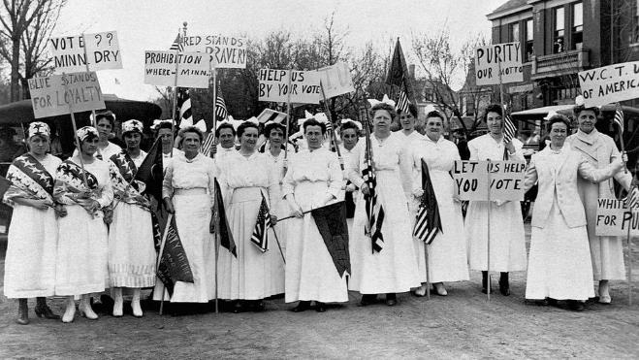
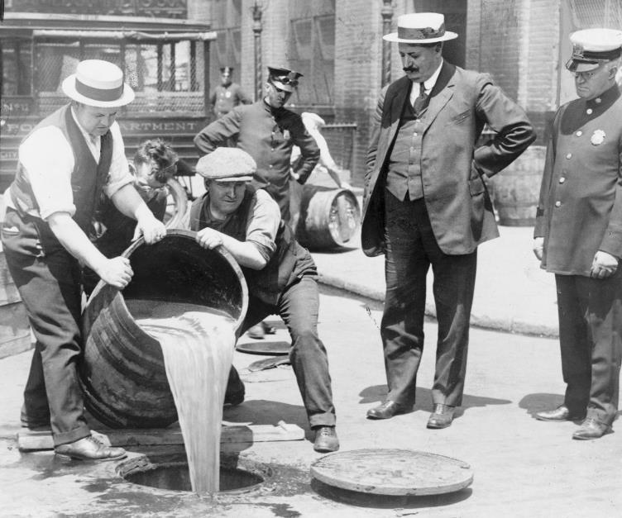
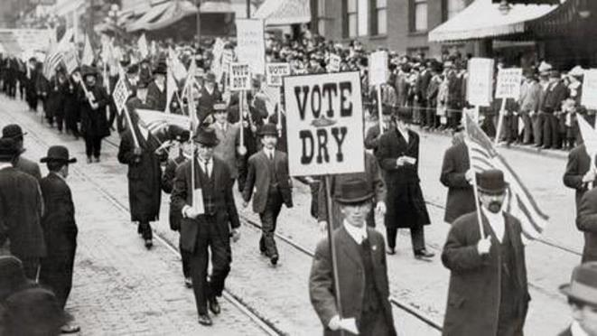
18TH AMENDMENT, 1919
Article V: The Amendment Process

Slide 36
18TH AMENDMENT, 1919
Section 1
After one year from the ratification of this article the manufacture, sale, or transportation of intoxicating liquors within, the importation thereof into, or the exportation thereof from the United States and all territory subject to the jurisdiction thereof for beverage purposes is hereby prohibited.
Article V: The Amendment Process

Slide 37
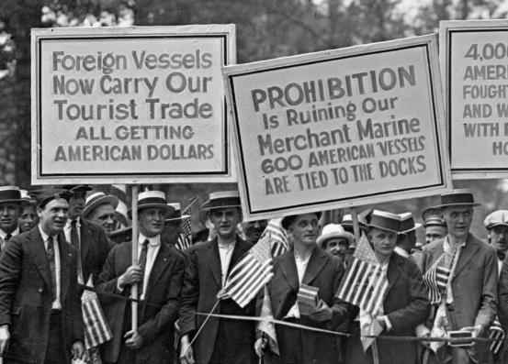
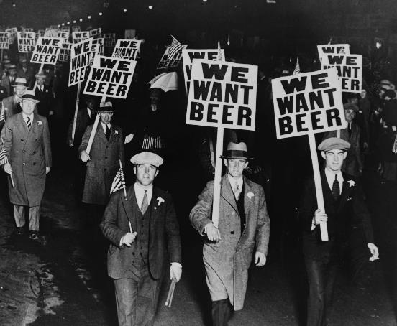
18TH AMENDMENT, 1919
Article V: The Amendment Process

Slide 38
21ST AMENDMENT, 1933
Section 1
The eighteenth article of amendment to the Constitution of the United States is hereby repealed.
Article V: The Amendment Process

Slide 39

21ST AMENDMENT, 1933
Article V: The Amendment Process

