Slide 1
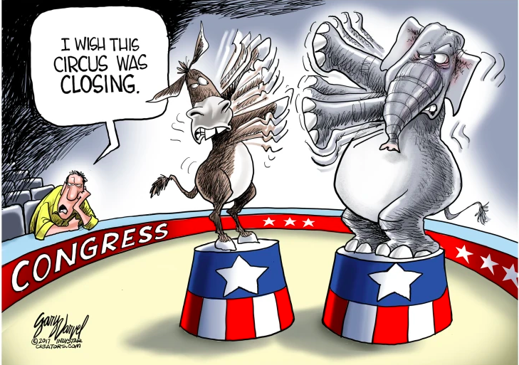

Cartoonist: Gary Varvel

