Slide 1
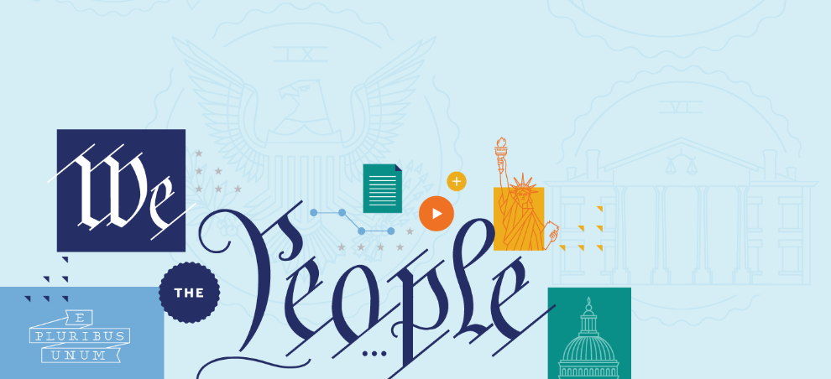
THE 19TH AMENDMENT – WOMEN’S RIGHT TO VOTE
The 19th Amendment - Women’s Right to Vote

Slide 2
BIG QUESTIONS
What did the 19th Amendment say, and who were some of the key figures who made it a reality?
What was the Seneca Falls Convention? What was the Declaration of Sentiments? And what did this key moment suggest about the roots of the women’s rights movement in the mid-1800s?
What were the constitutional arguments advanced by those supporting the women’s vote and those advanced by those opposing it?
How was the 19th Amendment story an example of federalism in action?
What did the 19th Amendment settle when it was ratified, and what work remained in the decades ahead?
The 19th Amendment - Women’s Right to Vote

Slide 3
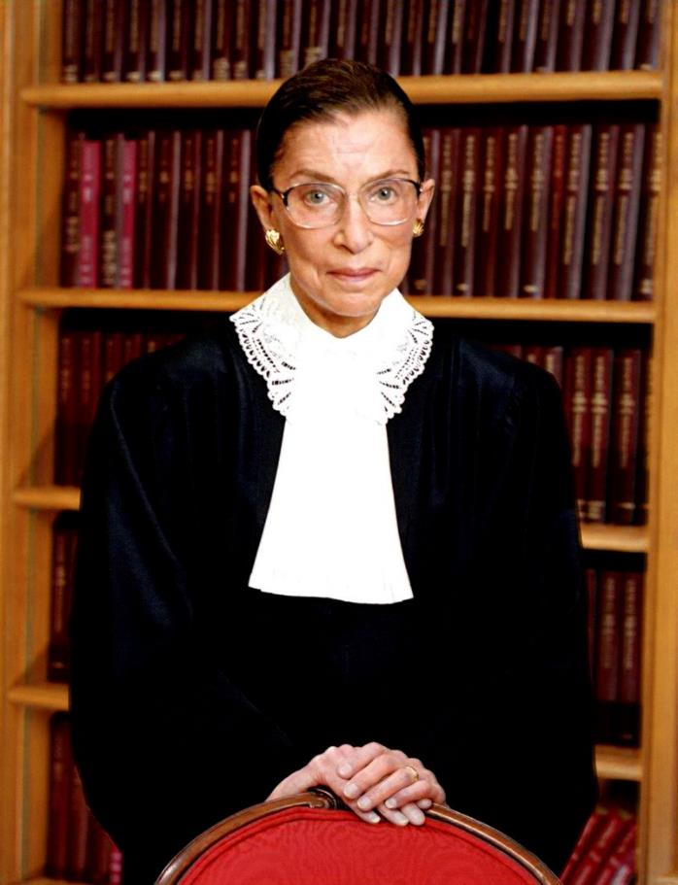
“‘Our Nation has had a long and unfortunate history of sex discrimination.’ . . . Women did not count among the voters composing ‘We the People’; not until 1920 did women gain a constitutional right to the franchise.”
-United States v. Virginia (1996)
The 19th Amendment - Women’s Right to Vote
Ruth Bader Ginsburg

Slide 4
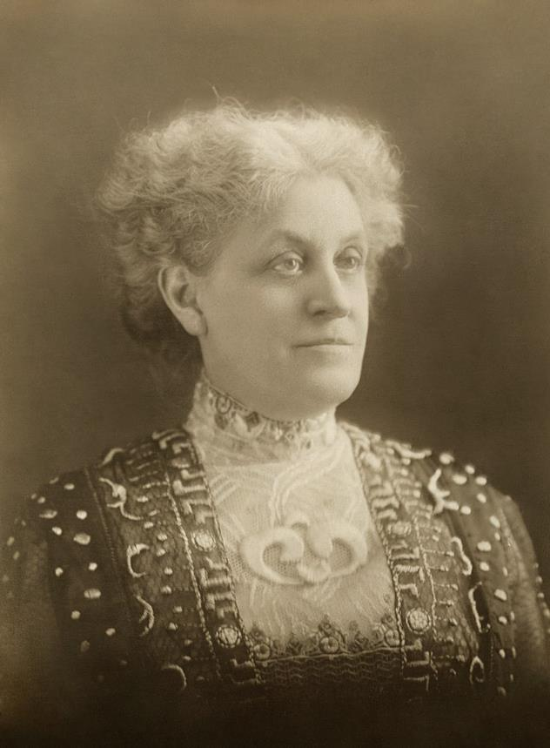
“To get the word male . . . out of the constitution cost the women of the country fifty-two years of pauseless campaigning. . . . During that time they were forced to conduct:”
The 19th Amendment - Women’s Right to Vote
Carrie Chapman Catt

Slide 5
“56 campaigns of referenda to male voters;
480 campaigns to urge Legislatures to submit suffrage amendments to voters;
47 campaigns to induce State constitutional conventions to write woman suffrage into State constitutions;
277 campaigns to persuade State party conventions to adopt woman suffrage planks in party platforms; and
19 campaigns with 19 successive Congresses.”
The 19th Amendment - Women’s Right to Vote
Carrie Chapman Catt

Slide 6
BIG IDEA
With the Nineteenth Amendment, women won the right to vote. This Amendment grew out of decades of advocacy by the suffragists and their allies. Women’s suffrage began out West in the late 1800s and eventually spread to the rest of the nation—culminating in the ratification of the Nineteenth Amendment in 1920. Even so, it would take many more years—and the hard work of the Civil Rights Movement—to extend voting rights on the ground to all women, including women of color.
The 19th Amendment - Women’s Right to Vote

Slide 7
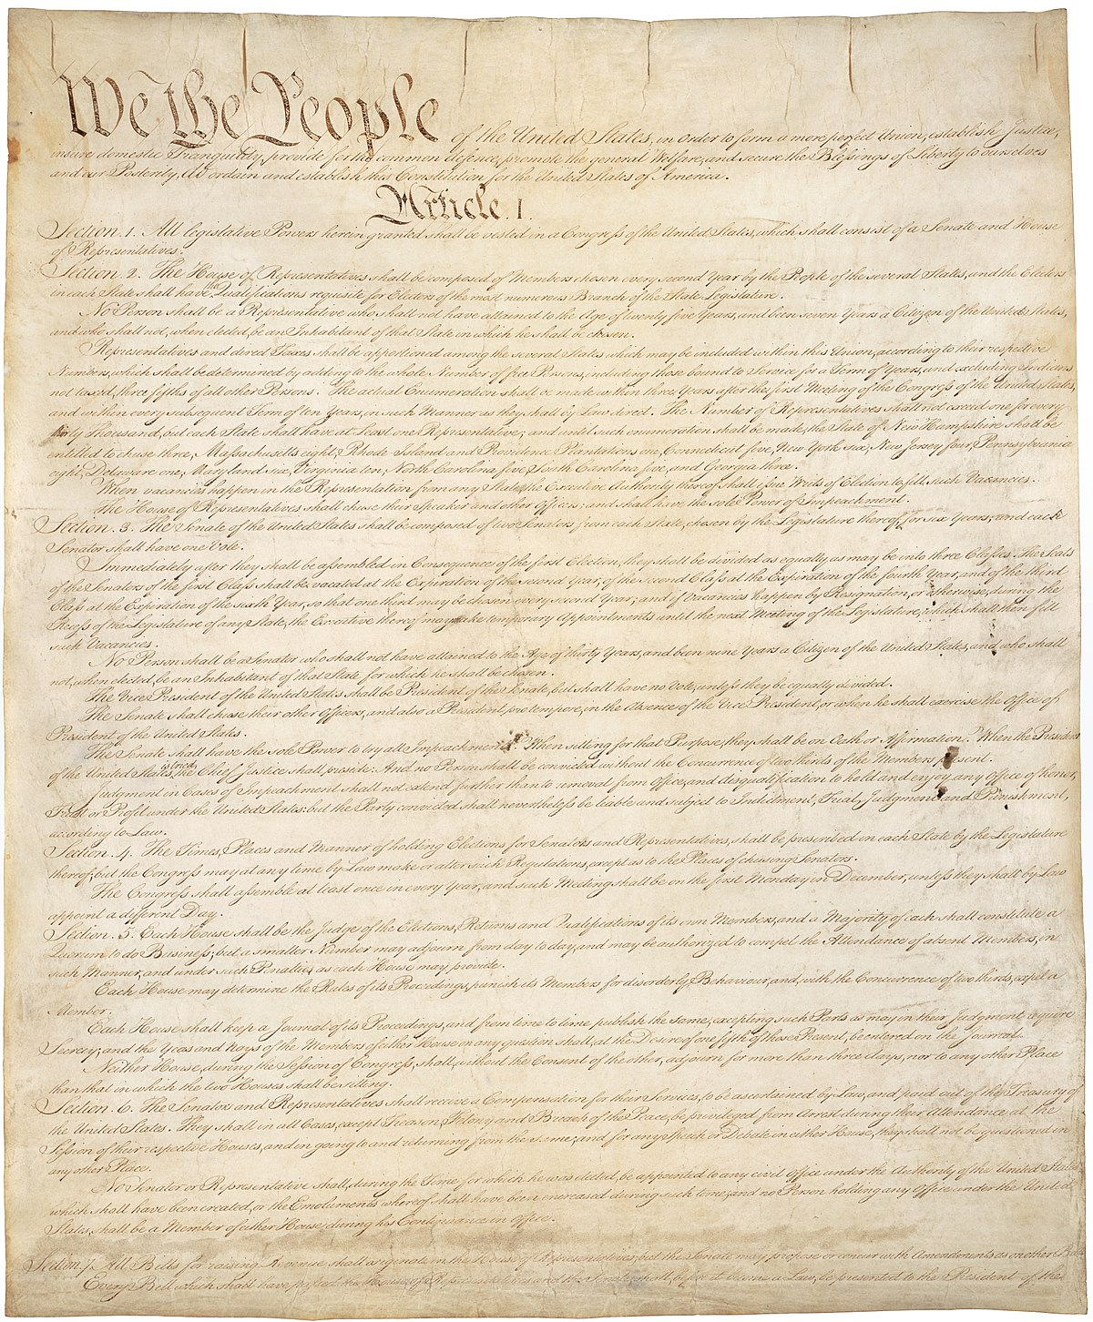
WHERE ARE VOTING RIGHTS IN THE CONSTITUTION?
The 19th Amendment - Women’s Right to Vote

Slide 8
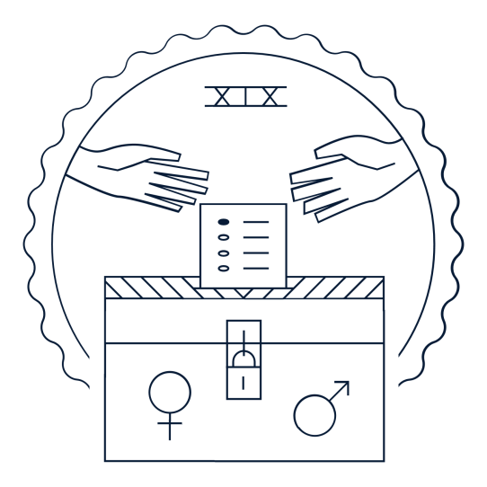
VOTING RIGHTS IN THE CONSTITUTION
15TH AMENDMENT
19TH AMENDMENT
26TH AMENDMENT
The 19th Amendment - Women’s Right to Vote
1870
Banned discrimination in voting on account of race.
1920
Banned discrimination in voting on account of sex.
1971
Banned discrimination in voting on account of age.

Slide 9
19TH AMENDMENT
1920
The right of citizens of the United States to vote shall not be denied or abridged by the United States or by any State on account of sex.
Congress shall have power to enforce this article by appropriate legislation.
The 19th Amendment - Women’s Right to Vote

Slide 10
15TH AMENDMENT
19TH AMENDMENT
Section 1
The right of citizens of the United States to vote shall not be denied or abridged by the United States or by any State on account of race, color, or previous condition of servitude.
Section 2
The Congress shall have the power to enforce this article by appropriate legislation.
The right of citizens of the United States to vote shall not be denied or abridged by the United States or by any State on account of sex.
Congress shall have power to enforce this article by appropriate legislation.
The 19th Amendment - Women’s Right to Vote

Slide 11
RATIFYING THE AMENDMENT
Suffragists settled on this language in 1878.
The “Susan B. Anthony Amendment” was introduced in each Congress (unchanged) for the next four decades.
Congress finally approved it on June 4, 1919.
And it was ratified by three-fourths of the states in August 1920.
The 19th Amendment - Women’s Right to Vote

Slide 12
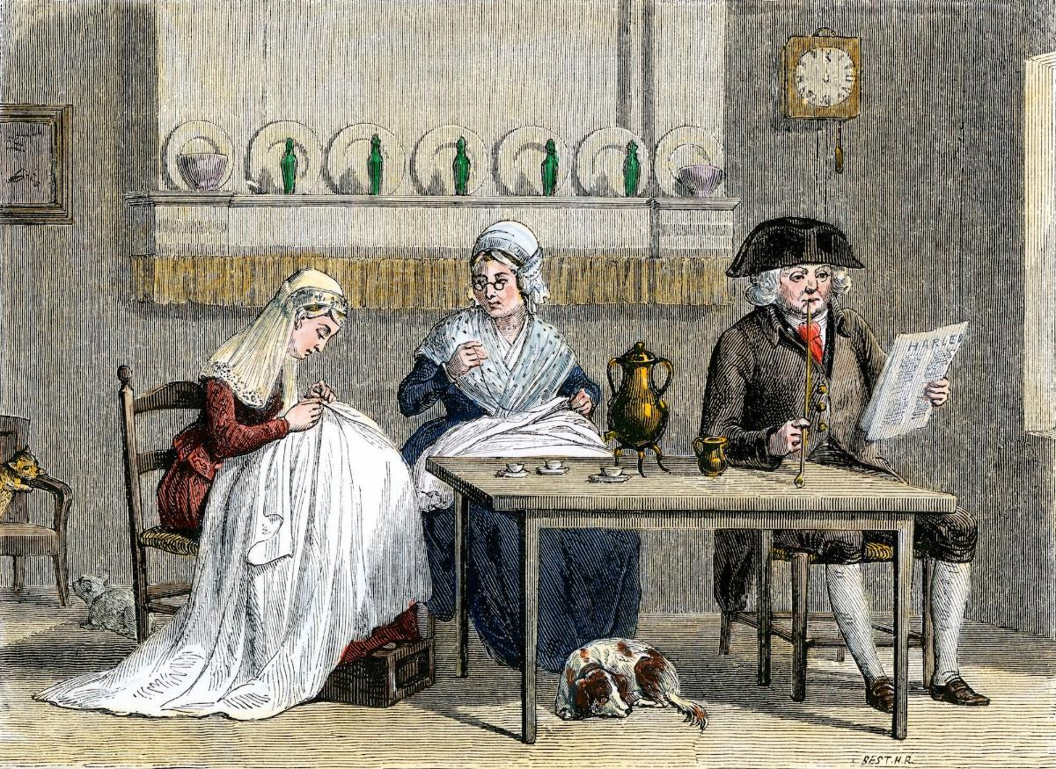
EARLY AMERICA
The Constitution left issues of elections and voting primarily to the states. Most states establish property requirements for voters. So, during this period, voting is generally restricted to white male property owners.
The 19th Amendment - Women’s Right to Vote
Early Americans thought that men served as the heads of their households, representing the views of their wives, daughters, etc., in public life.
(Image: Photograph of woodcut by North Wind Picture Archives)

Slide 13
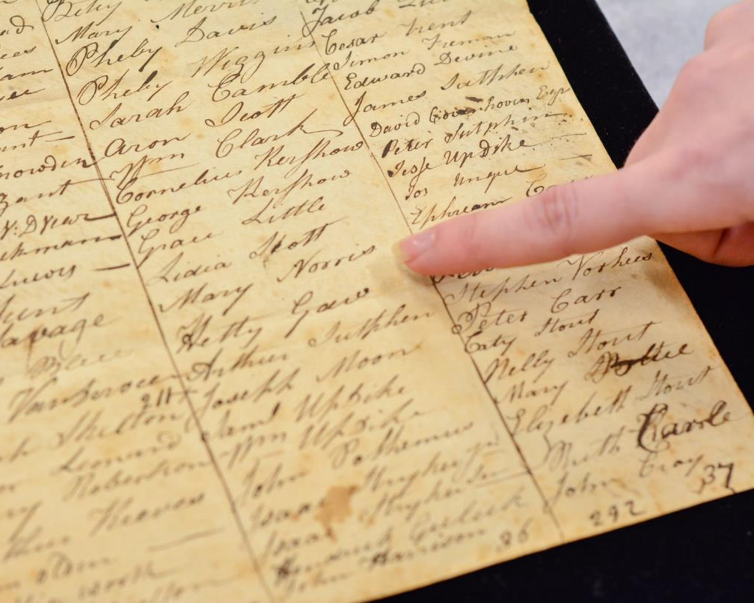
WOMEN’S SUFFRAGE IN EARLY AMERICA
There was a notable exception—New Jersey. There, unmarried female landowners voted in state and local elections from 1776-1807. However, in 1807, New Jersey closed off this brief period of women’s suffrage—limiting the vote to “free, white male citizens.”
The 19th Amendment - Women’s Right to Vote
A woman's name appears on a 1801 Montgomery Township, New Jersey, poll list from the N.J. State Archives. (Image: Museum of the American Revolution)

Slide 14
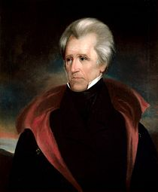
THE AGE OF JACKSONIAN DEMOCRACY
(1820S AND 1830S)
Brought a move towards
Universal White Male Suffrage
The 19th Amendment - Women’s Right to Vote
Andrew Jackson

Slide 15
RIGHTS FOR MARRIED WOMEN
Married women could not:
Hold property on their own
Enter into contracts
Sue or be sued
Vote
Coverture: The legal doctrine meaning that husbands assumed the legal rights and obligations of their wives when they became married.
Virtual Representation: The view that women’s suffrage was unnecessary because husbands, as heads of their households, already represented their wives and families.
The 19th Amendment - Women’s Right to Vote

Slide 16
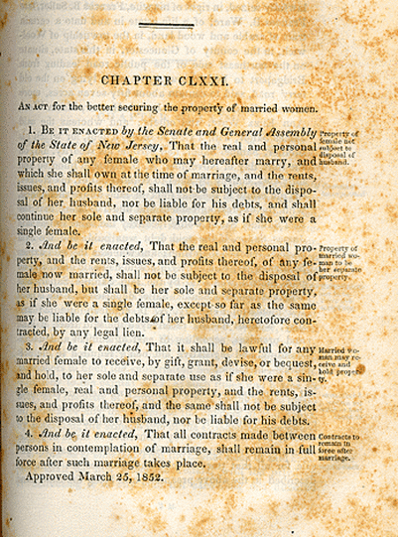
MARRIED WOMEN’S PROPERTY ACT OF 1848
The 19th Amendment - Women’s Right to Vote

Slide 17
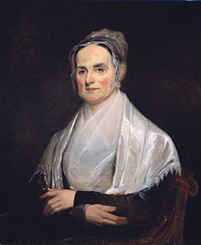
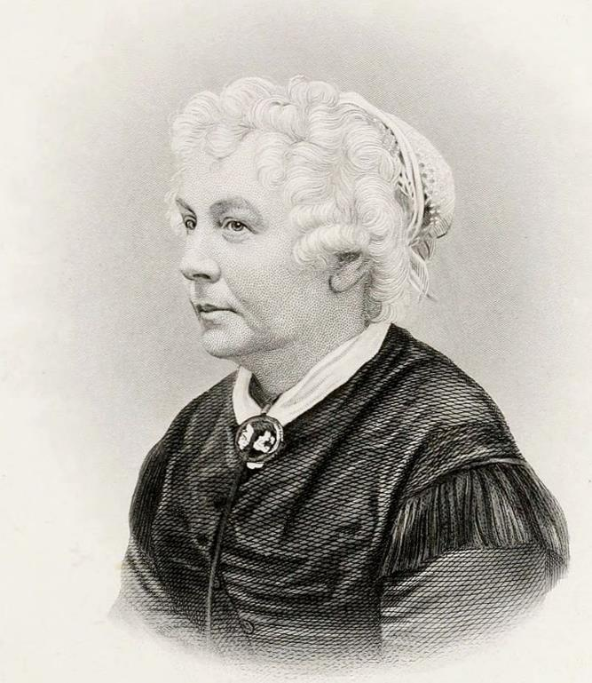
SENECA FALLS CONVENTION, 1848
The 19th Amendment - Women’s Right to Vote
Lucretia Mott
Elizabeth Cady Stanton

Slide 18
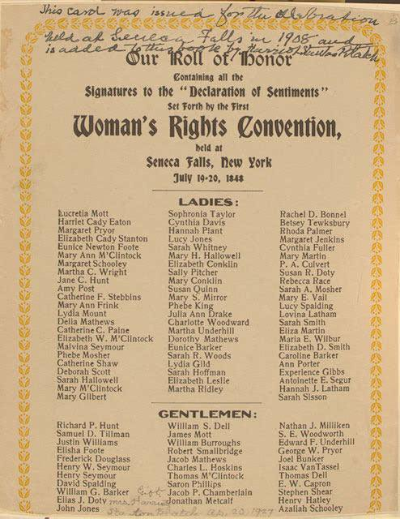
THE DECLARATION OF SENTIMENTS
The 19th Amendment - Women’s Right to Vote
Signatures on the Declaration of Sentiments included 68 women and 32 men

Slide 19
THE DECLARATION OF SENTIMENTS
“We hold these truths to be self-evident; that all men and women are created equal.”
The 19th Amendment - Women’s Right to Vote

Slide 20
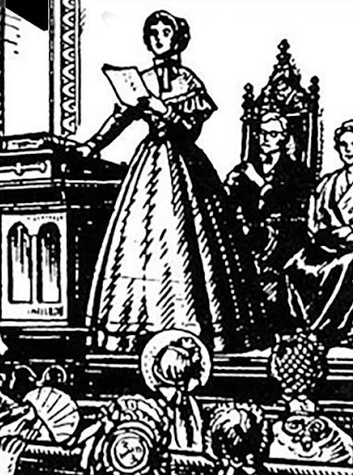
THE DECLARATION OF SENTIMENTS
The Declaration closed with 12 demands, including equal education, equal pay, property rights, and the “sacred right to the elective franchise.”
The 19th Amendment - Women’s Right to Vote

Slide 21
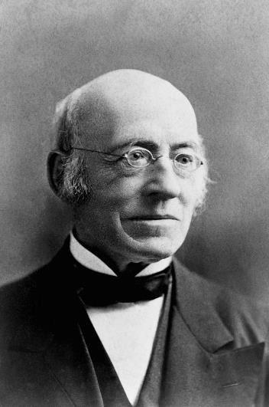
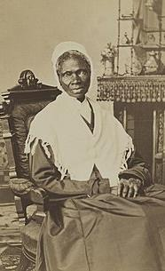
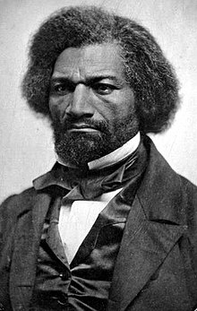
NATIONAL WOMEN’S RIGHTS CONVENTION
William Lloyd Garrison
Sojourner Truth
Frederick Douglass
The 19th Amendment - Women’s Right to Vote
After Seneca Falls, the first national women’s convention met in Massachusetts and drew 1,000 attendees. Furthermore, in the 1850s, more and more African American women joined the fight by attending—and speaking at—various conventions.

Slide 22
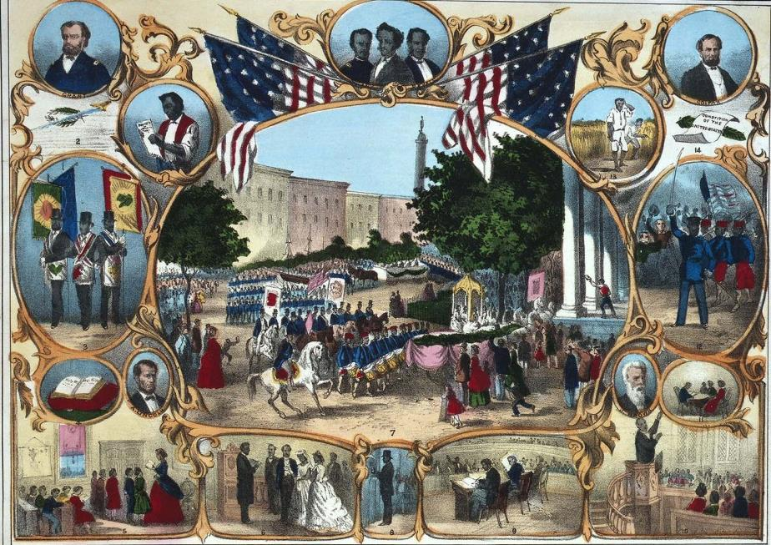
THE RECONSTRUCTION ERA
The 19th Amendment - Women’s Right to Vote

Slide 23
THE RECONSTRUCTION ERA
Following the Civil War (in a period known as Reconstruction), the Republican Party—the Party of Lincoln and of Union—pushed a series of constitutional amendments. During this period, Congress debated the reach of equality and the definition of citizenship. The goal was to set new constitutional baselines for post-Civil War America.
The 19th Amendment - Women’s Right to Vote

Slide 24
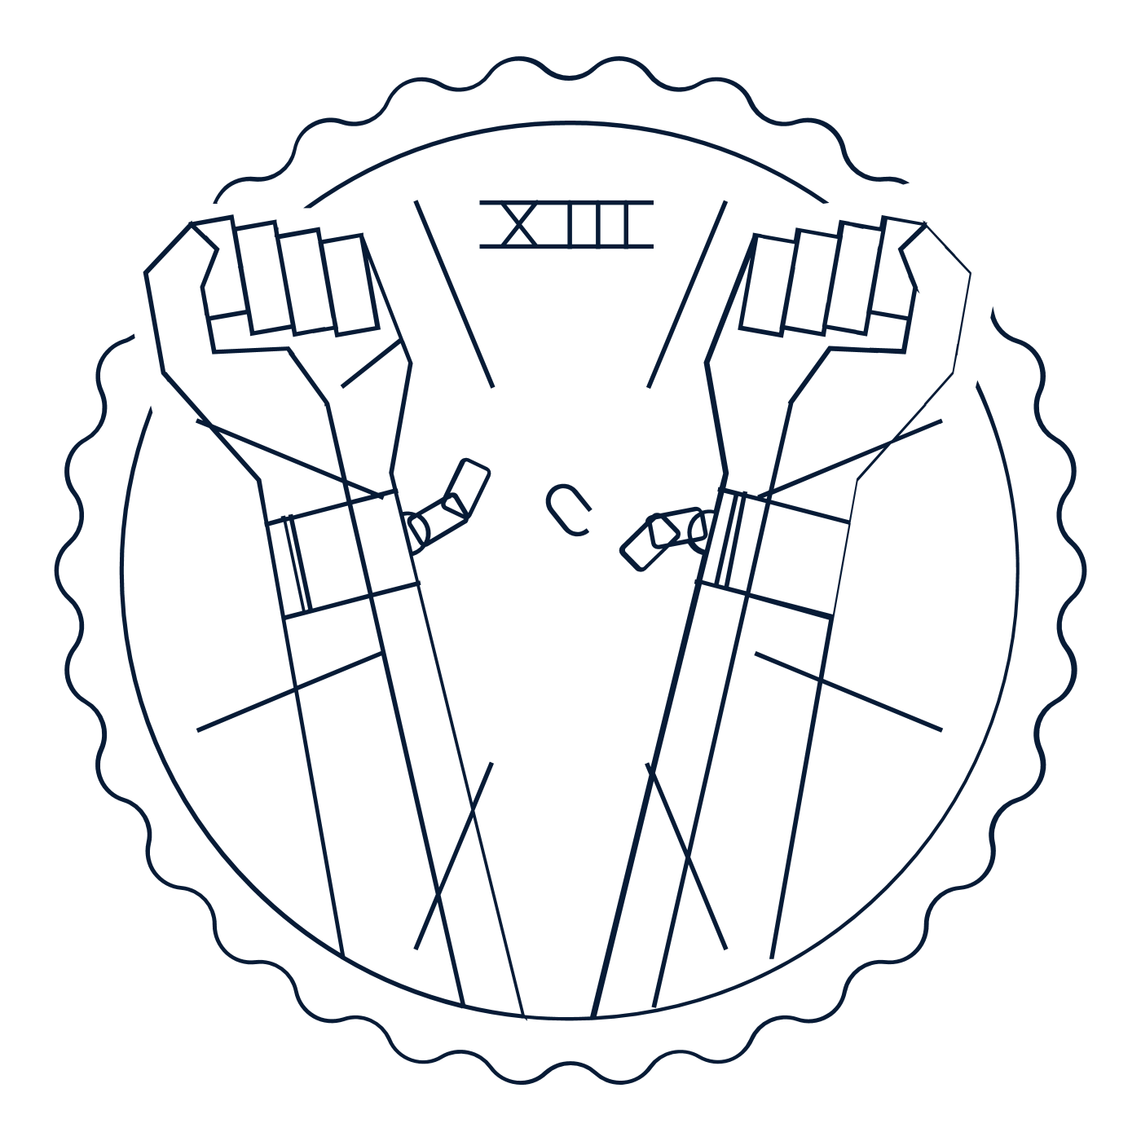
THE RECONSTRUCTION ERA
13TH AMENDMENT
14TH AMENDMENT
15TH AMENDMENT
The 19th Amendment - Women’s Right to Vote
1865 Abolished slavery
1868
Wrote promises of freedom and equality into the Constitution
1870
Banned racial discrimination in voting

Slide 25
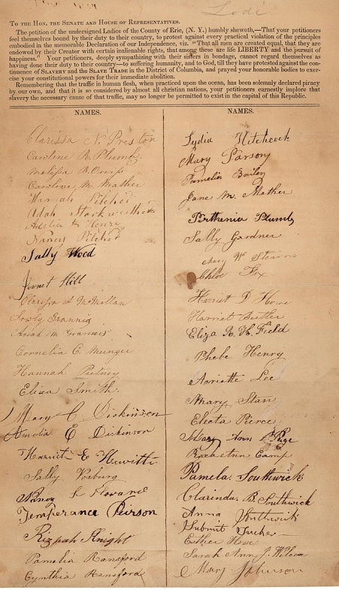
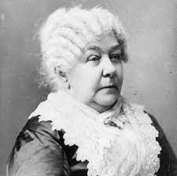
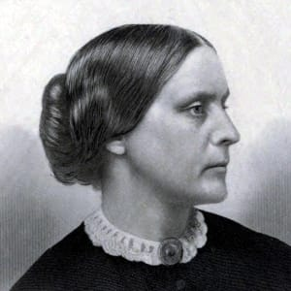
ABOLITIONIST MOVEMENT
And many suffragists—including Elizabeth Cady Stanton and Susan B. Anthony—played a central role in the anti-slavery movement. While publicly speaking out against slavery, women also petitioned Congress.
The 19th Amendment - Women’s Right to Vote
Image of anti-slavery petition sent to Congress during the 1830s

Slide 26
PUSH FOR UNIVERSAL VOTING RIGHTS
Building on their experience battling slavery, the suffragists advanced a powerful vision of universal voting rights—linking this cause to the plight of African Americans. The post-war emphasis on universal equality made women’s suffrage seem politically possible.
They adopted constitutional arguments at the core of the anti-slavery cause—drawing on the Constitution’s “guarantee” of a “Republican Form of Government” and its protection of the “Privileges and Immunities of Citizens.” For these reformers, the push for voting rights wasn’t about race or sex. It was about post-Civil War America’s commitment to universal rights.
The 19th Amendment - Women’s Right to Vote

Slide 27
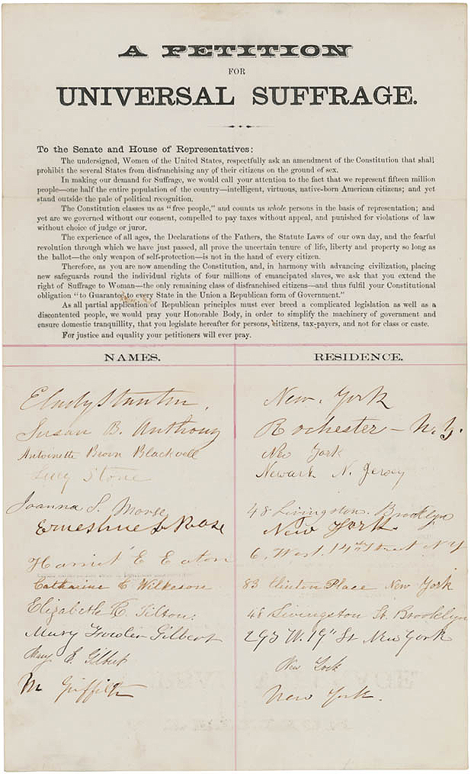
PETITION FOR UNIVERSAL SUFFRAGE (1866)
“As you are now amending the Constitution, and, in harmony with advancing civilization, placing new safeguards around the individual rights of four million of emancipated ex-slaves, we ask that you extend the right of Suffrage to Woman.”
The 19th Amendment - Women’s Right to Vote

Slide 28
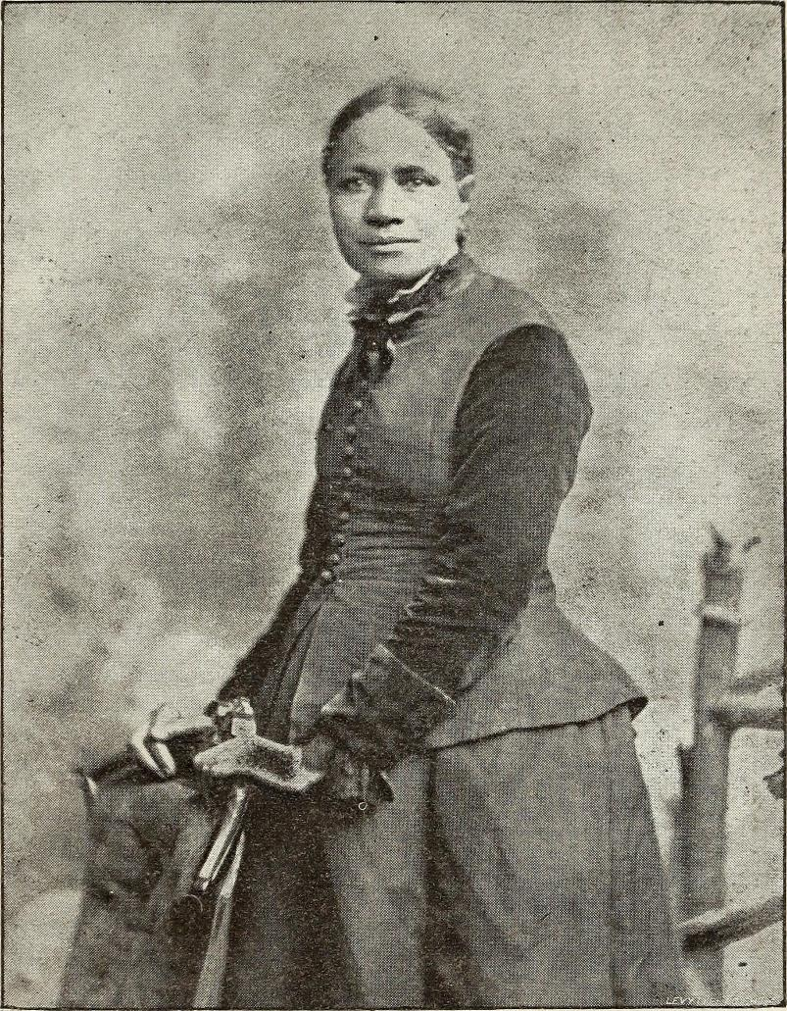
“We are all bound up together in one great bundle of humanity, and society cannot trample on the weakest and feeblest of its members without receiving a curse in its own soul.”
The 19th Amendment - Women’s Right to Vote
Frances Ellen Watkins Harper

Slide 29
14TH AMENDMENT, SECTION 2
“…But when the right to vote at any election for the choice of electors for President and Vice-President of the United States, Representatives in Congress, the Executive and Judicial officers of a State, or the members of the Legislature thereof, is denied to any of the male inhabitants of such State, being twenty-one years of age, and citizens of the United States, or in any way abridged, except for participation in rebellion, or other crime, the basis of representation therein shall be reduced in the proportion which the number of such male citizens shall bear to the whole number of male citizens twenty-one years of age in such State.”
The 19th Amendment - Women’s Right to Vote

Slide 30
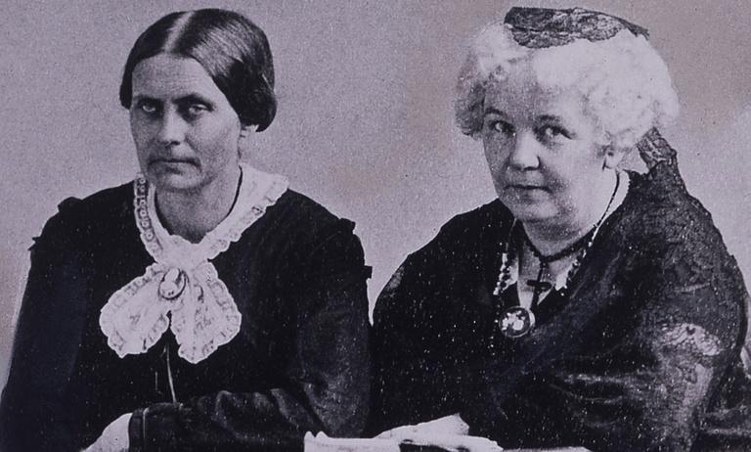
NATIONAL WOMAN SUFFRAGE ASSOCIATION
The 19th Amendment - Women’s Right to Vote
Susan B. Anthony
Elizabeth Cady Stanton
Opposed the 15th Amendment. They chose to fight exclusively for women’s suffrage first.

Slide 31
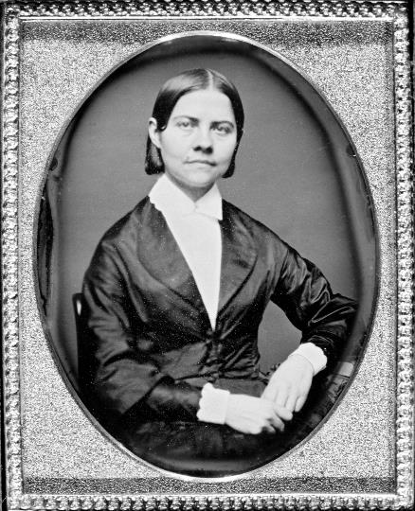
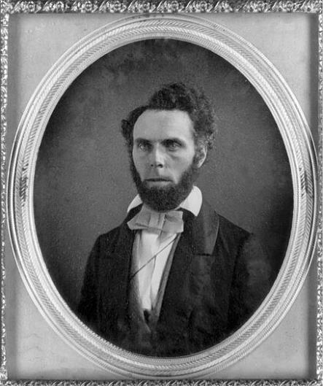
AMERICAN WOMAN SUFFRAGE ASSOCIATION
The 19th Amendment - Women’s Right to Vote
Lucy Stone
Henry Browne Blackwell
Supported the 15th Amendment. They sided with the Republican Party, prioritized African American rights, rallied around the 15 Amendment, and remained committed to a vision of universal rights.

Slide 32
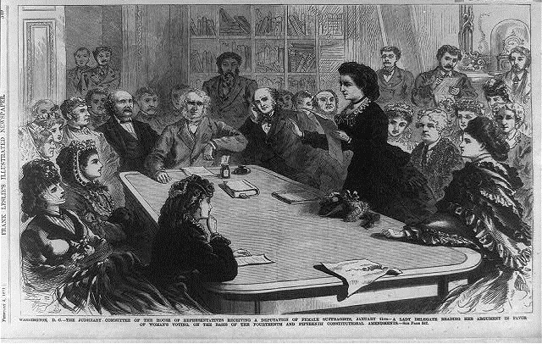
The 19th Amendment - Women’s Right to Vote
Some suffragists focused on Congress. The 14th Amendment gave Congress the power to pass new laws to enforce the “privileges or immunities” of U.S. citizenship.
(Illustration - Library of Congress)

Slide 33
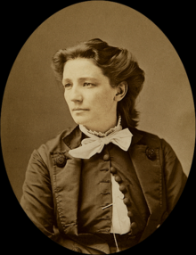
“I do now claim that I am, equally with men, possessed of the right to vote.”
Victoria Woodhull
The 19th Amendment - Women’s Right to Vote

Slide 34
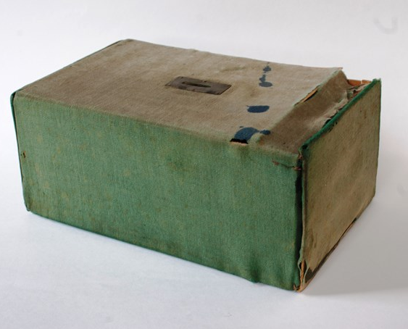
NEW DEPARTURE
Other suffragists used the Reconstruction Amendments to vote. In 1868, women in Vineland, New Jersey, set up their own voting tables on Election Day, even though their votes wouldn’t count.
Suffragist leaders soon developed a plan that relied on the Constitution’s text to get women to the polls.
The 19th Amendment - Women’s Right to Vote
(Vineland Historical and Antiquarian Society, Vineland, NJ)

Slide 35
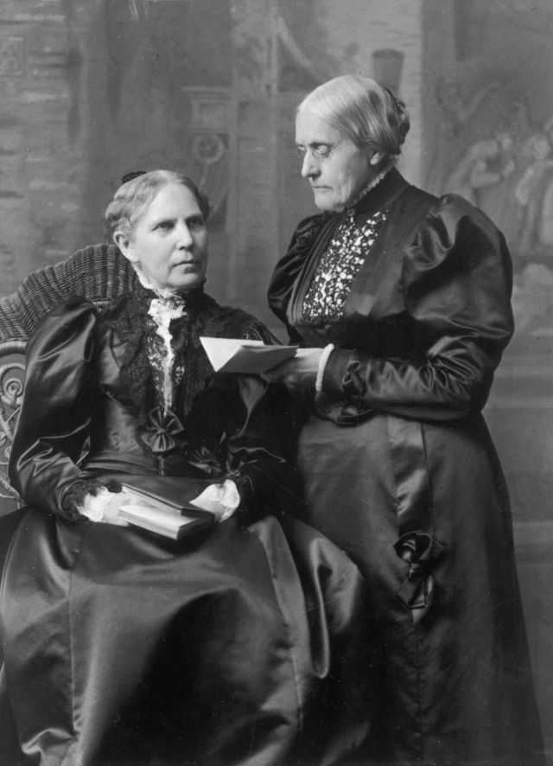
NEW DEPARTURE
1872, Susan B. Anthony, her three sisters, and eleven other women tried to vote in a New York election. Thanks to the help of local Republican Party officials, Anthony registered to vote. To Anthony’s surprise, she was even permitted to cast her vote, but her victory was short-lived. Two weeks later, she was arrested.
The 19th Amendment - Women’s Right to Vote
Susan B. Anthony with her sister Mary Stafford Anthony

Slide 36
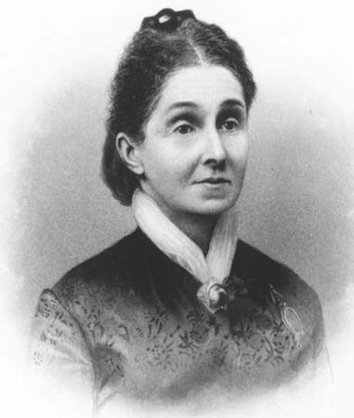
MINOR V. HAPPERSETT (1875)
The 19th Amendment - Women’s Right to Vote
Virginia Minor

Slide 37
MINOR V. HAPPERSETT (1875)
Virginia Minor challenged a St. Louis registrar’s decision to block her from registering to vote. Minor argued that women were U.S. citizens and that voting was a “privilege” of national citizenship protected by the 14th Amendment.
The 19th Amendment - Women’s Right to Vote
Virginia Minor

Slide 38
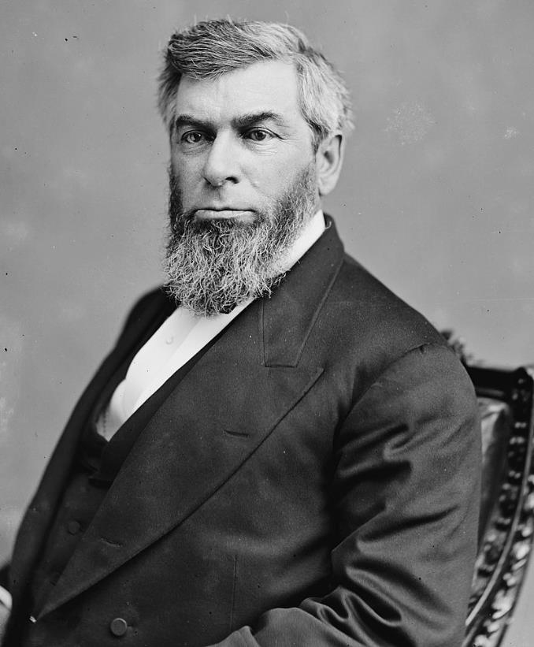
MINOR V. HAPPERSETT (1875)
In a unanimous decision written by Chief Justice Morrison Waite, the Supreme Court rejected Minor’s claim—and with it, one of the New Departure’s core arguments.
The Court agreed that women were U.S. citizens, but concluded that voting was not a right of national citizenship protected by the 14th Amendment.
The 19th Amendment - Women’s Right to Vote
Chief Justice Morrison Waite

Slide 39
MINOR V. HAPPERSETT (1875)
“[I]f the courts can consider any question settled, this is one. For nearly ninety years the people have acted upon the idea that the Constitution, when it conferred citizenship, did not necessarily confer the right of suffrage. . . . Our province is to decide what the law is, not to declare what it should be.”
The 19th Amendment - Women’s Right to Vote
Chief Justice Morrison Waite

Slide 40
THE FINAL PUSH
Following the New Departure, women turned their attention to two strategies:
Securing suffrage in the states
Pushing for a constitutional amendment
The 19th Amendment - Women’s Right to Vote

Slide 41
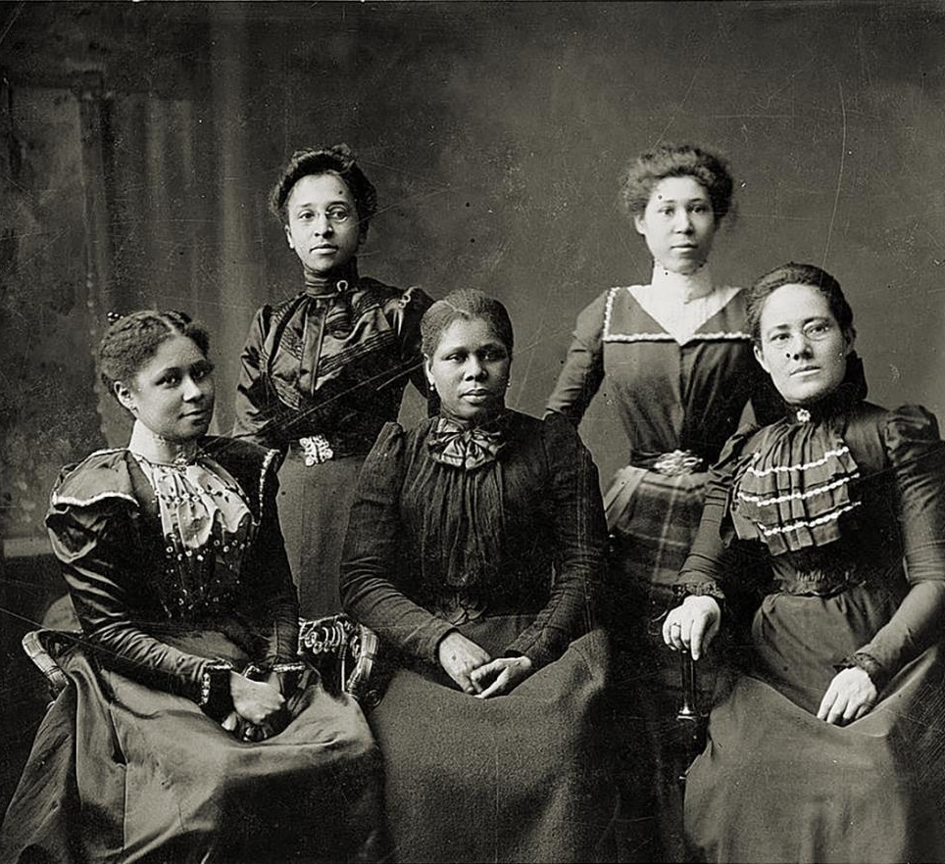
ROLE OF AFRICAN AMERICAN WOMEN
By the 1900s, suffrage organizations continued to divide over the issue of race. Parts of the movement grew increasingly exclusionary. At the same time, African American women organized into clubs and continued to push for the vote to secure social and economic change within their own communities. Other women of color, including Native Americans, lobbied for their citizenship to be recognized.
The 19th Amendment - Women’s Right to Vote
Five officers of the Women’s League in Newport, Rhode Island, c. 1899

Slide 42
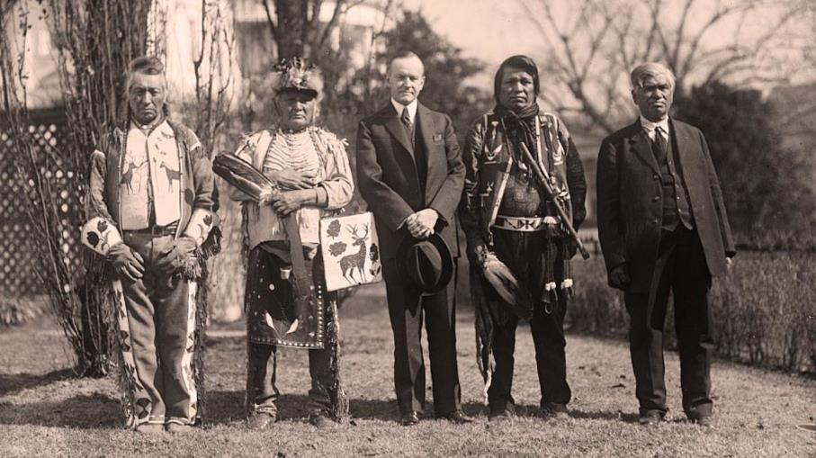
NATIVE AMERICAN’S FIGHT FOR CITIZENSHIP
The 19th Amendment - Women’s Right to Vote
The Indian Citizenship Act, which granted citizenship to all Native Americans born in the U.S. was passed in 1924

Slide 43
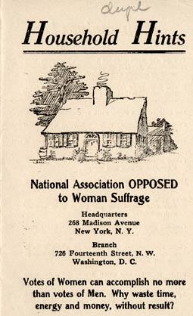
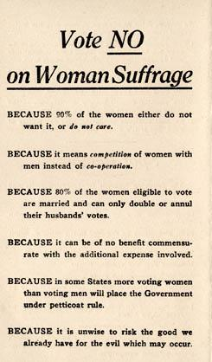
THE NATIONAL ASSOCIATION OPPOSED TO WOMAN SUFFRAGE
FORMED IN 1911
During this same period, anti-suffragists began to organize. In 1911, the National Association Opposed to Woman Suffrage formed. The anti-suffragists voiced a range of arguments against the women’s vote.
The 19th Amendment - Women’s Right to Vote

Slide 44
THE NATIONAL ASSOCIATION OPPOSED TO WOMAN SUFFRAGE
FORMED IN 1911
Virtual Representation
States’ Rights
Destruction of the Traditional Family/Gender Roles
Opposition to African American Voting
Educated Suffrage
Lack of Interest
The 19th Amendment - Women’s Right to Vote

Slide 45
The 19th Amendment - Women’s Right to Vote

Slide 46
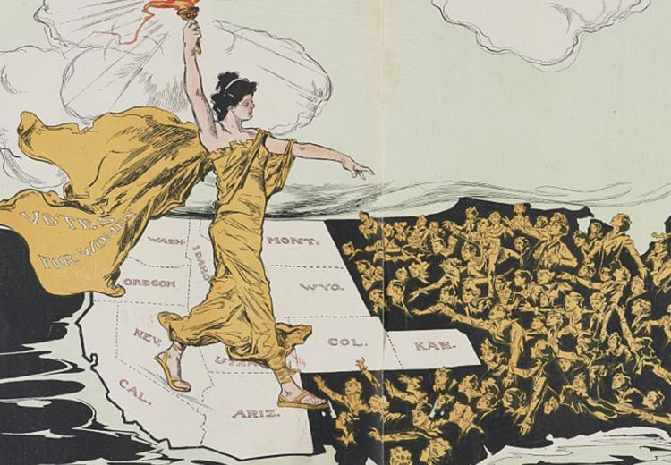
SUFFRAGE AT THE STATE LEVEL
The 19th Amendment - Women’s Right to Vote
By 1919, fifteen states permitted full women’s suffrage.

Slide 47
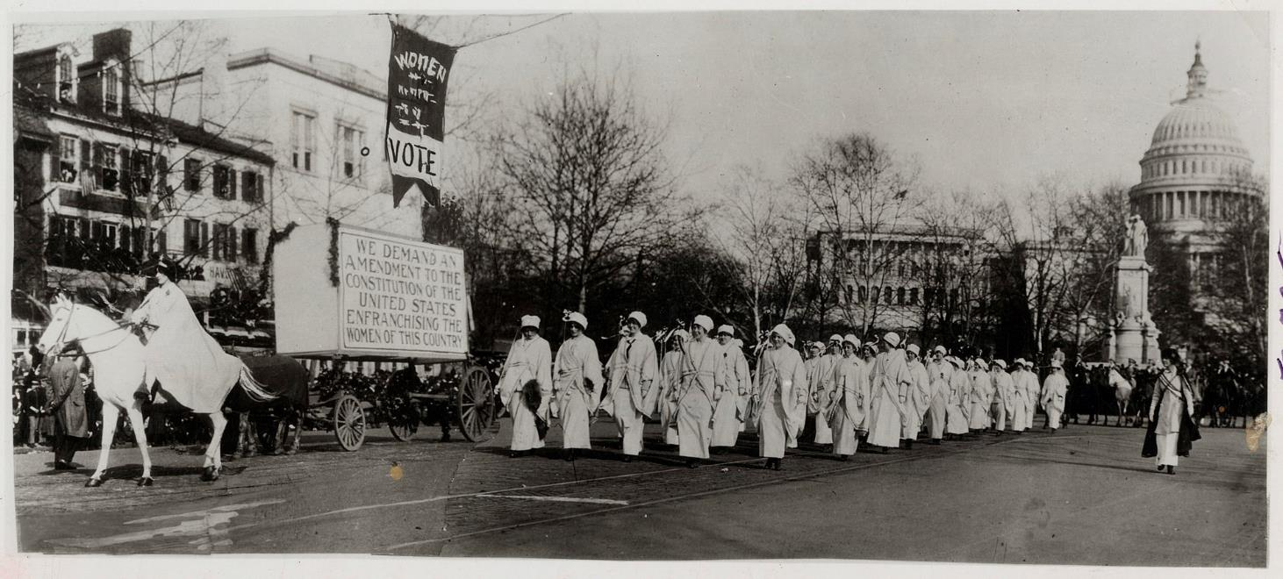
WOMAN SUFFRAGE PROCESSION WASHINGTON, DC, 1913
The 19th Amendment - Women’s Right to Vote

Slide 48
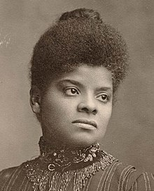
The 19th Amendment - Women’s Right to Vote
Ida B. Wells-Barnett

Slide 49
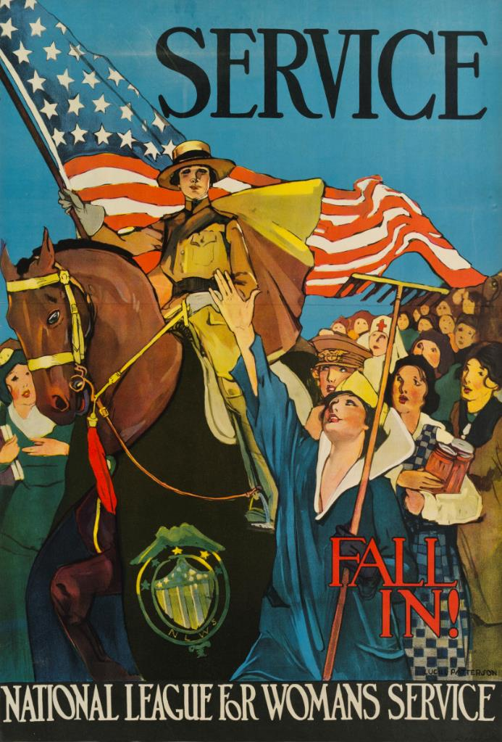
WORLD WAR I
In the final few years of the fight for the 19th Amendment, momentum continued to grow—driven by a mix of state-level victories, persistent lobbying, and militant protest tactics. These strategies, combined with the nation’s entry into World War I in 1917, turned the tide in favor of a national amendment for women’s suffrage.
The 19th Amendment - Women’s Right to Vote

Slide 50
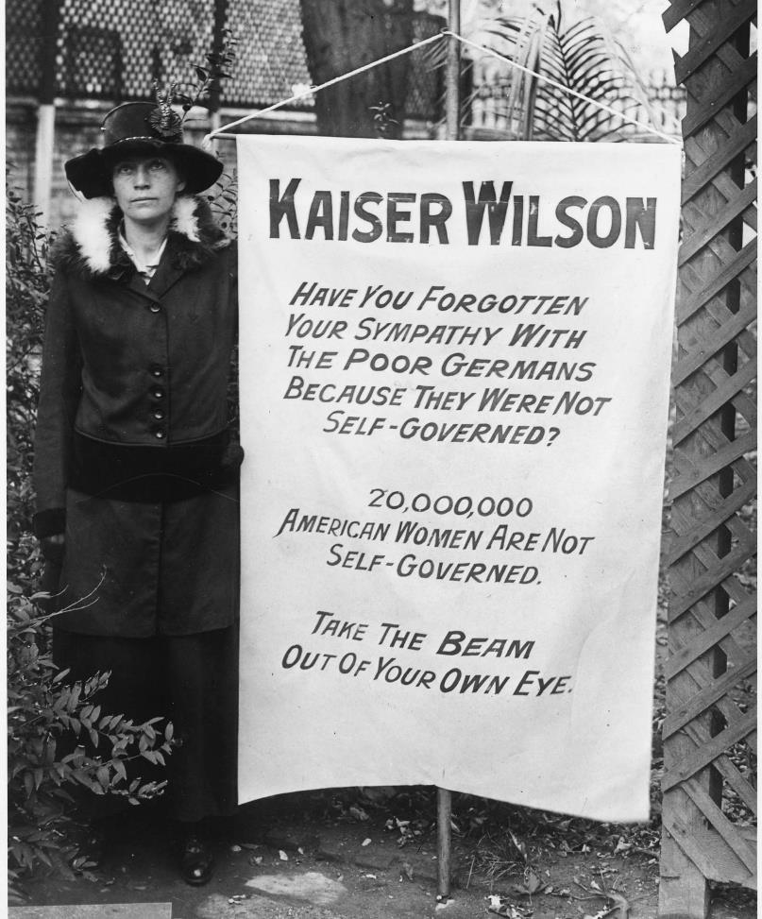
Militant suffragists continued their work—publicly criticizing the President for embracing democracy abroad while leaving half of the population without the vote at home. For instance, Alice Paul and her allies in the National Woman’s Party began protesting in front of the White House in 1917—placing pressure on Wilson to take action on a national amendment.
The 19th Amendment - Women’s Right to Vote

Slide 51
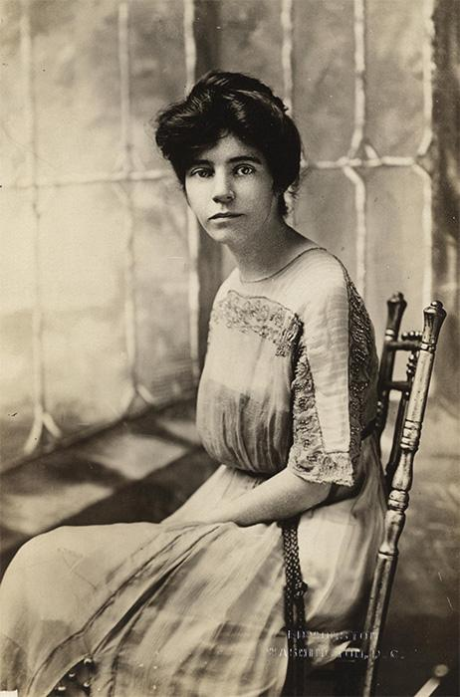
The 19th Amendment - Women’s Right to Vote
Alice Paul

Slide 52
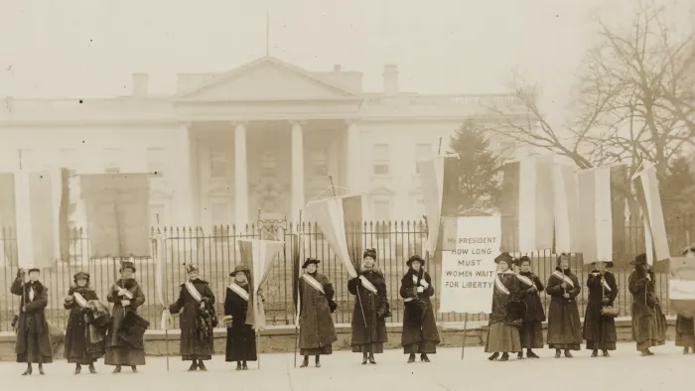
The 19th Amendment - Women’s Right to Vote
Suffragists on picket line in front of the White House, circa 1917.
One banner reads: "Mr. President How Long Must Women Wait For Liberty". (Library of Congress)

Slide 53
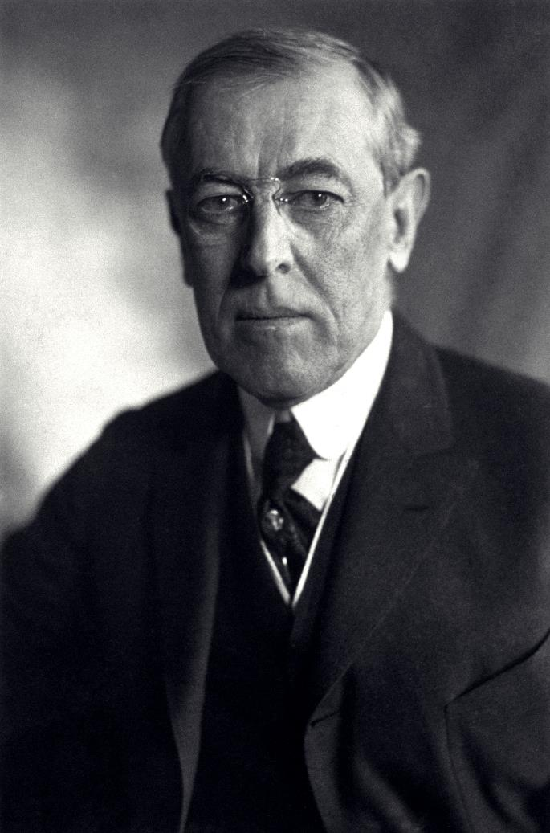
President Wilson eventually relented, giving his support to the 19th Amendment in January 1918 and declaring it a vital war measure.
The 19th Amendment - Women’s Right to Vote
President Woodrow Wilson

Slide 54
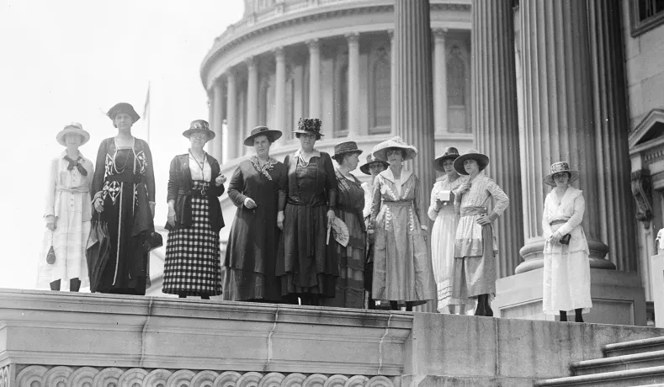
The 19th Amendment - Women’s Right to Vote
June 4, 1919: Congress passes the amendment.

Slide 55
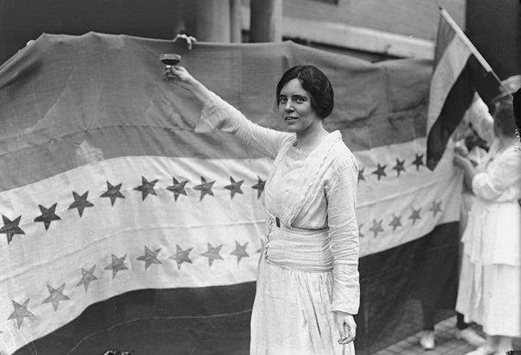
The 19th Amendment - Women’s Right to Vote
August 18, 1920: Ratification
After 70 years—and a 15-month ratification battle—women finally secured the women’s suffrage amendment.

Slide 56
FOUR PATHWAYS OF CONSTITUTIONAL CHANGE
Amend the Constitution: Advocate for amendments through the formal process outlined in Article V. (Think the 19th Amendment itself)
Lobby and Petition Congress: Pursue new laws to enforce the Constitution’s existing promises. (Think Victoria Woodhull’s push)
Use the Courts: Use the Constitution’s existing text to advance constitutional arguments inside the courts. (Think the New Departure)
Pursue State Reform: Test new ideas out at the state level that could potentially lead to nationwide reform. (Think the state-by-state push for women’s suffrage—changing state laws and state constitutions—beginning out West)
The 19th Amendment - Women’s Right to Vote

Slide 57
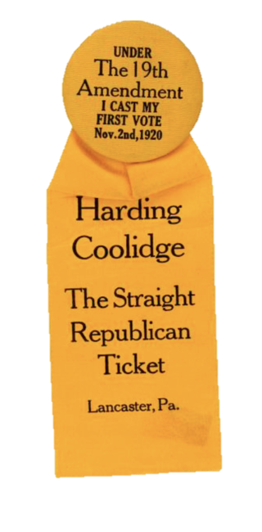
POST-RATIFICATION
In November 1920, many women across the country voted under the 19th Amendment. With support from female voters, the Republican candidate Warren G. Harding won in a landslide. He captured 60% of the popular vote.
The 19th Amendment - Women’s Right to Vote

Slide 58
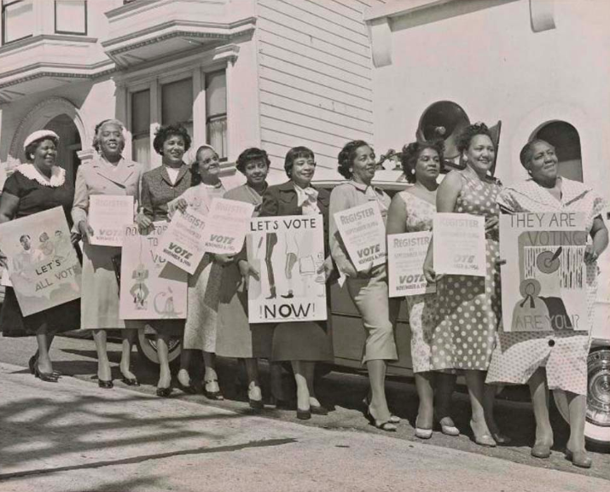
CONTINUING THE FIGHT FOR SUFFRAGE
The 19th Amendment - Women’s Right to Vote

Slide 59
CONTINUING THE FIGHT FOR SUFFRAGE
For millions of women, the fight for suffrage was not over. Before and after the ratification of the 19th Amendment, voters of color were disproportionately targeted by voter discrimination practices.
As many suffragist leaders debated whether to unify around another cause, many of these white leaders left behind women of color, who often continued their suffrage activism alone. For instance, millions of African American women fought against their continued disenfranchisement in the South.
For decades, they fought to remove these barriers—leading to the Voting Rights Act of 1965 (“VRA”).
The 19th Amendment - Women’s Right to Vote

Slide 60
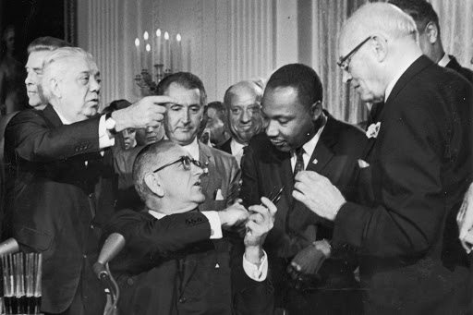
THE VOTING RIGHTS ACT OF 1965
The 19th Amendment - Women’s Right to Vote
Signing of the Voting Rights Act of 1965

Slide 61
THE VOTING RIGHTS ACT OF 1965
This landmark law empowered the national government to protect voting rights for all people of color and attack state voter discrimination efforts.
Congress was granted this enforcement power in 1870 with the 15th Amendment. (Reinforced by the Nineteenth Amendment’s own enforcement clause.)
And the Supreme Court upheld the VRA in South Carolina v. Katzenbach.
The VRA itself was a massive success. Following its passage, women of color began voting in huge numbers for the first time.
The 19th Amendment - Women’s Right to Vote

Slide 62
BEYOND RATIFICATION
Carrie Chapmen Catt’s National American Woman Suffrage Association
League of Women Voters
Focus on educating voters about elections and issues.
The 19th Amendment - Women’s Right to Vote
The National Woman’s Party
led by Alice Paul
Pursued the Equal Rights Amendment

Slide 63
EQUAL RIGHTS AMENDMENT
The National Woman’s Party—led by Alice Paul—pursued the Equal Rights Amendment (ERA). Drafted by Alice Paul, the ERA was first proposed in Congress in 1923.
The 19th Amendment - Women’s Right to Vote
Alice Paul

Slide 64
EQUAL RIGHTS AMENDMENT
Original ERA drafted by Alice Paul (1923):
“Men and women shall have equal rights throughout the United States and every place subject to its jurisdiction.”
The 19th Amendment - Women’s Right to Vote

Slide 65
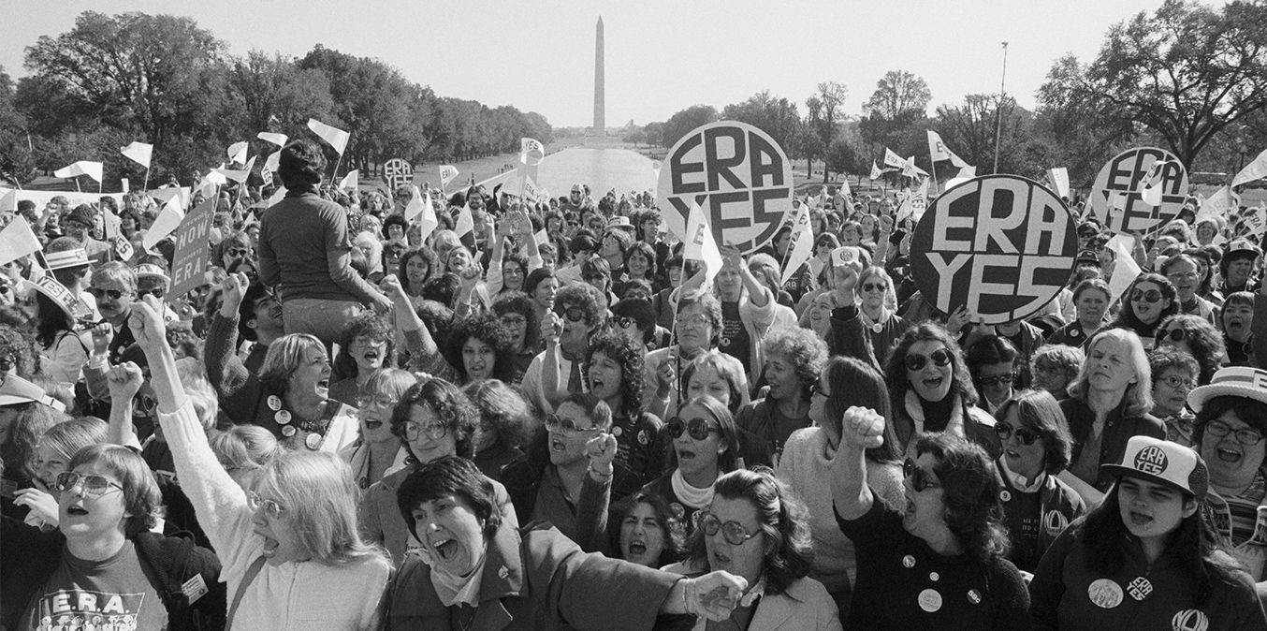
EQUAL RIGHTS AMENDMENT
The 19th Amendment - Women’s Right to Vote

Slide 66
EQUAL RIGHTS AMENDMENT
The proposed amendment enjoyed widespread support in the 1970s. Both Houses of Congress passed it in 1972—after being introduced in every Congress for 49 years. By 1977, the ERA had been ratified by 35 states.
Congress extended the deadline for ratifying the amendment for another five years, but no new states ratified it before 1982. In the last few years, supporters of the ERA revival adopted a “three-state strategy” to get enough states to ratify.
The 19th Amendment - Women’s Right to Vote

Slide 67
EQUAL RIGHTS AMENDMENT
Since then, Nevada, Illinois, and Virginia have voted in favor of amendment—meaning that 38 states have ratified the ERA (the three-fourths required by the Constitution). However, there are key questions that will need to be answered to determine the validity of the ERA:
Can Congress impose a deadline on ratifying an amendment proposal?
And if the time limit is valid, can a future Congress extend that deadline?
Can a state rescind its ratification? (Between 1973 and 1979, five state legislatures voted to rescind their ratifications.)
The 19th Amendment - Women’s Right to Vote

