Slide 1
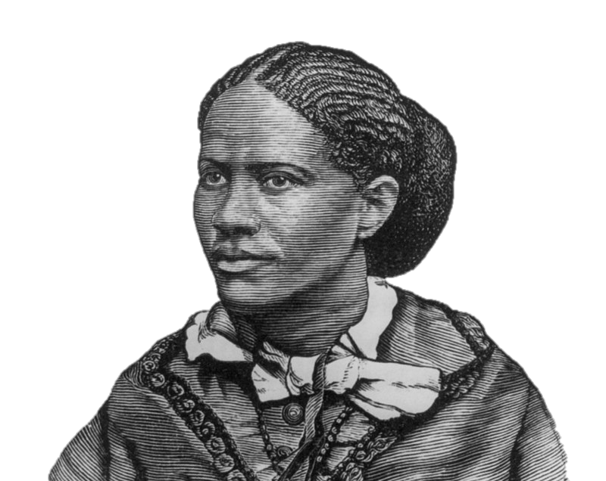
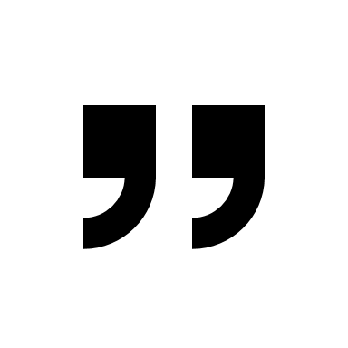
I do not think the mere extension of the ballot a panacea for all the ills of our national life. What we need to-day is not simply more voters, but better voters.
Frances Ellen Watkins Harper,
Women’s Political Future (1893)

