Slide 1
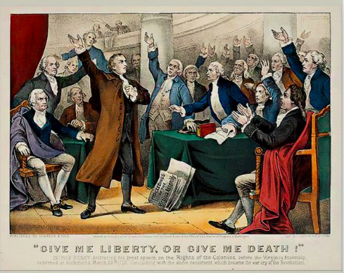


Slide 2
“Gentlemen may cry, Peace, Peace-- but there is no peace. The war is actually begun! The next gale that sweeps from the north will bring to our ears the clash of resounding arms! Our brethren are already in the field! Why stand we here idle? What is it that gentlemen wish? What would they have? Is life so dear, or peace so sweet, as to be purchased at the price of chains and slavery? Forbid it, Almighty God! I know not what course others may take; but as for me, give me liberty or give me death!”
Patrick Henry

Slide 3
“Is it not amazing that at a time when the rights of humanity are defined and understood with precision, in a country, above all others, fond of liberty . . . that in such an age and such a country we find men professing a religion the most humane, mild, meek, gentle and generous, adopting a principle as repugnant to humanity as it is inconsistent with the Bible and destructive to liberty?
I shall honor the Quakers for their noble efforts to abolish Slavery. It is equally calculated to promote moral and political good.
Would any one believe that I am master of slaves by my own purchase? I am drawn along by the general inconvenience of living without them. I will not—I cannot justify it, however culpable my conduct. I will so far pay my devoir to Virtue, as to own the excellence and rectitude of her precepts, and to lament my want of conformity to them. I believe a time will come when an opportunity will be afforded to abolish this lamentable evil.”
Patrick Henry

